Slide 1
Building to Fluid Topics
DITA OT Day 2026
How we did it and why
Eliot Kimber
Senior Staff Content Engineer, ServiceNow, Inc.

Slide 2

Eliot
Kimber
Senior Staff Content Engineer,
ServiceNow

Slide 3
Table of contents
 | Background
 | FTML
 | Challenges
 | Other stuff
 | Summary

Slide 4
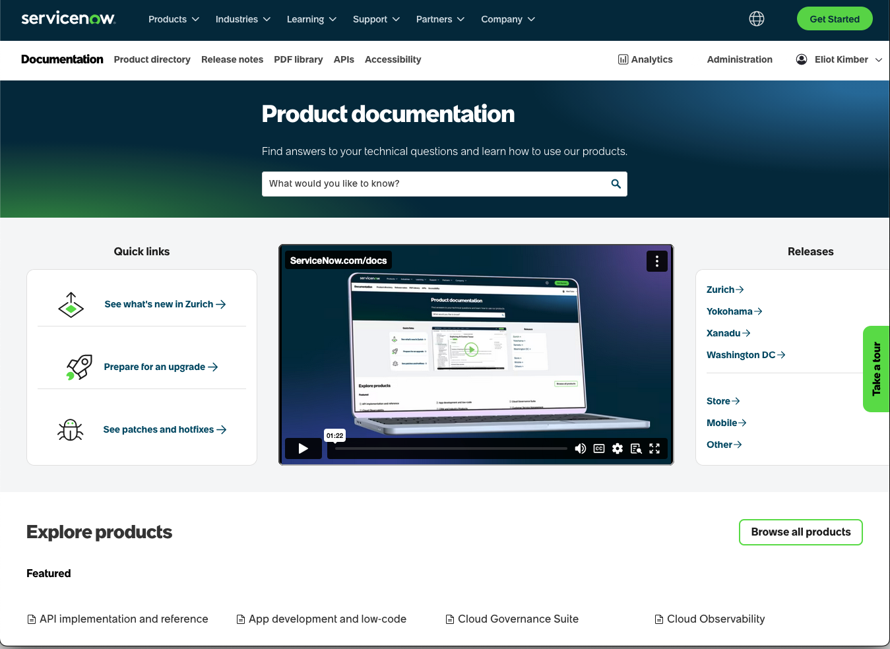
Background
Implemented Fluid Topics to replace Zoomin for our docs site
(go-live Jan, 2026)
Fluid Topics uses a unique package format for publishing HTML (FTML)
New requirement: Use corporate taxonomy to classify content, define URLs
Fluid Topics is all about metadata—metadata is everything and everything is metadata
Product content is 100% key-based: Every topic has an associated key
Doc site reflects four release versions and 6 languages
~45K topics per version = about 1 million published topics
https://www.servicenow.com/docs
Source

Slide 5
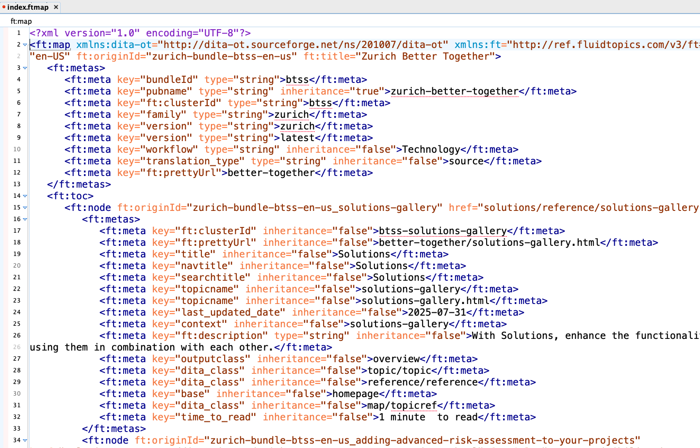
FTML
Separates publishing details from HTML source
Publication structure and metadata defined in "ftmap" file
  Publication- and topic-level metadata
  "Pretty URLs"
  Search configuration details (is topic included in search?)
FTMAP and HTML packaged as zip for ingestion
HTML source organization doesn't matter
Metadata in HTML files not used
Can have any metadata fields you want
  Single values
  Multi values
  Hierarchical values

Slide 6
Challenges
Generate FTMAP files
Apply stand-off classification
Track changes to URLs
Assign reliable origin IDs
Do AI summarization
Preprocess SVGs
Resolve cross-deliverable links (already solved)

Slide 7
Challenge: Apply stand-off classification
Product name classification defined in map-to-subject mapping CSV file
Subjects defined in a subject scheme map
Subject scheme generated from corporate taxonomy maintained in ServiceNow instance
Subjects are localized separately for publication
Data processing challenge:
  Apply subjects to topics based on map-to-subject mapping with locale-specific display labels
  Generate pretty URLs from classification

Slide 8
Challenge: Track changes to URLs
Topic URLs can change due to several causes:
  Changes to classification:
    Different subject
    Different English display label
  Change to topic's key
  Topic moved to a different publication
  Publication top-level URL component changed
Need to generate redirect rules for changed URLs

Slide 9
Challenge: Assign reliable origin IDs
Origin IDs identify publications and topics in FT
Allow FT to update existing objects
Need to be as persistent as possible
Reflect content as published
  Single DITA topic might be published multiple times

Slide 10
Challenge: Do AI summarization
Generate AI summaries at build time
  Minimize AI costs
  Enable review and approval of summaries
  Avoid browse-time summarization load
Use ServiceNow LLM
Only summarize new and changed content
Only summarize published content, not work in progress
Post process applied to generate HTML before packaging for publication to Fluid Topics
Will present on this at ConVEx

Slide 11
Challenge: Preprocess SVGs
Ensure inlined SVGs have unique CSS class names
Ensure SVG has viewBox specified

Slide 12
Implementation

Slide 13
Processing flow
html-map
Generates FTMAP file
html-topic
Generates topics, uses FTMAP to set canonical URL metadata
Check FTMAP
Validates FTMAP and fails build if necessary
<antcall target="do-dita2ft-html">
<param name="args.xsl"
value="${dita.plugin.com.servicenow.ft-html.dir}/xsl/map2ft-html5.xsl"/>
<param name="args.html5.toc.xsl"
value="${dita.plugin.com.servicenow.ft-html.dir}/xsl/map2ftml-map.xsl"/>
<param name="nav-toc" value="child"/>
<param name="args.rellinks" value="noparent"/>
<param name="args.gen.task.lbl" value="YES"/>
<param name="args.figurelink.style" value="TITLE"/>
<param name="args.tablelink.style" value="TITLE"/>
<param name="com.servicenow.dita-author-tools-dir"
value="${com.servicenow.dita-author-tools-dir}"
if:set="com.servicenow.dita-author-tools-dir"/>
<param name="com.servicenow.url-report-dir"
value="${com.servicenow.url-report-dir}"/>
<param name="com.servicenow.subjectscheme"
value="${com.servicenow.subjectscheme}"
if:set="com.servicenow.subjectscheme"/>
<param name="com.servicenow.fail-on-duplicate-keys"
value="${com.servicenow.fail-on-duplicate-keys}"
if:set="com.servicenow.fail-on-duplicate-keys"/>
<param name="com.servicenow.is-public" value="${com.servicenow.is-public}"/>
</antcall>
<target name="do-dita2ft-html"
depends="html5.init,
build-init,
preprocess2,
html5.map,
html5.topic,
ft-html.check-ftmap"
/>

Slide 14
Generate FTMAP
Input is root map
Loads classification data
Processes root DITA map to generate FTMAP structure:
  Publication-level metadata
  ToC structure
  Topic-level metadata:
    origin ID
    cluster ID
    pretty URL
    Classifications
    other metadata from DITA source

Slide 15
FTMAP Details
FTMAP file replaces normal index.html
Unique metadata:
  Origin ID: Unique ID for each topic
  Cluster ID: ID for variants of same topic (versions, languages, etc.)
  Pretty URL: as-published URL for topics
    Our URLs are determined by classification, not file system organization
  Search and navigation titles:
    Fluid Topics does not support nav and search titles natively
    Capture as metadata so available for search and in custom components
Must ensure FTMAP matches HTML or publishing fails:
  References to non-existent HTML files
  Duplicate origin IDs

Slide 16
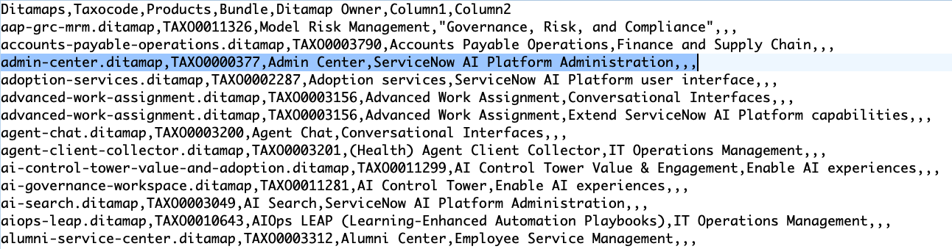
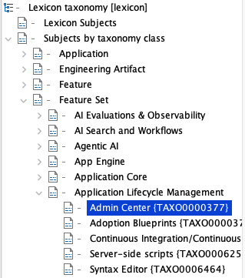
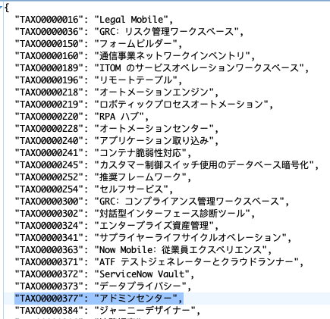
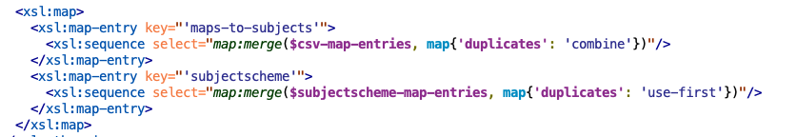
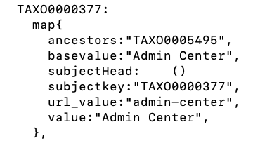
Load classification data
Load map-to-subject mapping file
  maps DITA maps to taxonomy subjects (by subject key)
Load taxonomy subject scheme
  Provides subject hierarchy
Load taxonomy L10N JSON files
  Provides English and localized display names
Construct XQuery map for the classification
  merges map-to-subject mapping with taxonomy hierarchy and localized display names.

Slide 17
Generate topic HTML
Use FTMAP to get topic's as-published URL
  Used to set canonical URL metadata
Generate otherwise normal HTML with a few small customizations:
  Iframes for videos
  Set HTML metadata for release version ("family")
  Wrap SVGs with element to capture @outputclass values (FT bug workaround)
  Set @role on specific kinds of tables
  Generate HTML structure with markup emulating legacy Zoomin delivery (last-updated date, time-to-read)
    Uses code shared among several different delivery processes
    Could be eliminated once Fluid Topics fully in production

Slide 18
Other stuff
Separate plug-ins for:
  L10N strings (used for all SN delivery targets)
  Cross-deliverable link resolution
  SVG fixup
  Common metadata embedded in topics (reflects different delivery targets that need the same in-topic markup)
  AI summary generation: post processing applied to HTML
Plug-in source maintained in git repo
OT 4.x
OT configurations managed in separate git repository just for OT
Jenkins for CI/CD processing

Slide 19
Summary
FTMAP map structure generation is simple enough: walk map tree
Most of our complexity is in applying the classification
Surprised by need to validate FTMAP file
  Can now guarantee FTMAP files will publish successfully
  Contains publication failures to our CI/CD environment
Topic HTML is almost entirely out-of-the-box
SVGs require some management but it's not too challenging

Slide 20
Thank you

