Slide 1

From Maps To Models
How DITA-OT Powers Ontology-Ready Content For AI and Beyond

Slide 2

About The Presenter
Amit Siddhartha
CEO at METAPERCEPT TECHNOLOGY SERVICES (LLP) and Consultant Director with Ingajer Limited - New Zealand

Slide 3
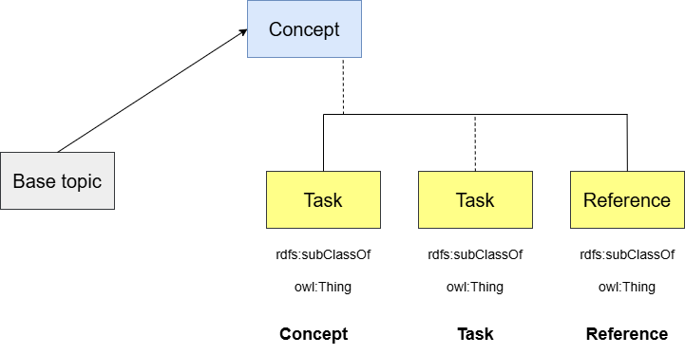
Specialization = Type System
DITA specialization is semantic typing

Slide 4
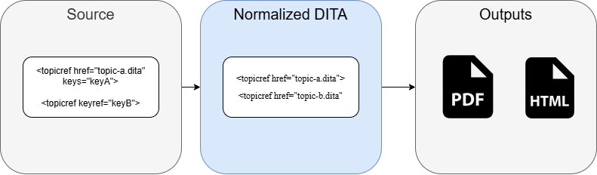
DITA-OT normalization produces resolved topics/maps, resolves map refs, keys, conrefs, code refs, and pushes metadata.
This is your “single source of truth” snapshot for KG extraction.

Slide 5
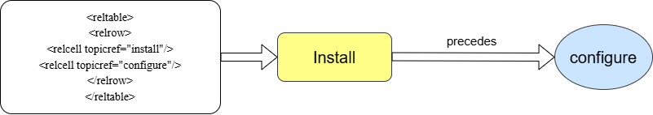

Slide 6
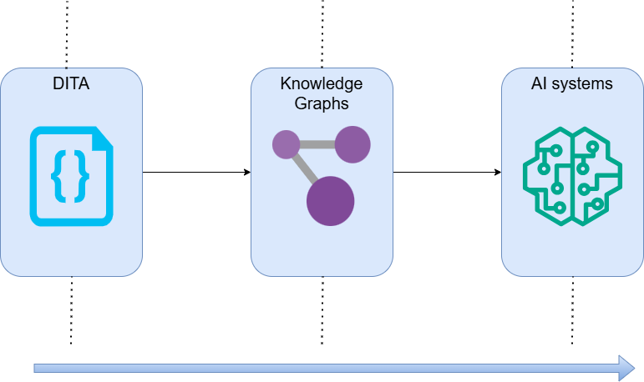
DITA-OT Is Future-Proof

Slide 7

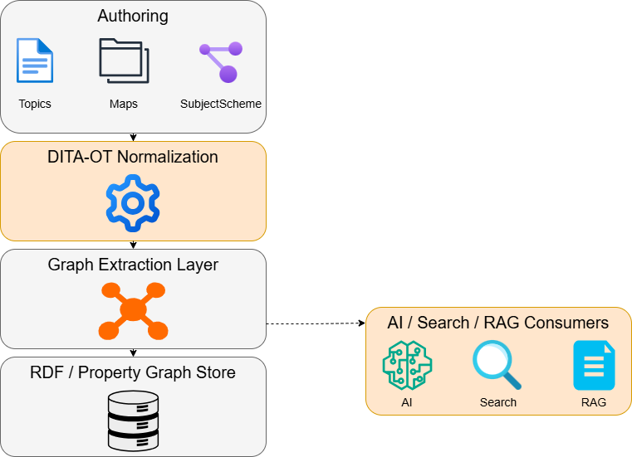
From Map to Graph Pipeline
DITA-OT → Knowledge Graph Architecture

Slide 8
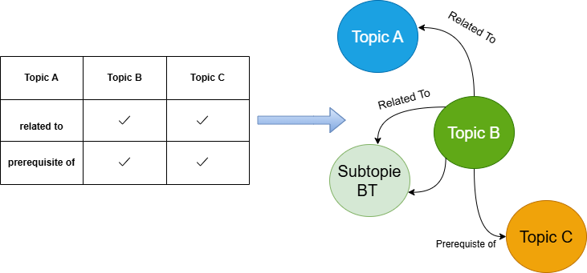
RELATABLEs are first-class graph definitions

Slide 9
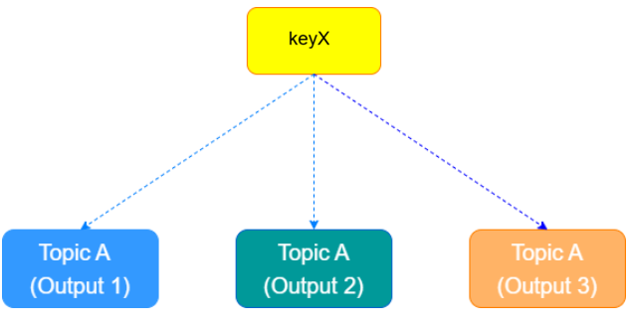
RELATABLEs is your explicit edge factory. Keys provide stable semantic identifiers

Slide 10
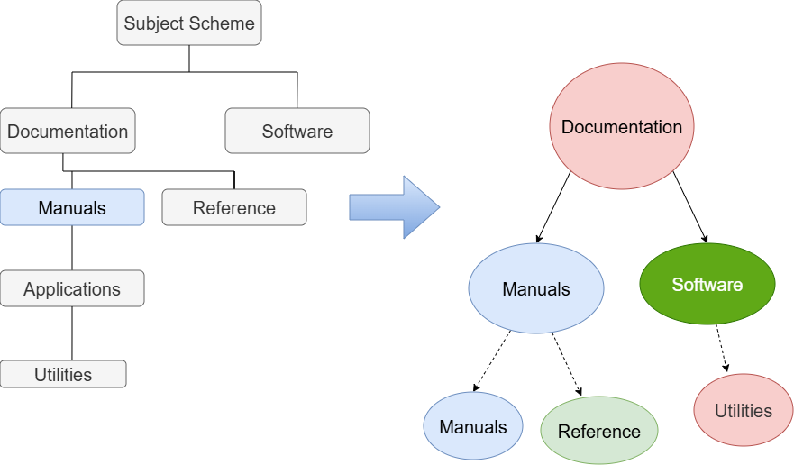
Subject Schemes → Taxonomies
Controlled values become computable semantics

Slide 11
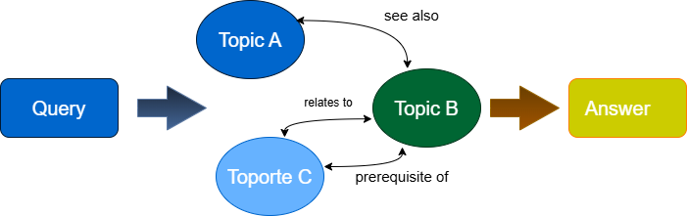
Why This Matters for AI
Graphs make AI explainable

Slide 12
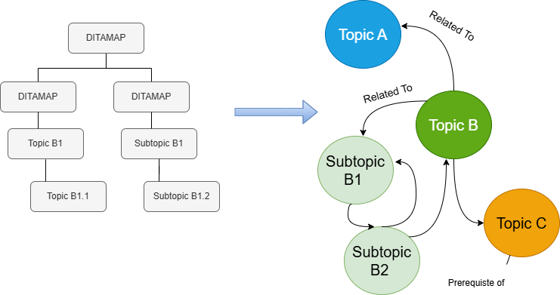
The missing step: materialize the implicit graph
The best place to materialize is after DITA-OT preprocessing, when references are resolved

Slide 13

Why “graph”, not “just navigation”
Property graphs exist too; RDF isn’t the only target.

Slide 14
Thank You
Email: info@metapercept.com
Phone: +91-839-090-5726
Website: https://metapercept.com/

