Slide 1

Making the DITA-OT Add Up: MathML Support
DITA-OT Day 2026
Jason Coleman
February 1, 2026

Slide 2
About Me
Me
UX Designer
Technical Writer
Structural Engineer
Bentley Systems
Software Company
Infrastructure
Engineering formulae
Colleague Credit
Rolandas Rimkus
Kongwhan Shin
Notes:
You’ll kindly note that I make no claims of being a developer.
Rolandas Rimkus - Sr. Principle Software Engineer; Open Applications CTO
Konghwan Shin - Summer Software Development Intern from UT Austin

Slide 3
Agenda
01 Current MathML Support
02 General Solution
03 Even Better Solution
04 Wider Opportunities
05 What’s Next

Slide 4
01 Current MathML Support
Notes:
What is the current out-of-the-box support for MathML in the DITA-OT?

Slide 5
Math and Equations in DITA
MathML
Equation
<mathml> <m:math
xmlns:m="http://www.w3.org/1998/Math/MathML"> <m:msup> <m:mi>b</m:mi> <m:mn>2</m:mn> </m:msup> </m:math> </mathml>
<mathref keyref="quadratic-formula"/>
<equation-block id="equation-abc">
<mathml>
⋮
</mathml>
<equation-number/>
</equation-block>
<equation-inline>…</equation-inline>
<equation-figure>
⋮
</equation-figure>
Notes:
There are actually TWO domains in DITA we’re discussing: the MathML domain (which is the ”container” for MathML markup) and the Equation domain, which is used to present inline and block equation formats.
The mathml domain just has two elements: a contain for MathML markup and a mathml reference, for including content from external files.
The equation domain just has four elements: block and inline elements, an element used to indicate numbering of equations, and a grouping container.
Worth noting that these are well supported in Oxygen Author and equations do render in your topic in Author mode.

Slide 6
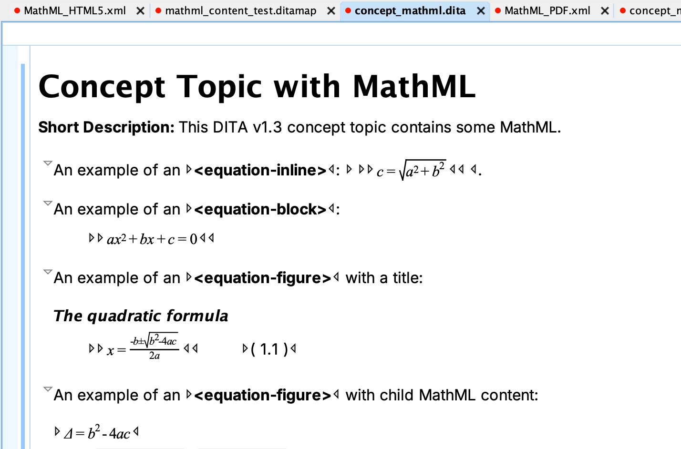
What Happens When We Publish…

Slide 7
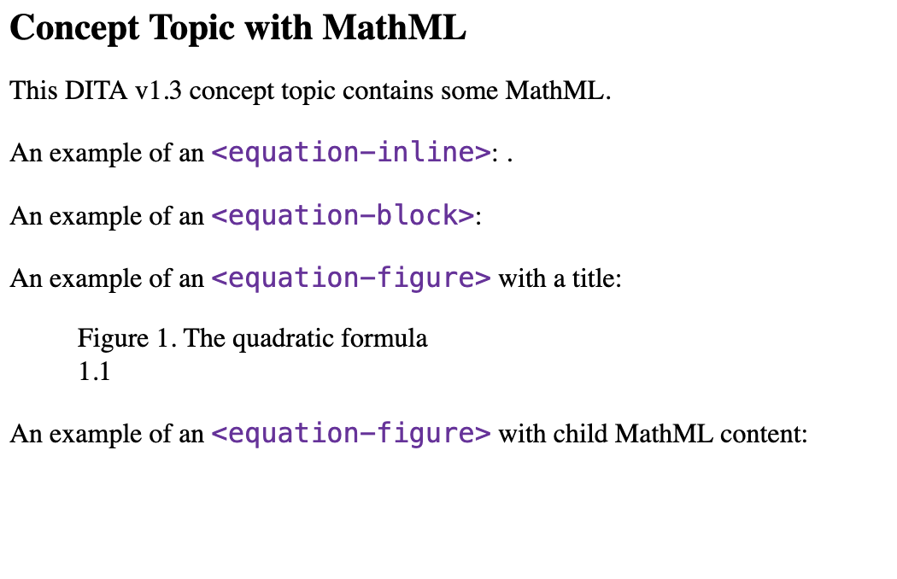
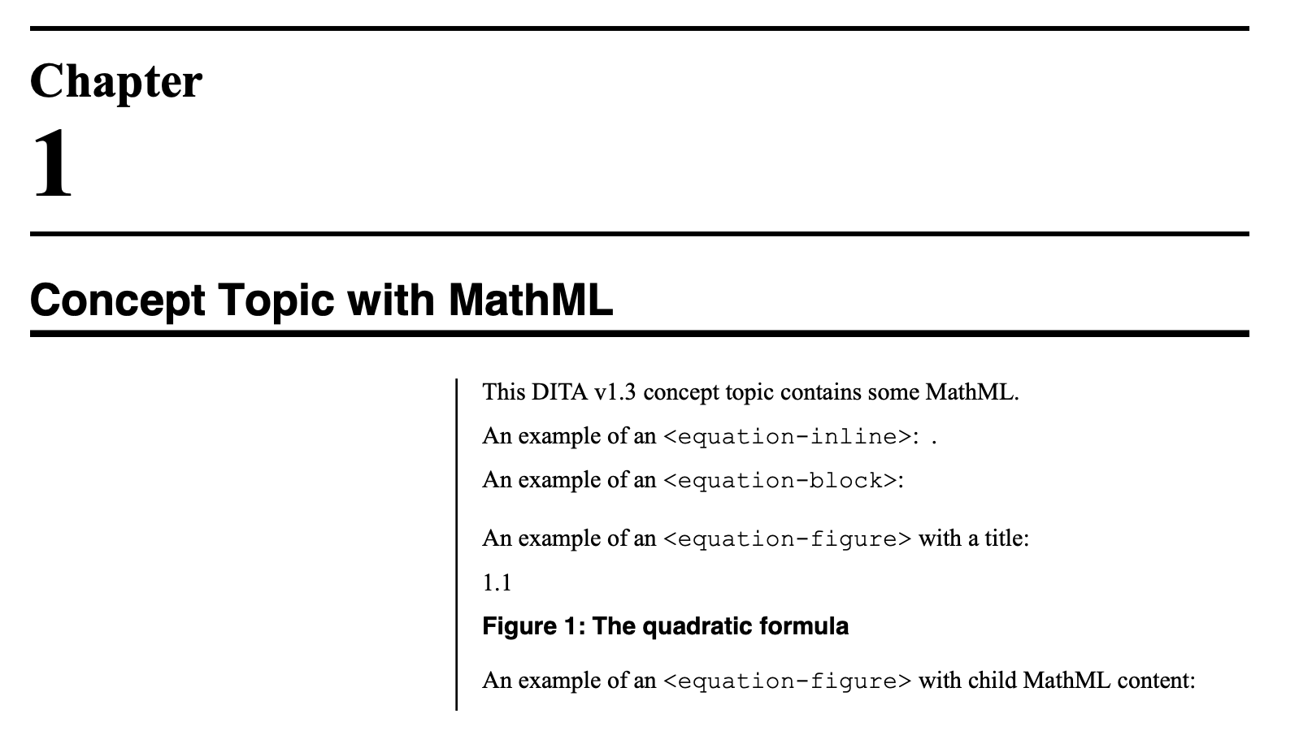
Nothing
Notes:
Any content in DITA topics in the equation or mathml domains is simply ignored.

Slide 8
Why?
Elliot Kimber filed Issue #1774 in late 2014 for support of the equation and math domains
HTML
DITA v1.3 first approved in 2015 ‒ MathML officially became part of the DITA specification
Virtually zero support for MathML in browsers at that time ‒ even though HTML5 supports MathML
PDF
JEuclid FOP extension was available
PDF in the DITA-OT was a bit of mess then
Math is niche content
Notes:
How many here have math in their content? (probably no one; but kind to listen)

Slide 9
And Today?
Issue #1774 remains open
DITA v2.0 on the horizon
HTML5
It became part of the W3C HTML5 standard
MathML is well supporting in browsers now
PDF
PDF is more manageable to create than the DITA-OT 2.x era
JEuclid project has appears abandoned and doesn’t support Java 17
Math remains niche content
Notes:
But niche doesn’t mean some edge case we don’t need to worry about.

Slide 10
02 General Solution

Slide 11
How?
XSL to support the equation and mathml domains in the DITA OT
Limit to HTML5 and PDF* outputs
Features
Equations should be numbered per the DITA v1.3 specification
Support for cross references to equations – use natural reference language such as “Equation 4”
Copies over all *.mml files (assumed file extension for MathML markup files)
This should be “core” DITA-OT functionality

Slide 12


Limit to HTML5 and PDF outputs
PDF Outputs
Antenna House fully supports MathML
FOP and XEP do not and the JEuclid FOP extension no longer works with the DITA-OT
Markdown could just include MathML
XHTML is sort of on its own now; lost to time
HTMLHelp (CHM) is a dead format
I know nothing about Eclipse help
Notes:
Caveat emptor…

Slide 13
PR #4745 For This
Submitted to close issue #1774.
Covers HTML5 very nicely – much better than expected
Works with Antenna House Formatter
Doesn’t break FOP (but still no math in the output today 😢)
Can still add the MathJax CDN script for HTML5 if desired
Unknown formatting object "{http://www.w3.org/1998/Math/MathML}math" encountered (a child of fo:instream-foreign-object}
Notes:
This should cover probably 99% of the MathML needs for HTML5 output.

Slide 14



Who Does Not Need This?
Notes:
Miramo PDF
Oxygen PDF Chemistry
Oxygen WebHelp
These are all handle MathML and the equation domain well.
Did note that the default handling of equation numbering didn’t render anything in PDF Chemistry, though. Further links to an equation don’t render nicely.

Slide 15
03 Even Better Solution

Slide 16
If Not MathML, SVG?
“Pre” render the math content into SVG during the DITA-OT build instead
JEuclid needed to be updated to work with Java 17 (at least) – Kong Shin worked on this in Summer ‘25

Slide 17
MathJax
Open source
Gold standard for rendering of math content – just in JavaScript
Unfortunately, the CDN has (had?) some limitations and would often stop rendering part-way through a page.
Would prefer a client-side rendering option

Slide 18
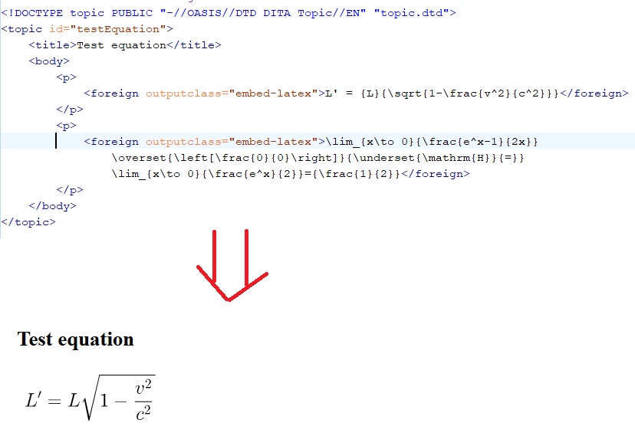
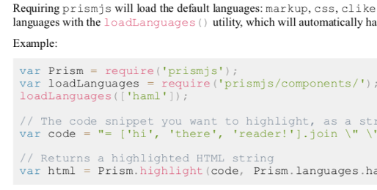
Inspiration
LaTeX plugin: uses Saxon extension functions
Radu Coravu
Prism.js plugin: static rendering for HTML and PDF
Jason Fox (presented at DITA-OT Day 2019)

Slide 19
MathML → SVG
Use Saxon extension functions – greatly simplifies XSLT markup; only called when needed
<xsl:copy-of select="parse-xml(mathjax:mml2svg($mathml))"/>
Java function
writes MathML to file – not something to pass as a command line parameter
Uses command line to call tiny JavaScript file through Node.js
JavaScript calls MathJax and return SVG markup
Small ”clean-up” of SVG for use in XSL:FO (at least for FOP)
Return either the SVG markup or a URL of the SVG file if storing externally

Slide 20
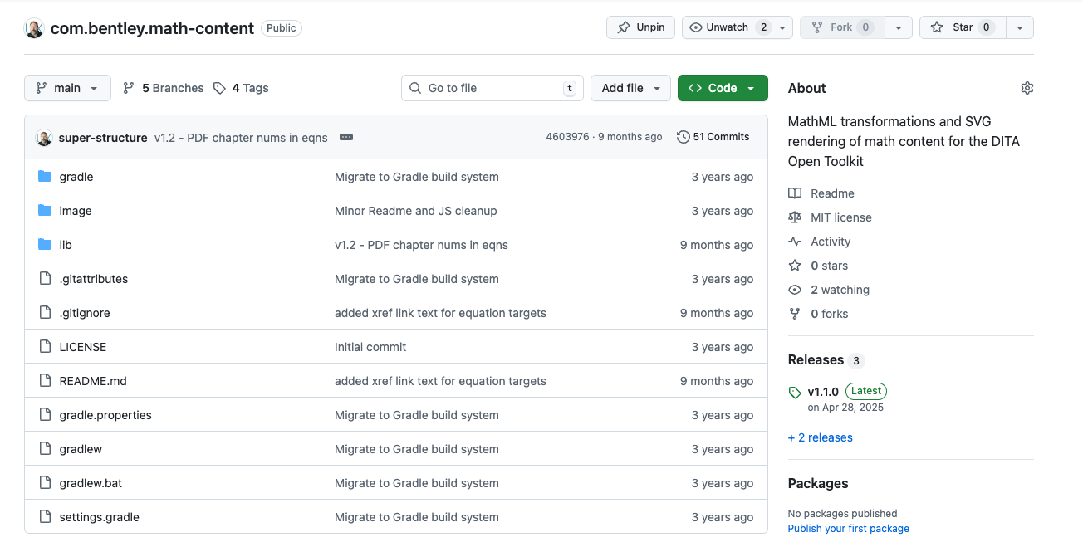
com.bentley.math-content
Notes:
https://github.com/super-structure/com.bentley.math-content

Slide 21
Actual Case Results
Structural Engineering Software Product Documentation:
4,477 topics
9,628 instances of MathML
HTML5 output with only MathML – 3’ 16”
HTML5 output with MathJax “Pre” – 9’ 26”

Slide 22
04 Wider Opportunities

Slide 23
Saxon Extension Functions
Some documentation in the DITA-OT and in Saxon docs
Works best with Java libraries
XSLT and Saxon have great support JSON / XML, so could leverage Web APIs
Allows for virtually any programming language and library to be used via command line
Trade-off: speed – Never going to be as fast as native Java code

Slide 24
05 What’s Next

Slide 25
Immediate Needs
Localization help for strings (“Equation”)
Support for Markdown output – just inline MathML or convert to LaTeX?
Support for Eclipse help – had a very recent update; no idea about it
Notes:
Similar to an academic presentation, I want to provide what work or research needs to be done next.
Didn’t want to just use Google translate and assume that the term would work in context.
Not sure what –if any- preferences in Markdown output there are for math content.
Eclipse help is a bit of a mystery to me. I don’t know anything about it, but it did have a very recent update.

Slide 26
Future Possibility
Native Java Libraries to support MathML conversion to SVG
Update JEuclid
Who should ”own” this? (Ideally Apache Foundation, who support FOP)
Move JEuclid “officially” to GitHub: legacy on SourceForge in Hg
Support more recent versions of Java: 17 and beyond
Port MathJax to Java
Similarly, who should “own” this?
MathJax 3 used currently
See if MathJax v4 still works; SVG rendering is different now
Notes:
Where this could go in the future:
A Java library for converting MathML to SVG would be ideal. Whether this is updating Jeuclid or a Java port of MathJax.
Either option could have an issue of “ownership” and maintenance.

Slide 27



Thank you
jason.coleman@bentley.com
github.com/super-structure
mastodon.social/@super_structure

