Slide 1


Welcome to DITA-OT Community
WELCOME
Where Code meets Passion
Justyna Hietala
justyna.hietala@gmail.com

Slide 2
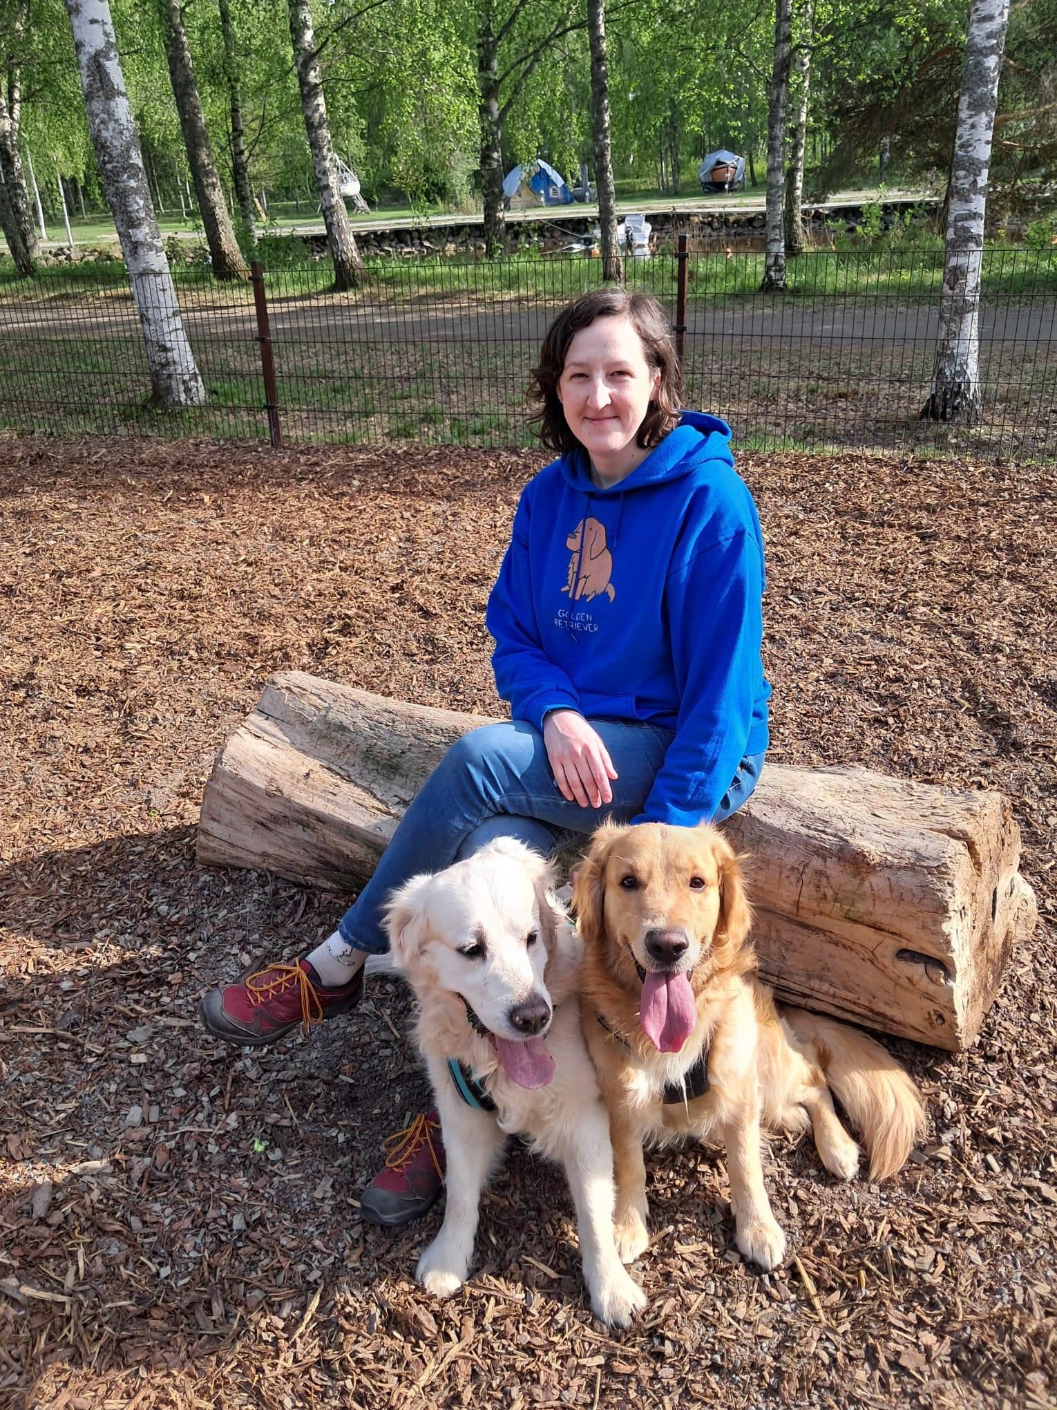
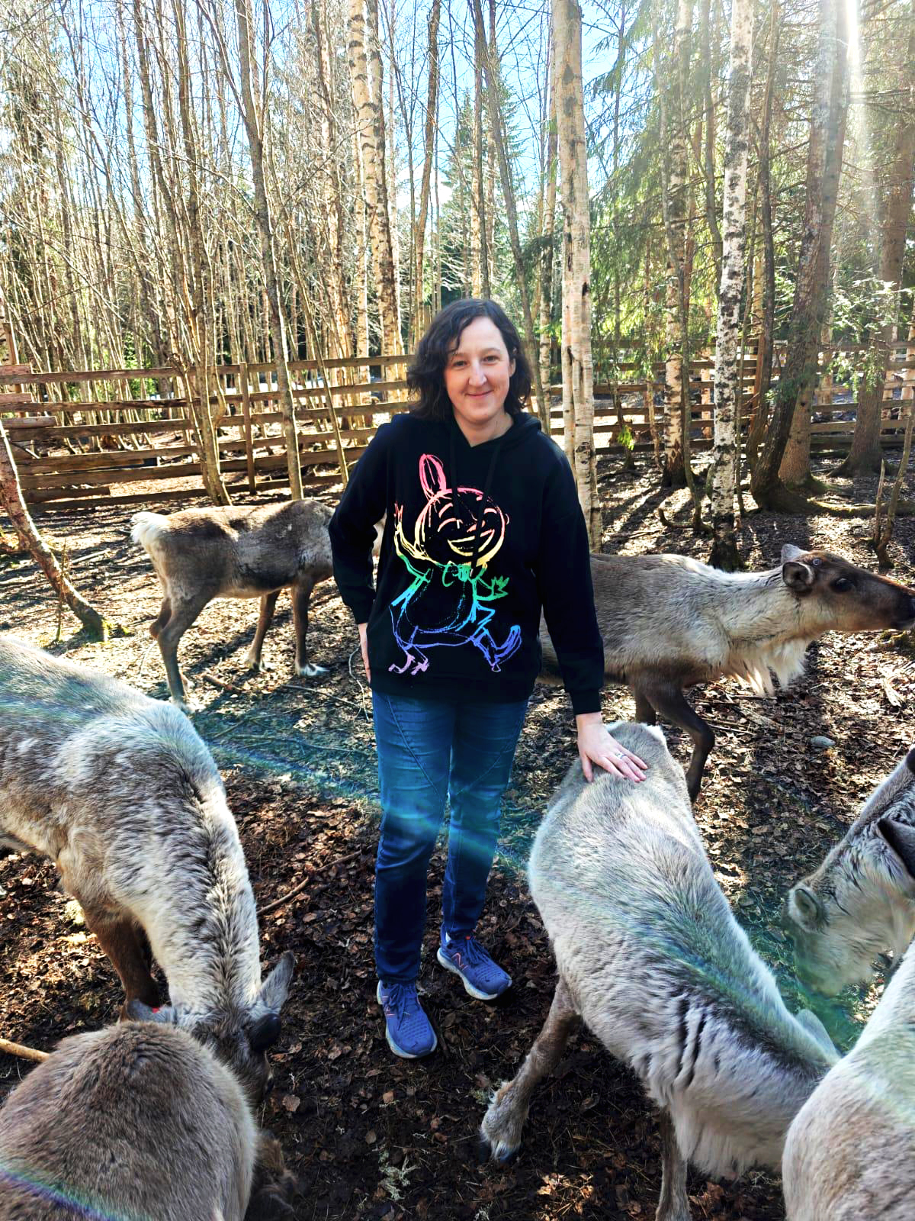
INTRODUCTION – about Justyna

Slide 3
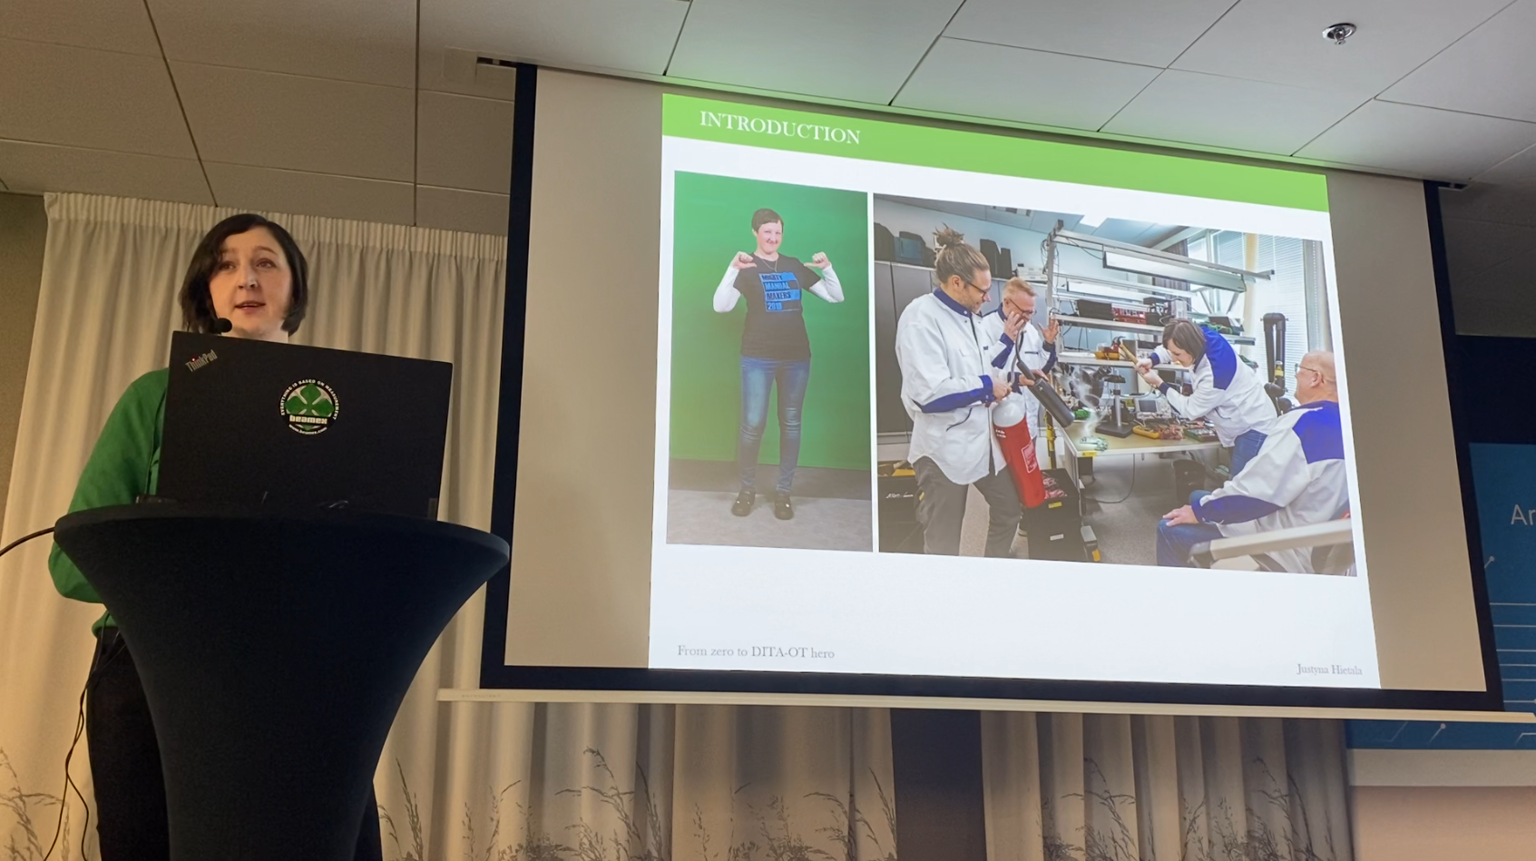
INTRODUCTION –DITA-OT Day 2024

Slide 4

INTRODUCTION –Life after

Slide 5












HELP ME – I have this issue and I don’t know how to solve it

Slide 6
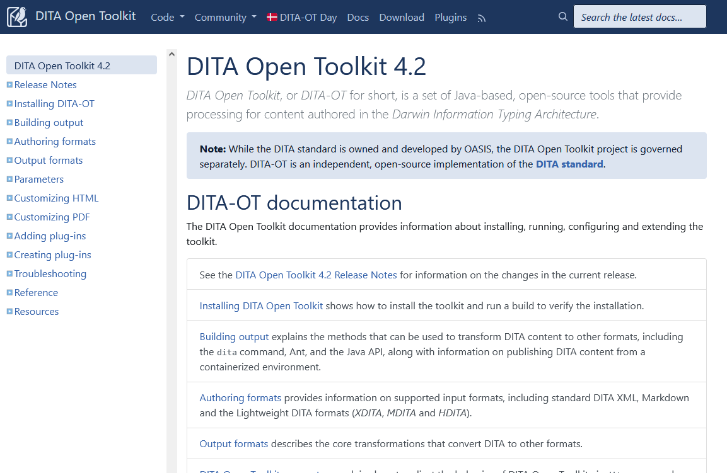
SUPPORT CHANNELS – DITA-OT Documentation
https://www.dita-ot.org/dev/

Slide 7
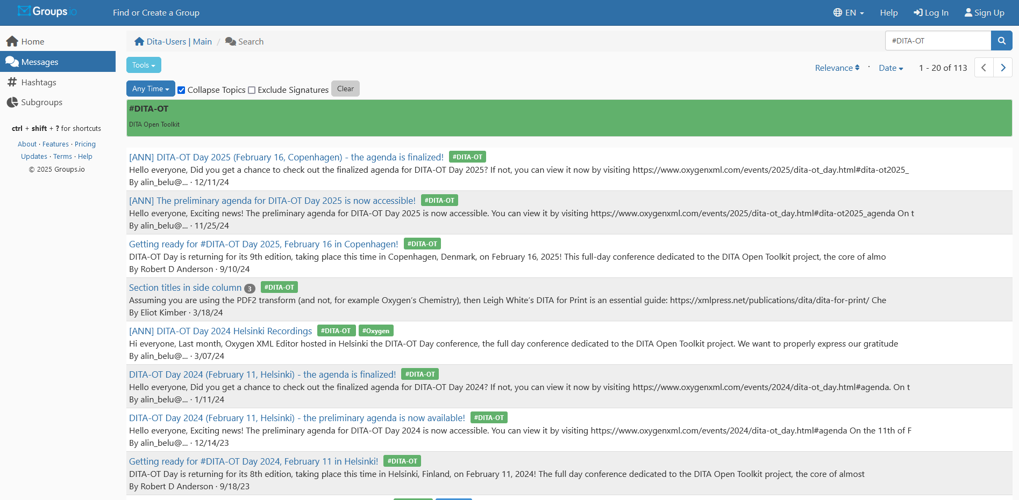
SUPPORT CHANNELS – DITA Users group
https://dita-users.groups.io/g/main

Slide 8
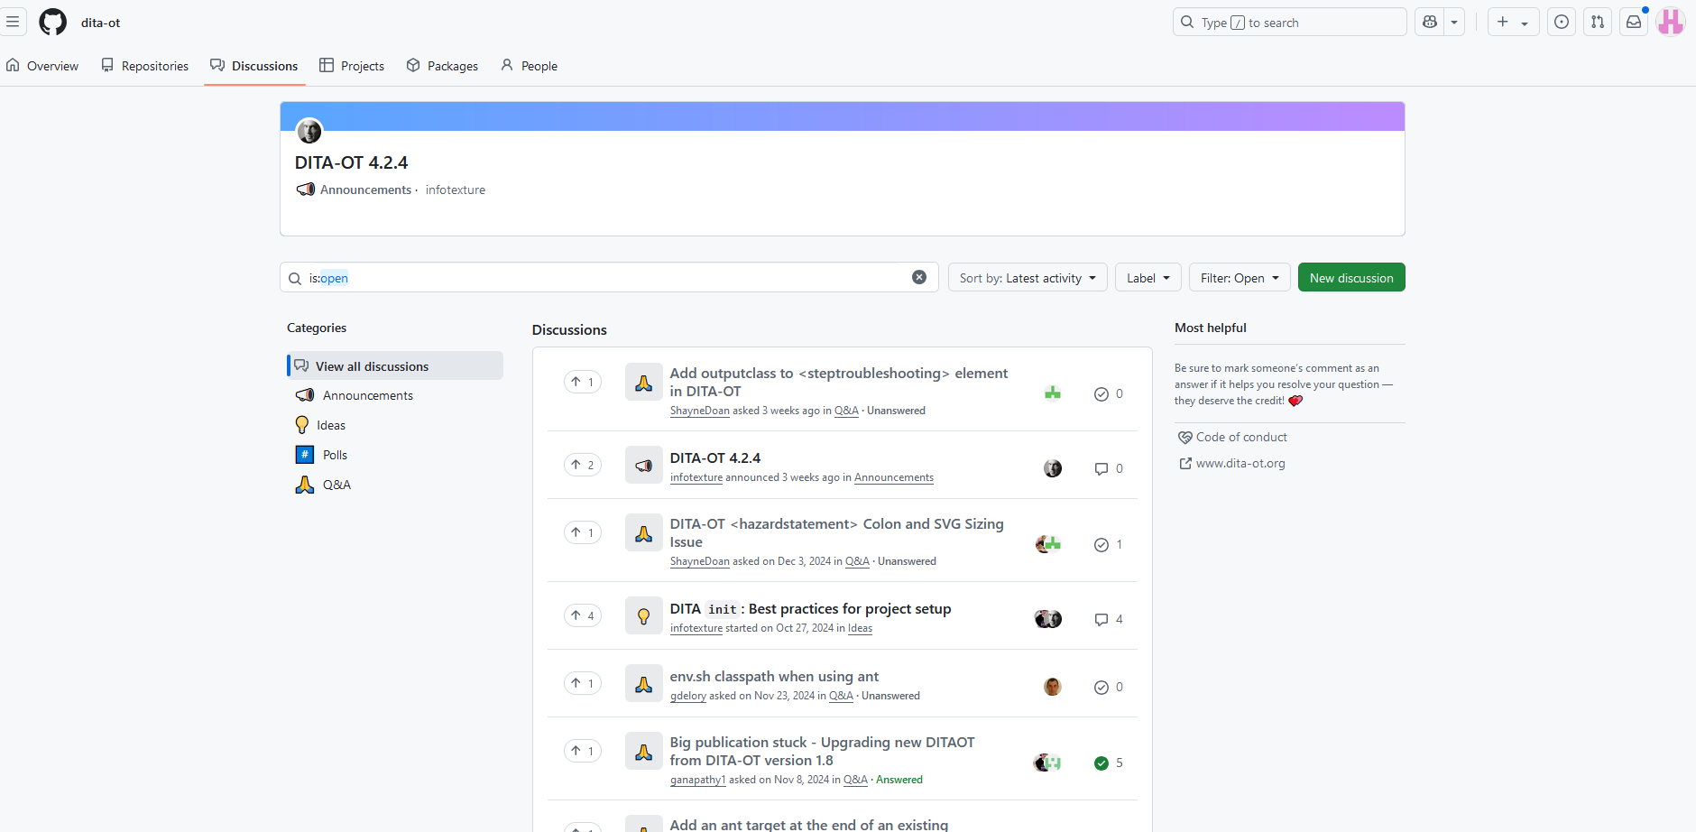
SUPPORT CHANNELS – DITA-OT Discussions
https://github.com/orgs/dita-ot/discussions

Slide 9
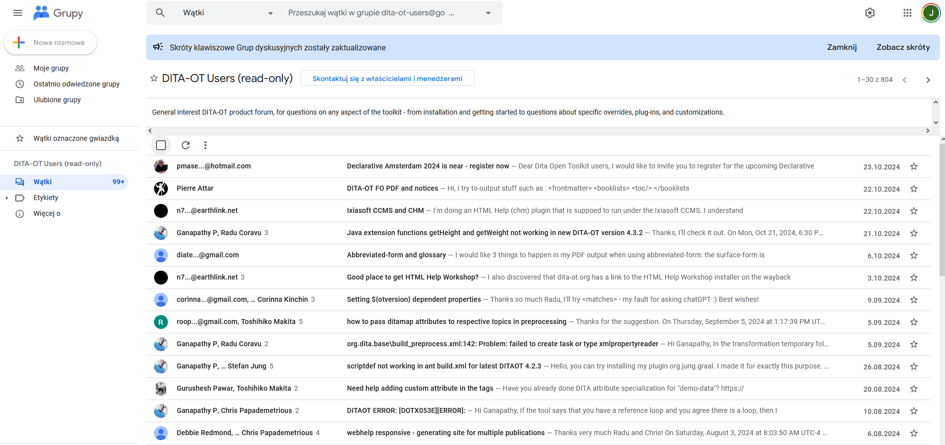
SUPPORT SOURCES – DITA-OT Users group archive
https://groups.google.com/g/dita-ot-users

Slide 10
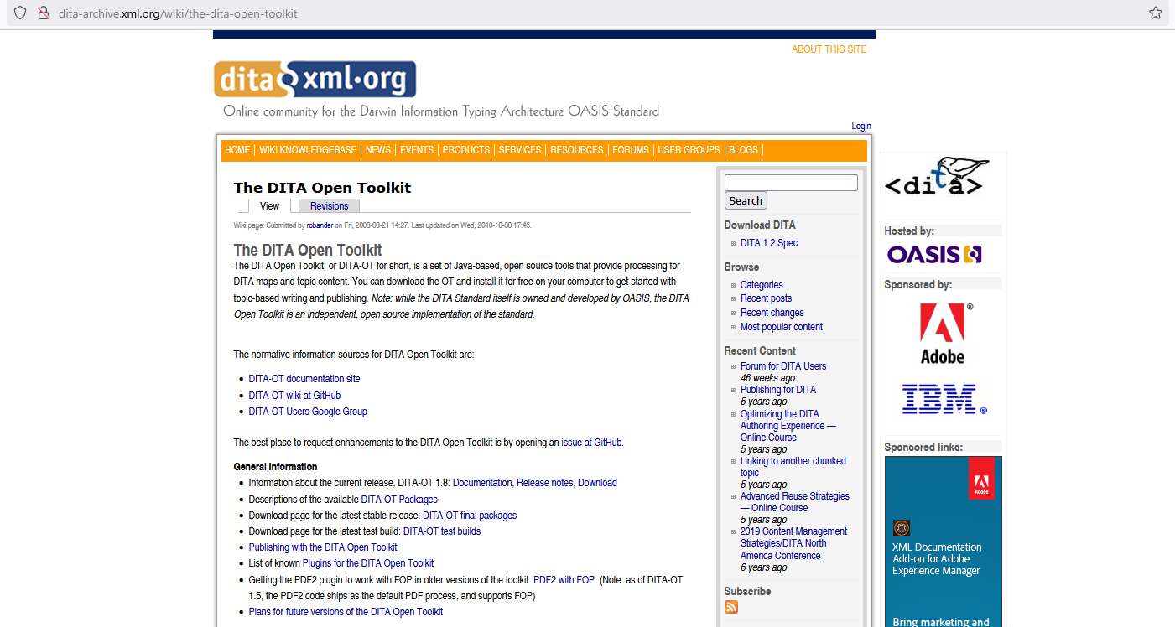
SUPPORT SOURCES – DITA-OT project archive
http://dita-archive.xml.org/wiki/the-dita-open-toolkit

Slide 11
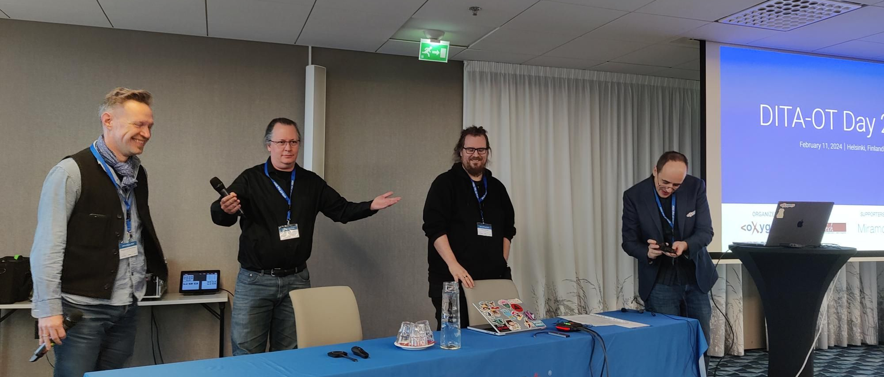
SUPPORT SOURCES – DITA-OT Day conference recordings
https://www.dita-ot.org/dev/topics/dita-ot-day-videos

Slide 12
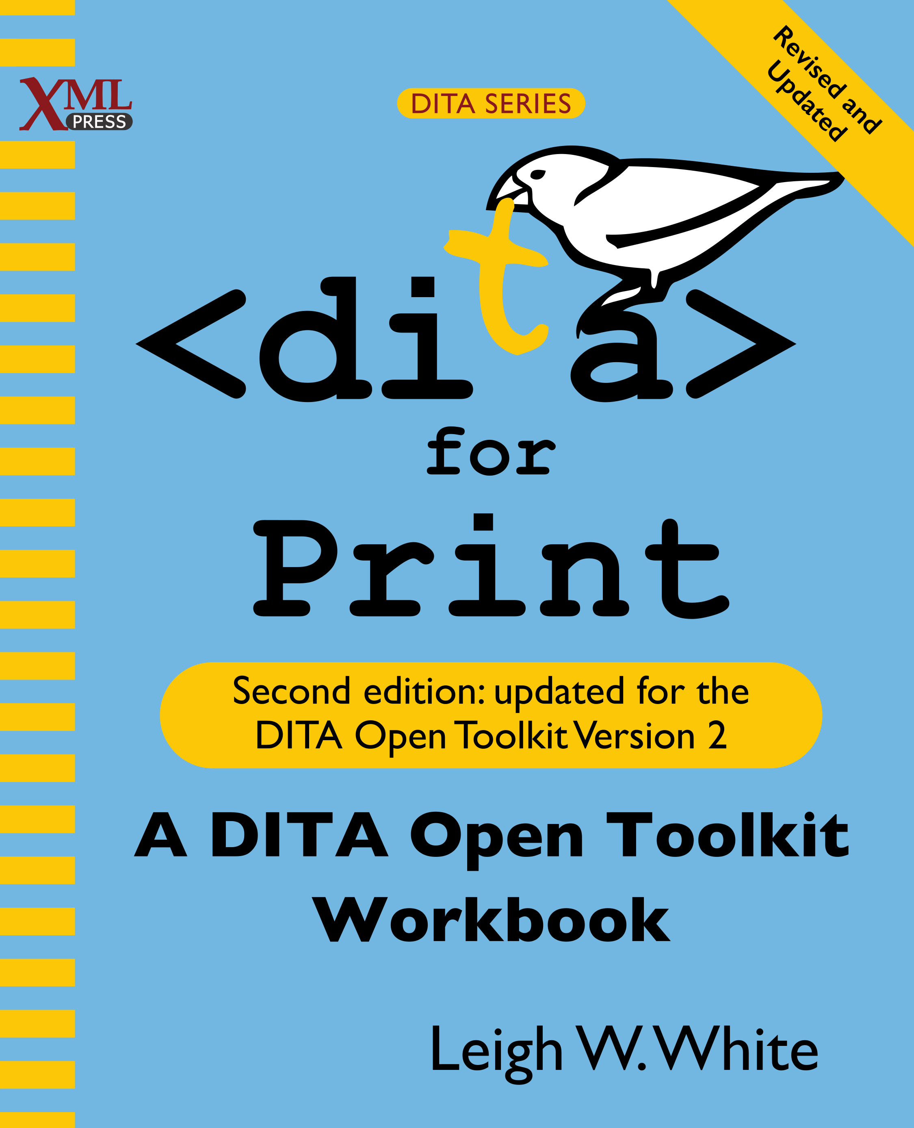

SUPPORT SOURCES – Books
DITA for Print: A DITA Open Toolkit Workbook (Second Edition, 2017)
By Leigh W. White
DITA for Practitioners: Volume 1, Architecture and Technology (2012)
By Eliot Kimber

Slide 13
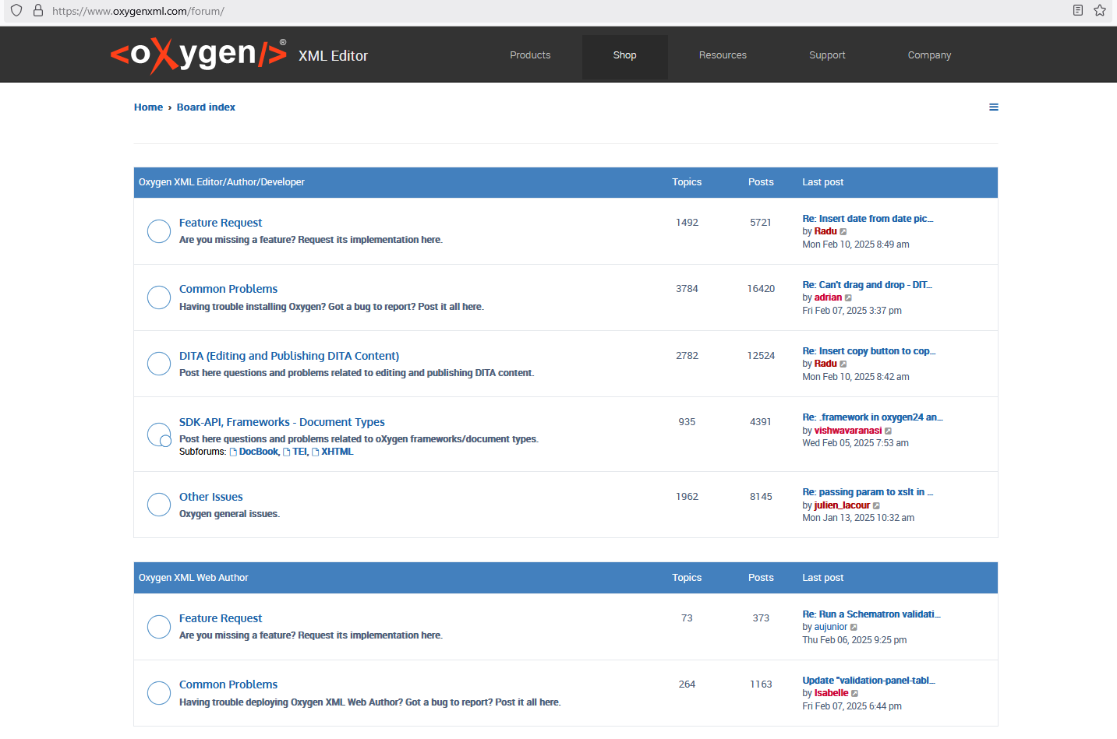
SUPPORT SOURCES – oXygen forum
https://www.oxygenxml.com/forum/

Slide 14


SUPPORT SOURCES – Consultancy business

Slide 15
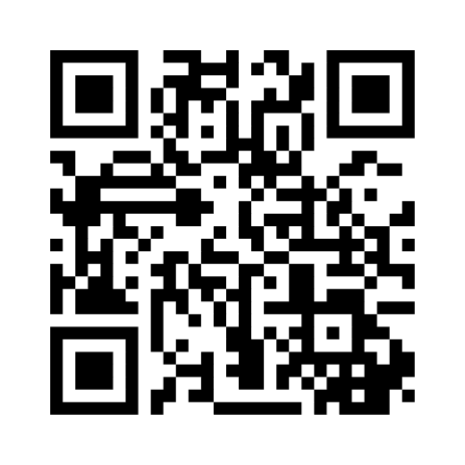
DITA-OT COMMUNITY – Let’s get to know each other!
Go to
www.menti.com
Enter the code
4456 8413

Slide 16

DITA-OT COMMUNITY – Survey results

Slide 17
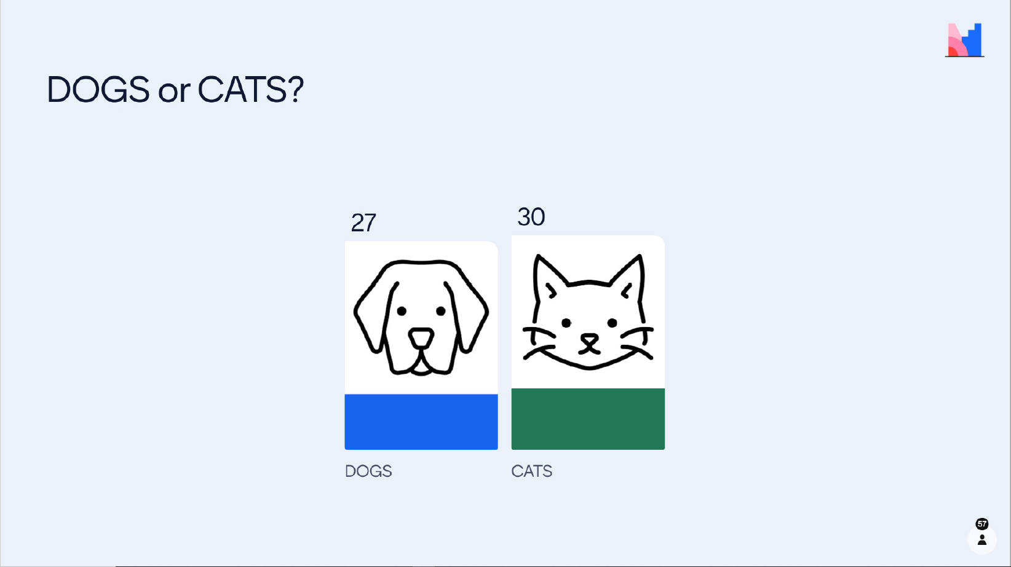
DITA-OT COMMUNITY – Survey results

Slide 18
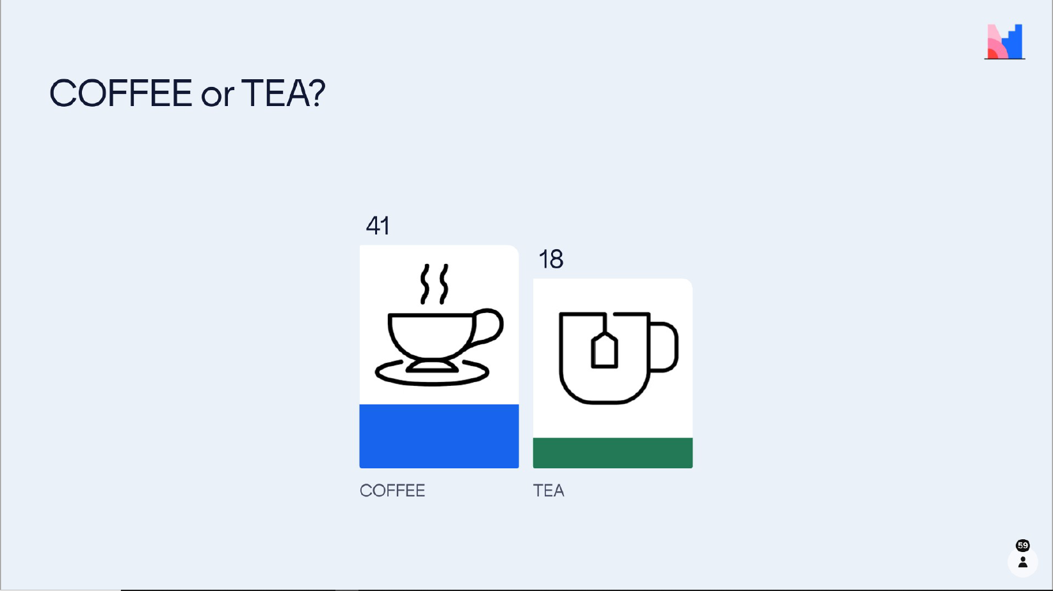
DITA-OT COMMUNITY – Survey results

Slide 19
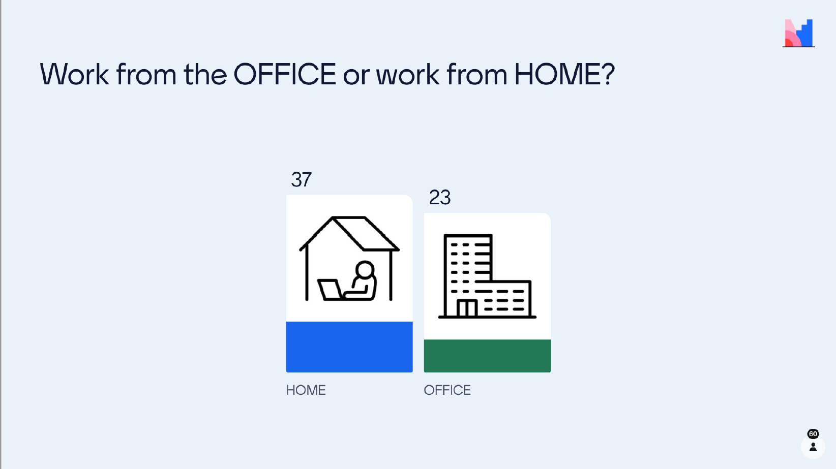
DITA-OT COMMUNITY – Survey results

Slide 20
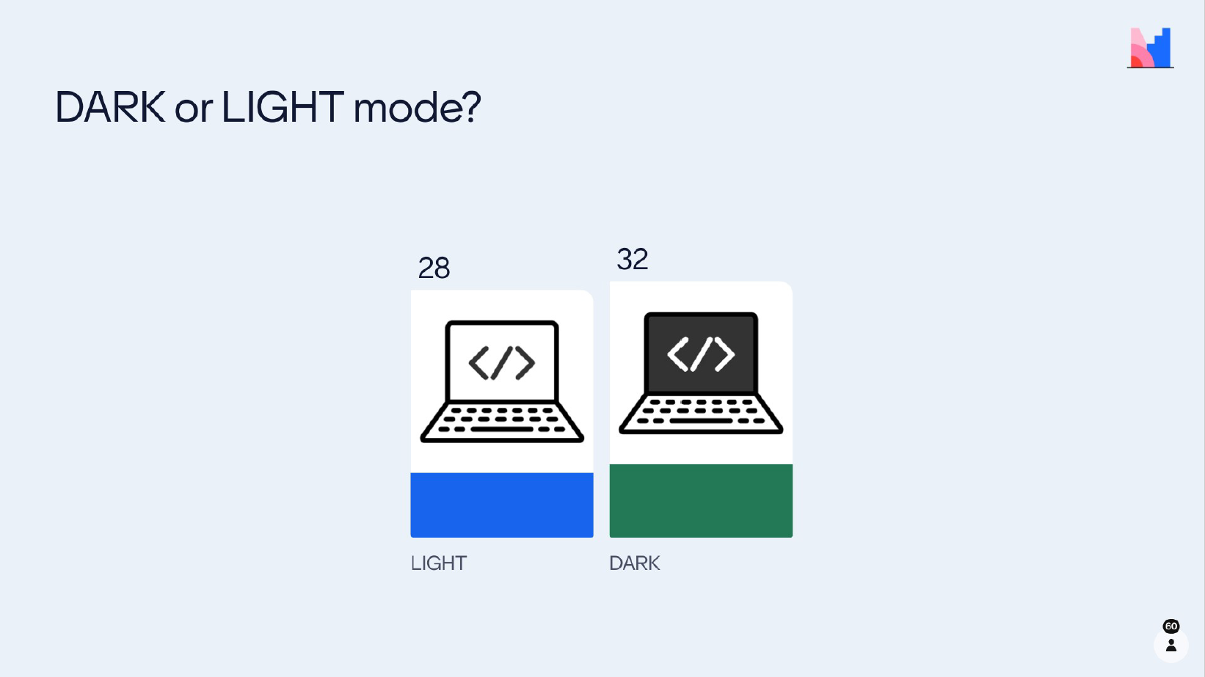
DITA-OT COMMUNITY – Survey results

Slide 21
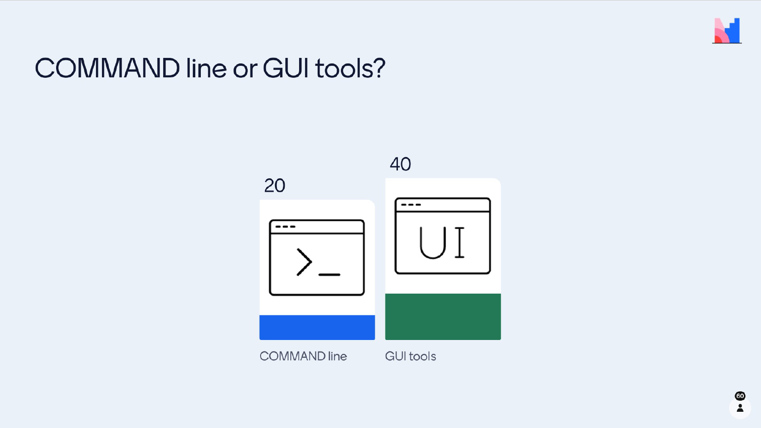
DITA-OT COMMUNITY – Survey results

Slide 22
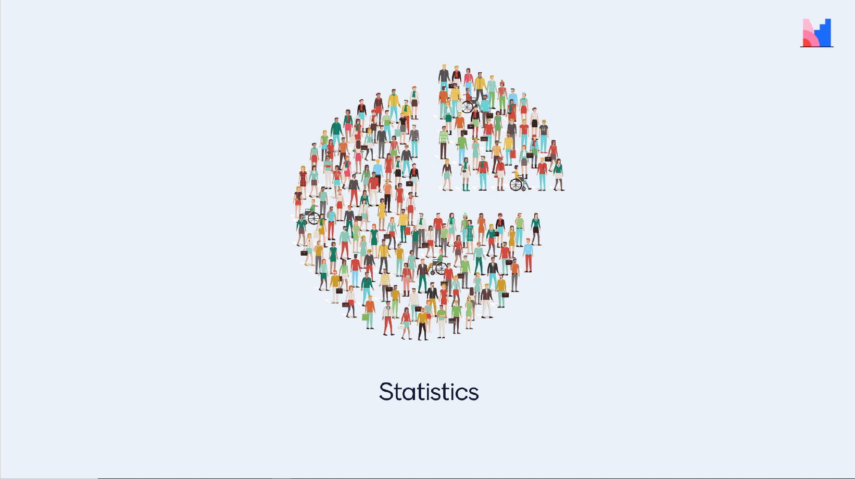
DITA-OT COMMUNITY – Survey results

Slide 23
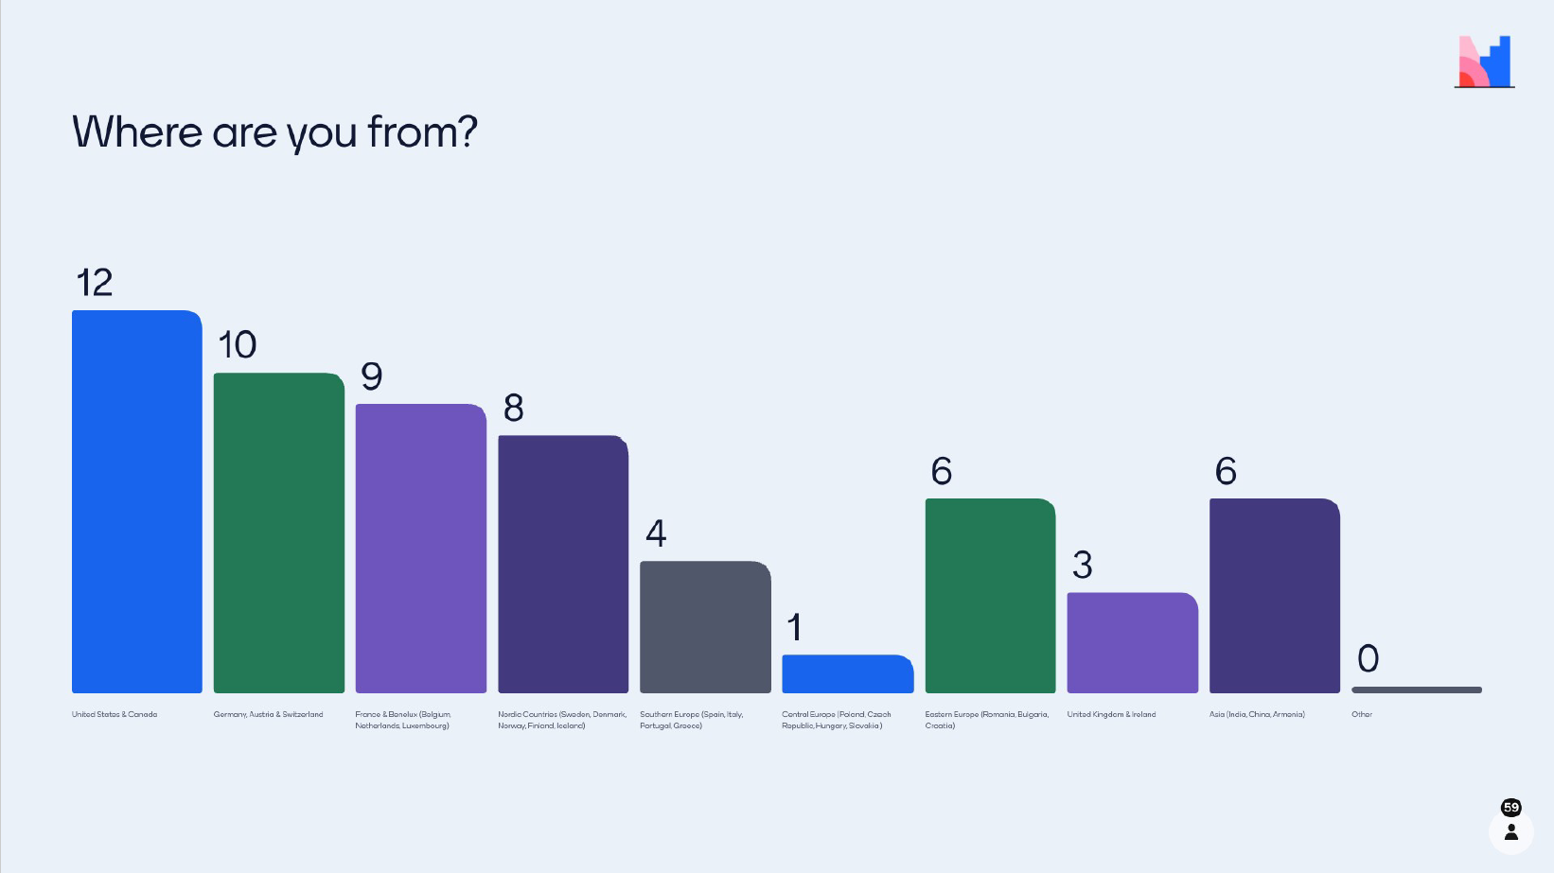
DITA-OT COMMUNITY – Survey results

Slide 24
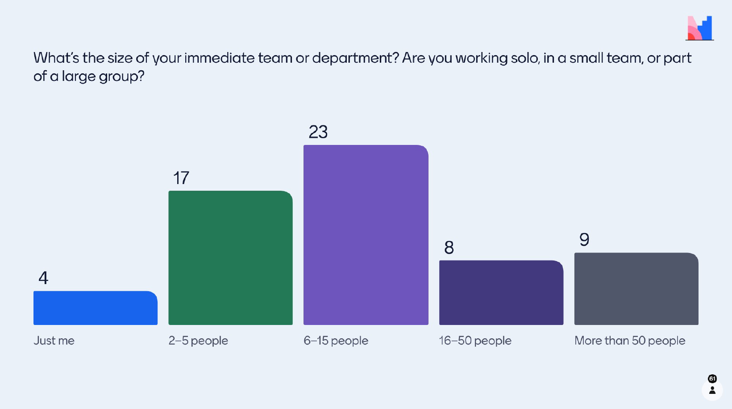
DITA-OT COMMUNITY – Survey results

Slide 25

DITA-OT COMMUNITY – Survey results

Slide 26
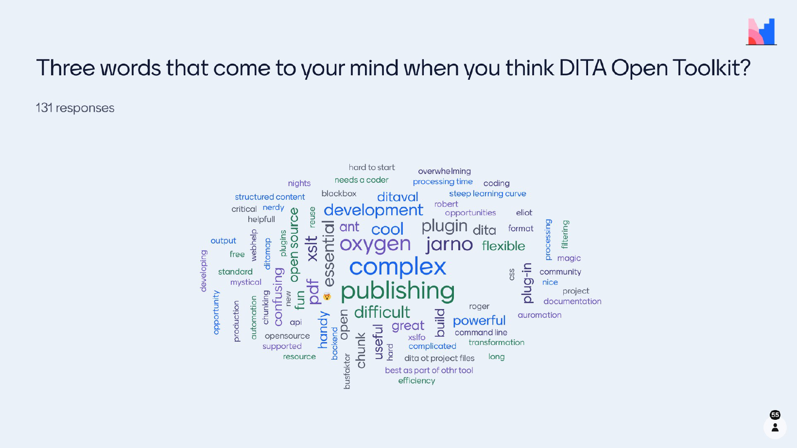
DITA-OT COMMUNITY – Survey results

Slide 27
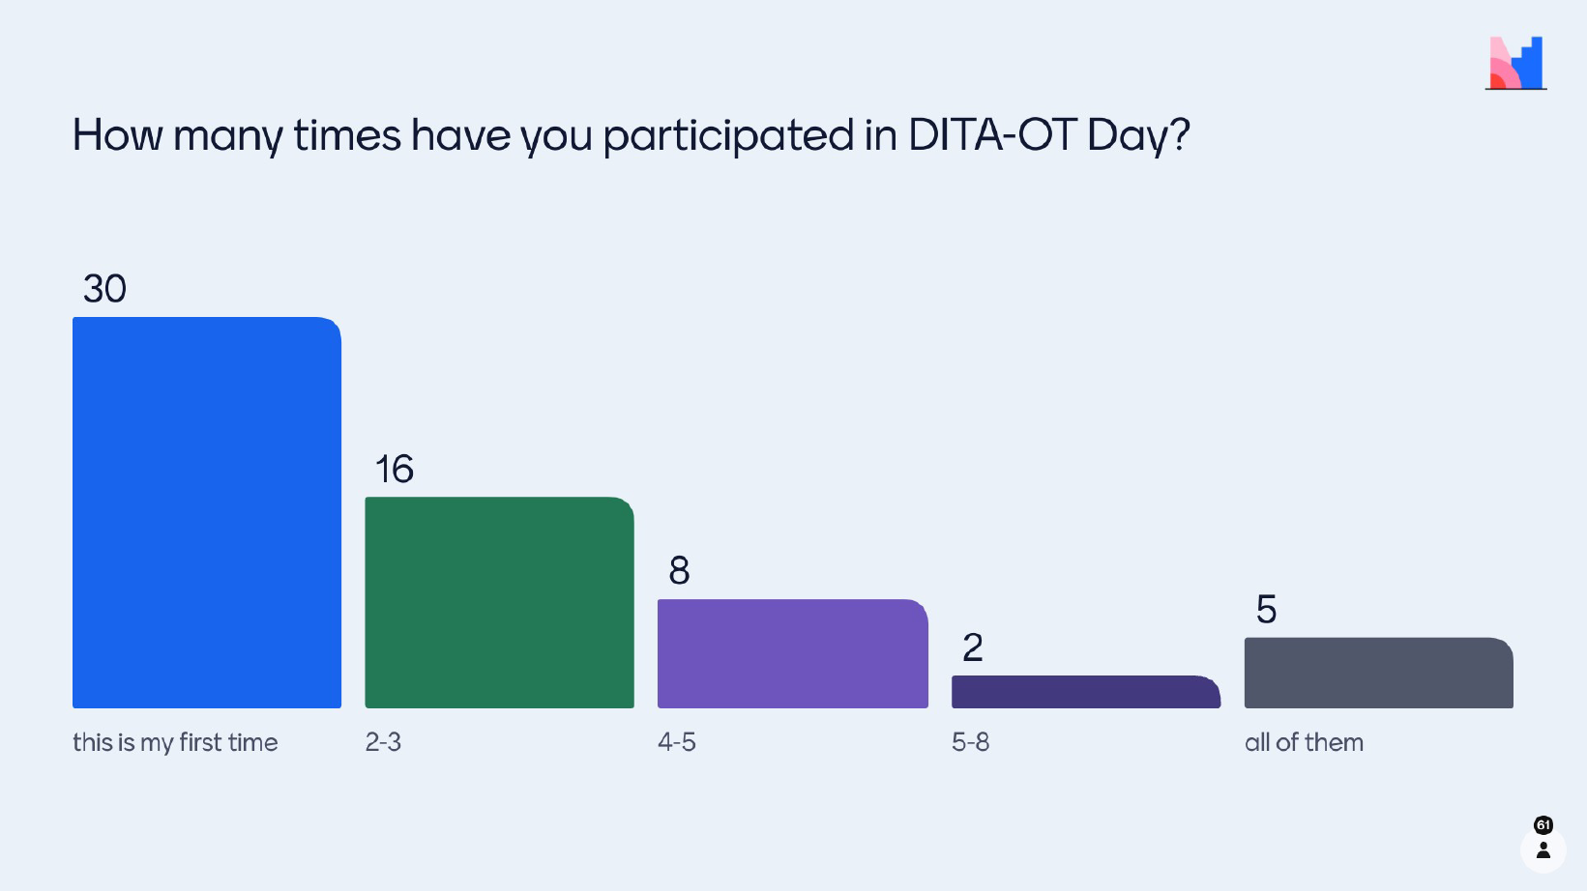
DITA-OT COMMUNITY – Survey results

Slide 28
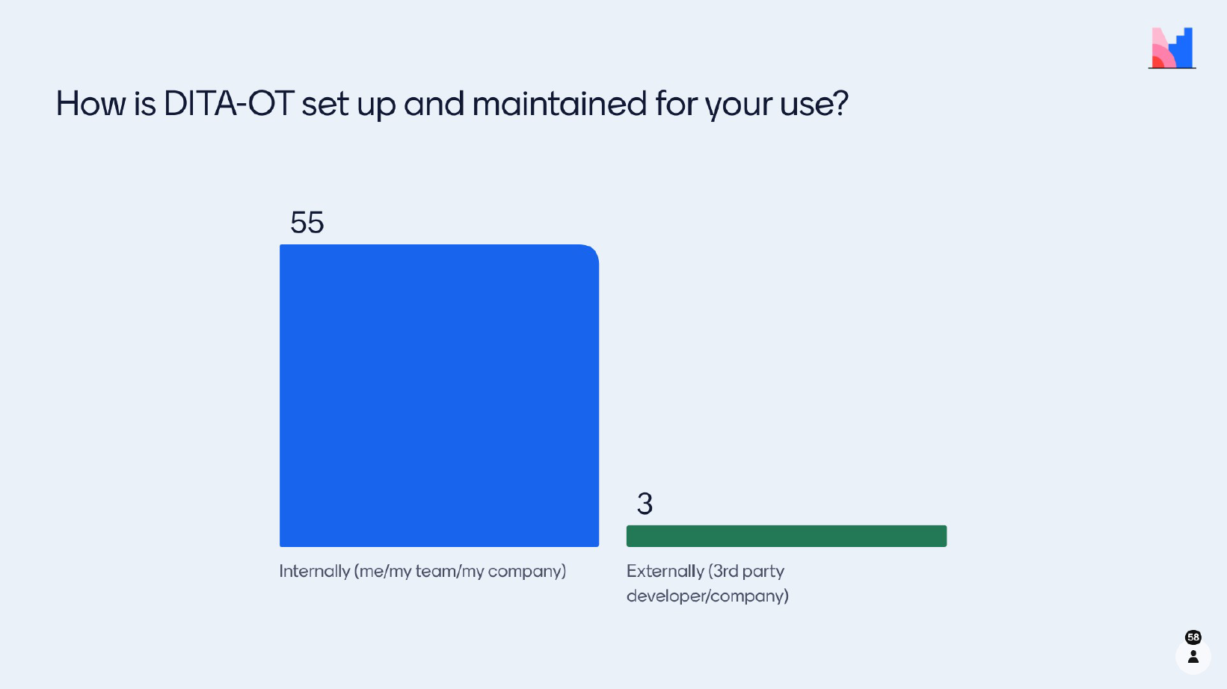
DITA-OT COMMUNITY – Survey results

Slide 29
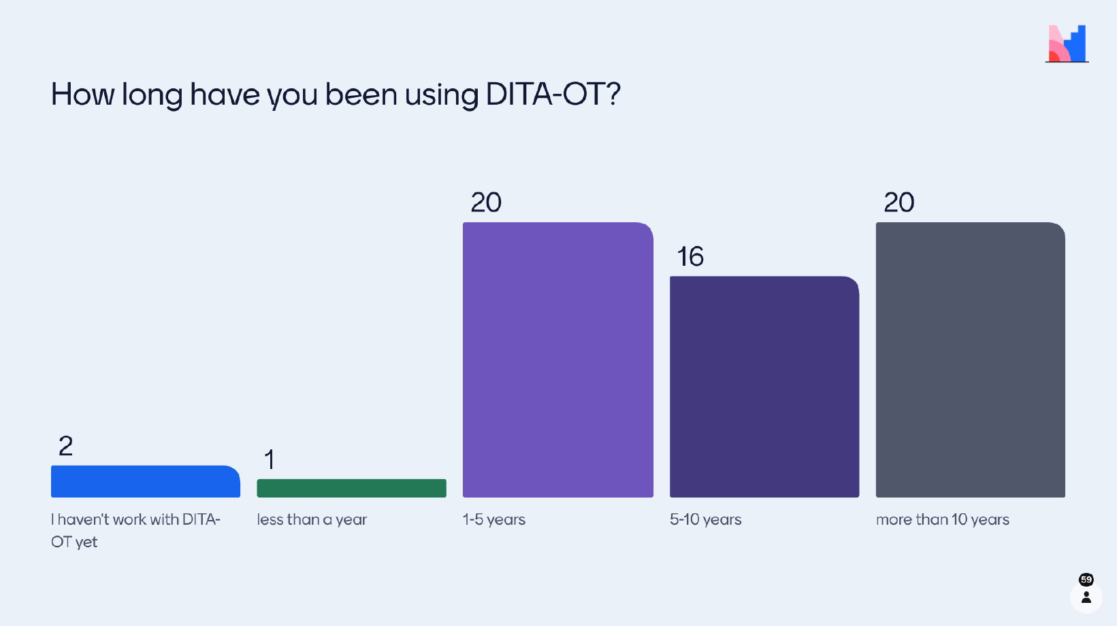
DITA-OT COMMUNITY – Survey results

Slide 30
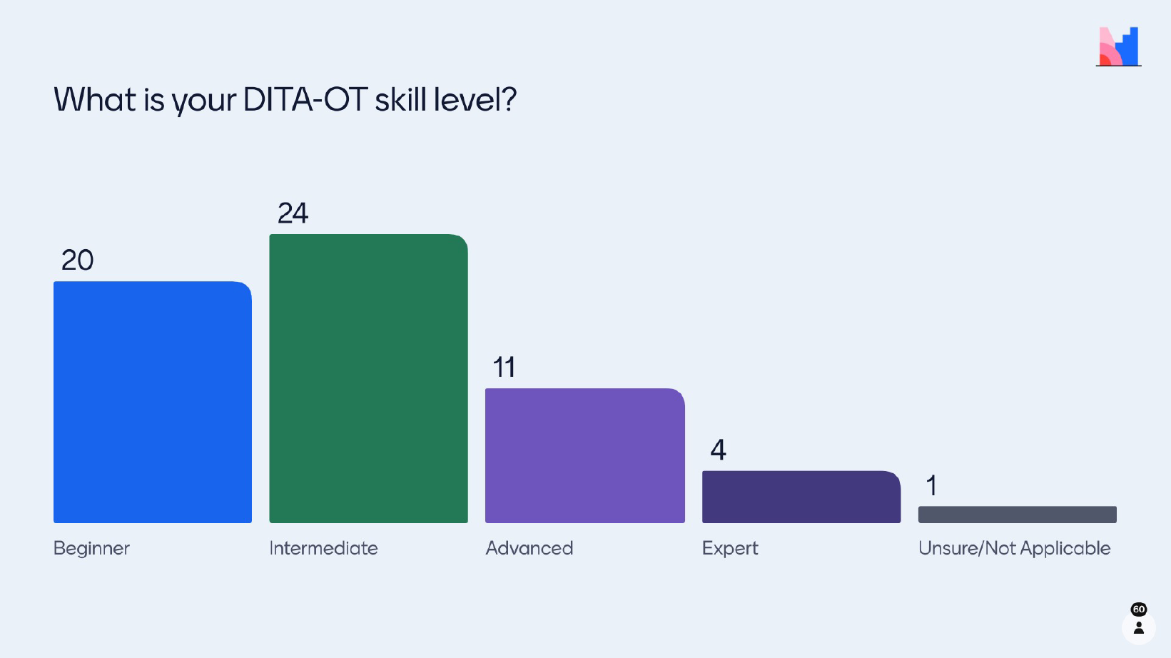
DITA-OT COMMUNITY – Survey results

Slide 31
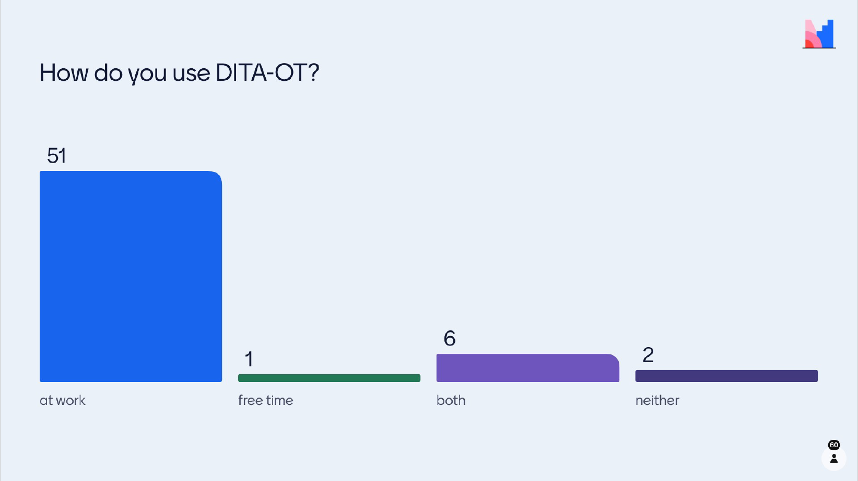
DITA-OT COMMUNITY – Survey results

Slide 32
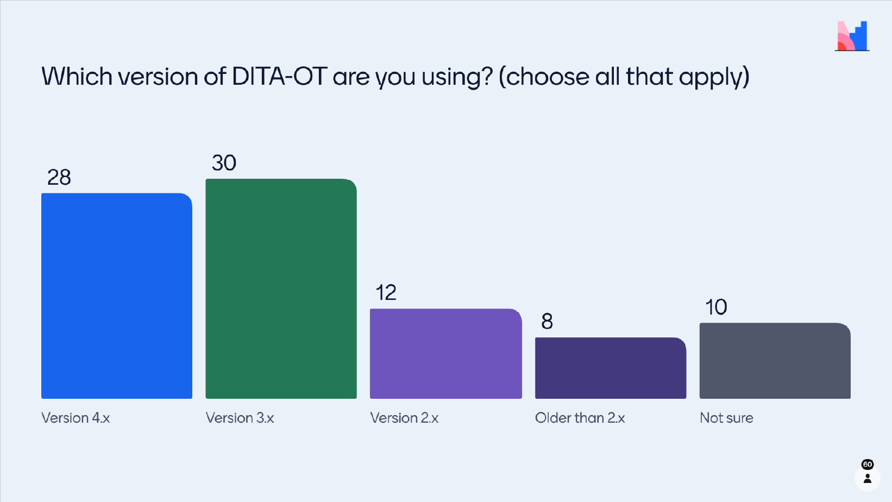
DITA-OT COMMUNITY – Survey results

Slide 33
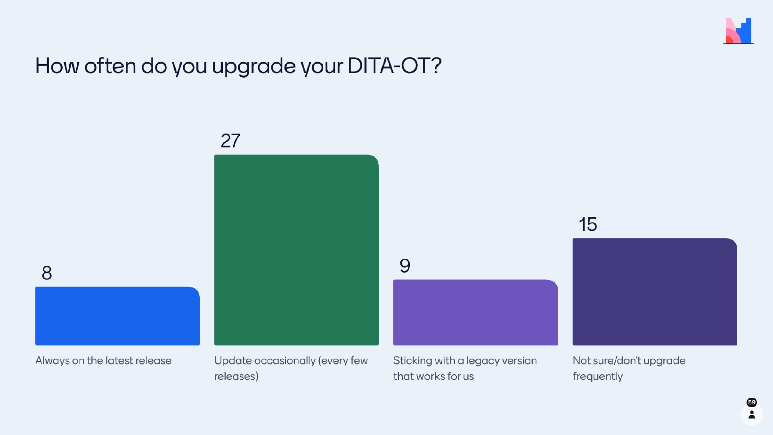
DITA-OT COMMUNITY – Survey results

Slide 34
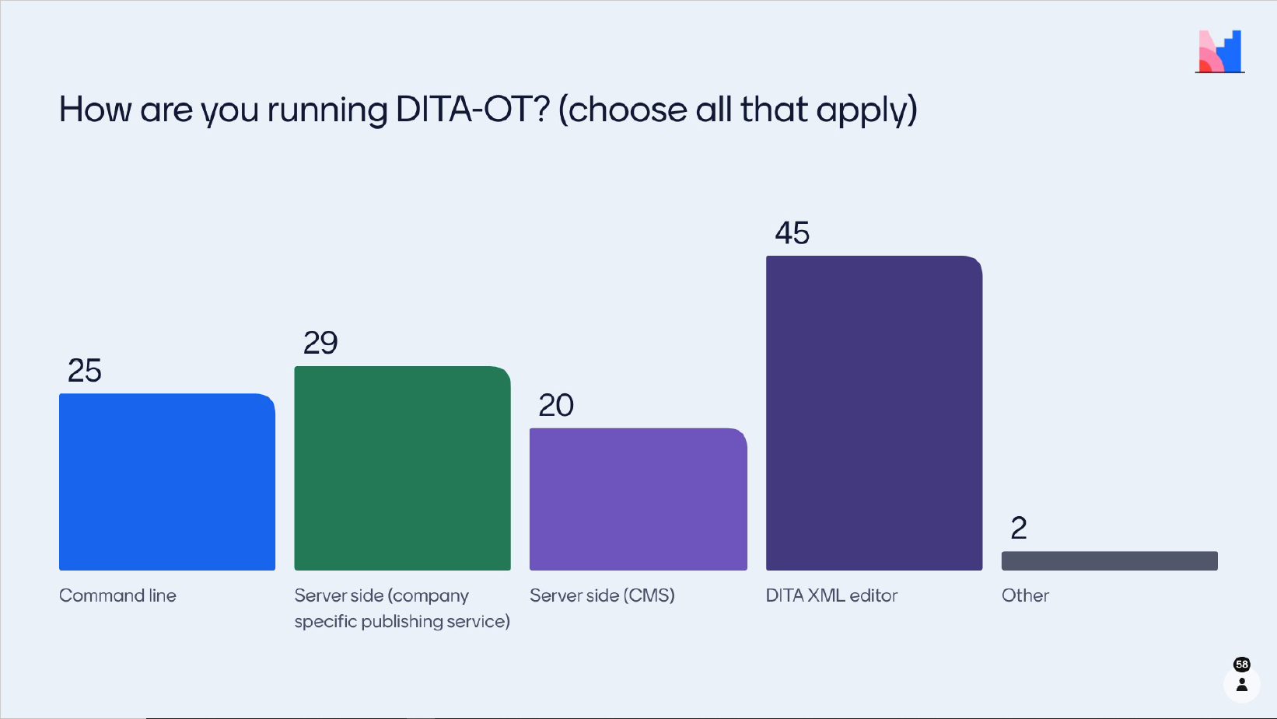
DITA-OT COMMUNITY – Survey results

Slide 35
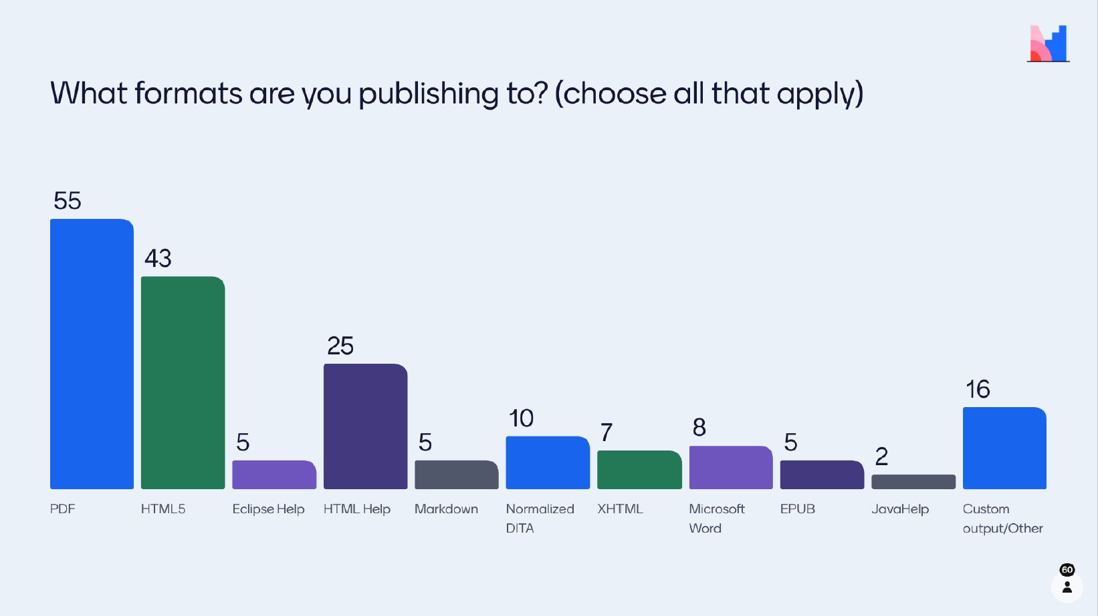
DITA-OT COMMUNITY – Survey results

Slide 36
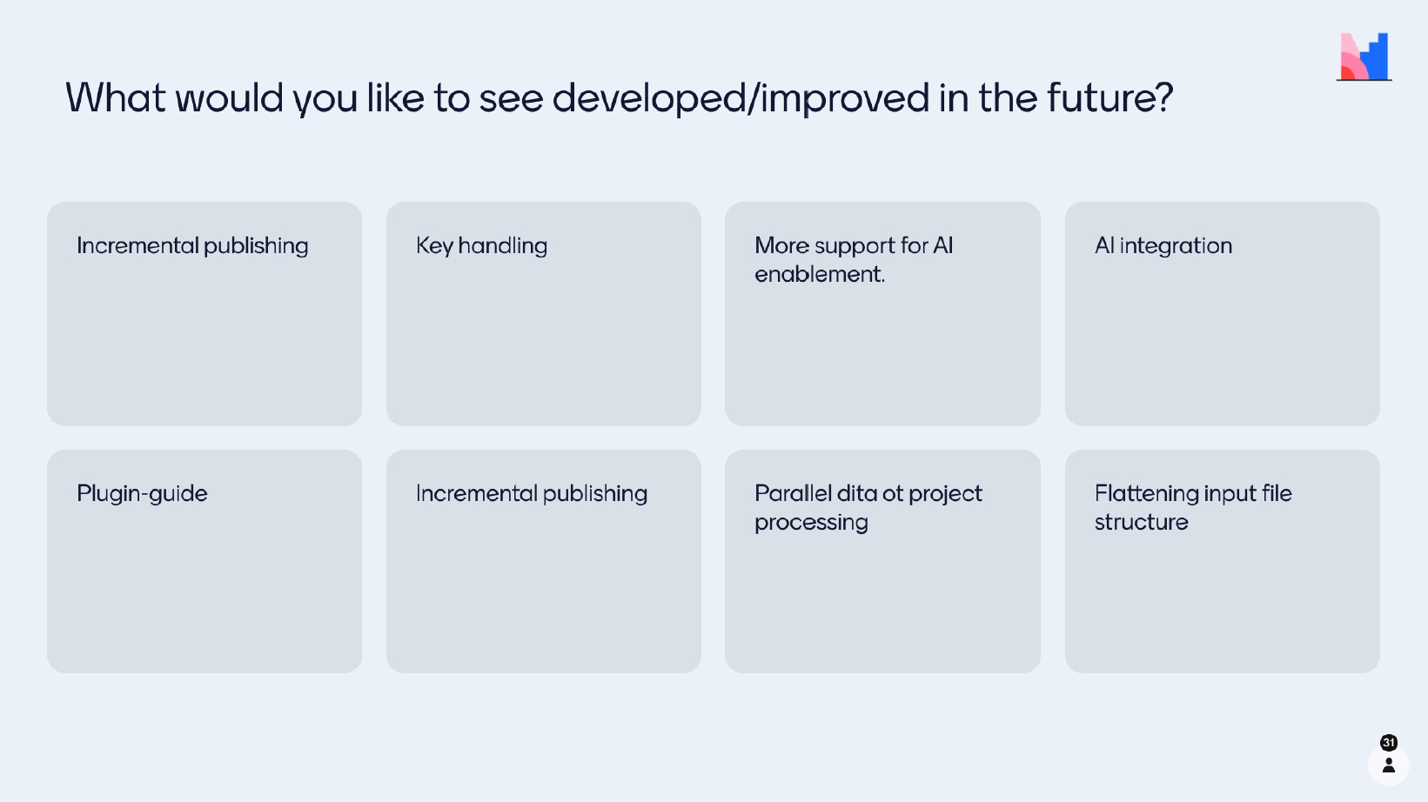
DITA-OT COMMUNITY – Survey results

Slide 37
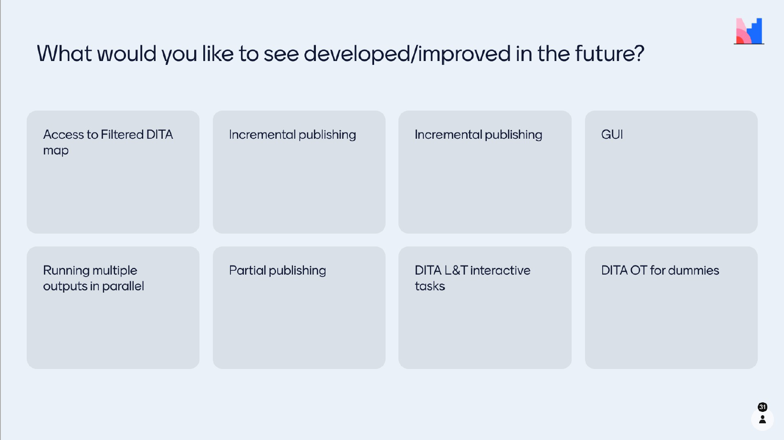
DITA-OT COMMUNITY – Survey results

Slide 38
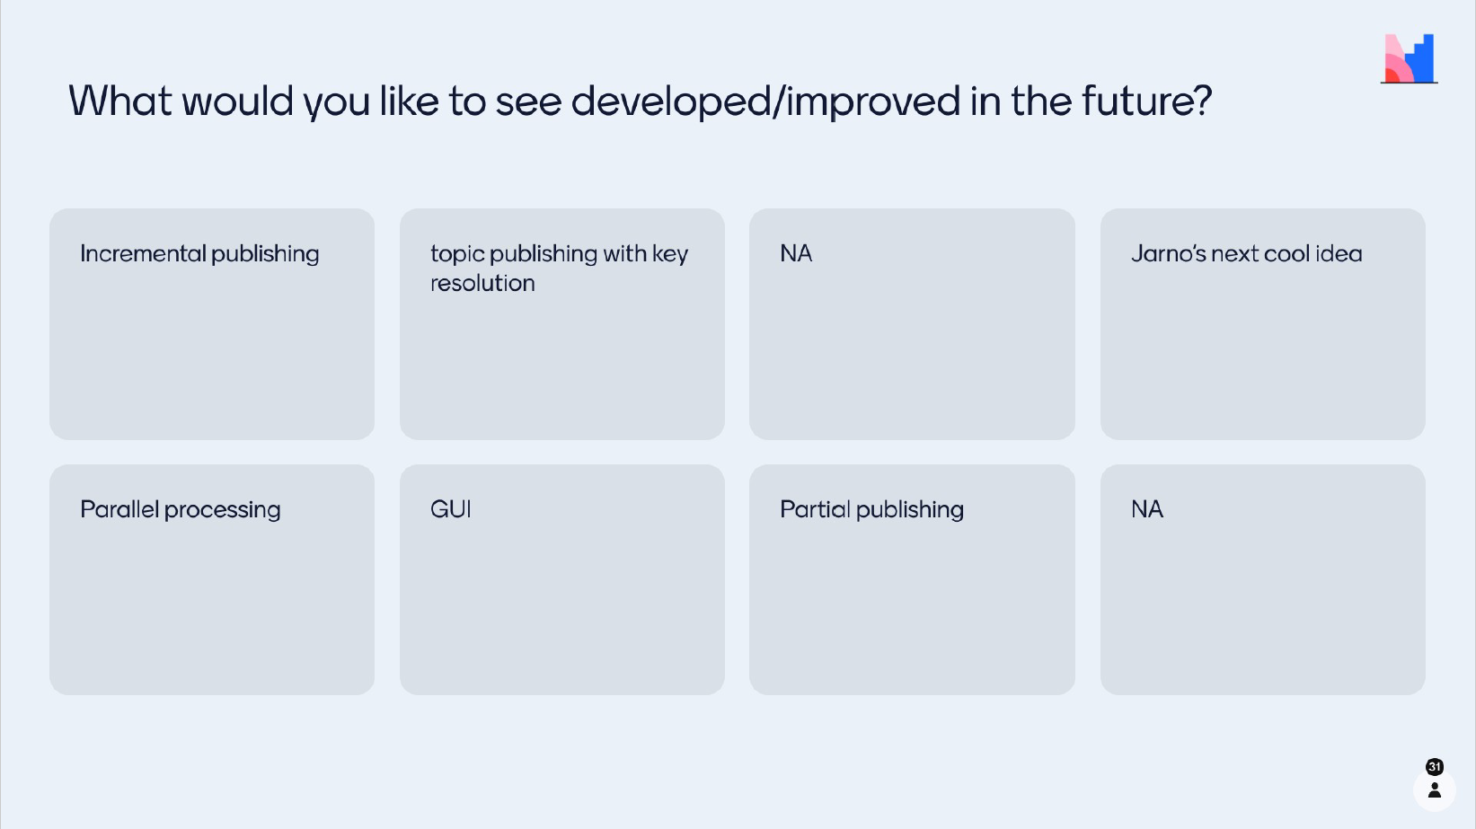
DITA-OT COMMUNITY – Survey results

Slide 39
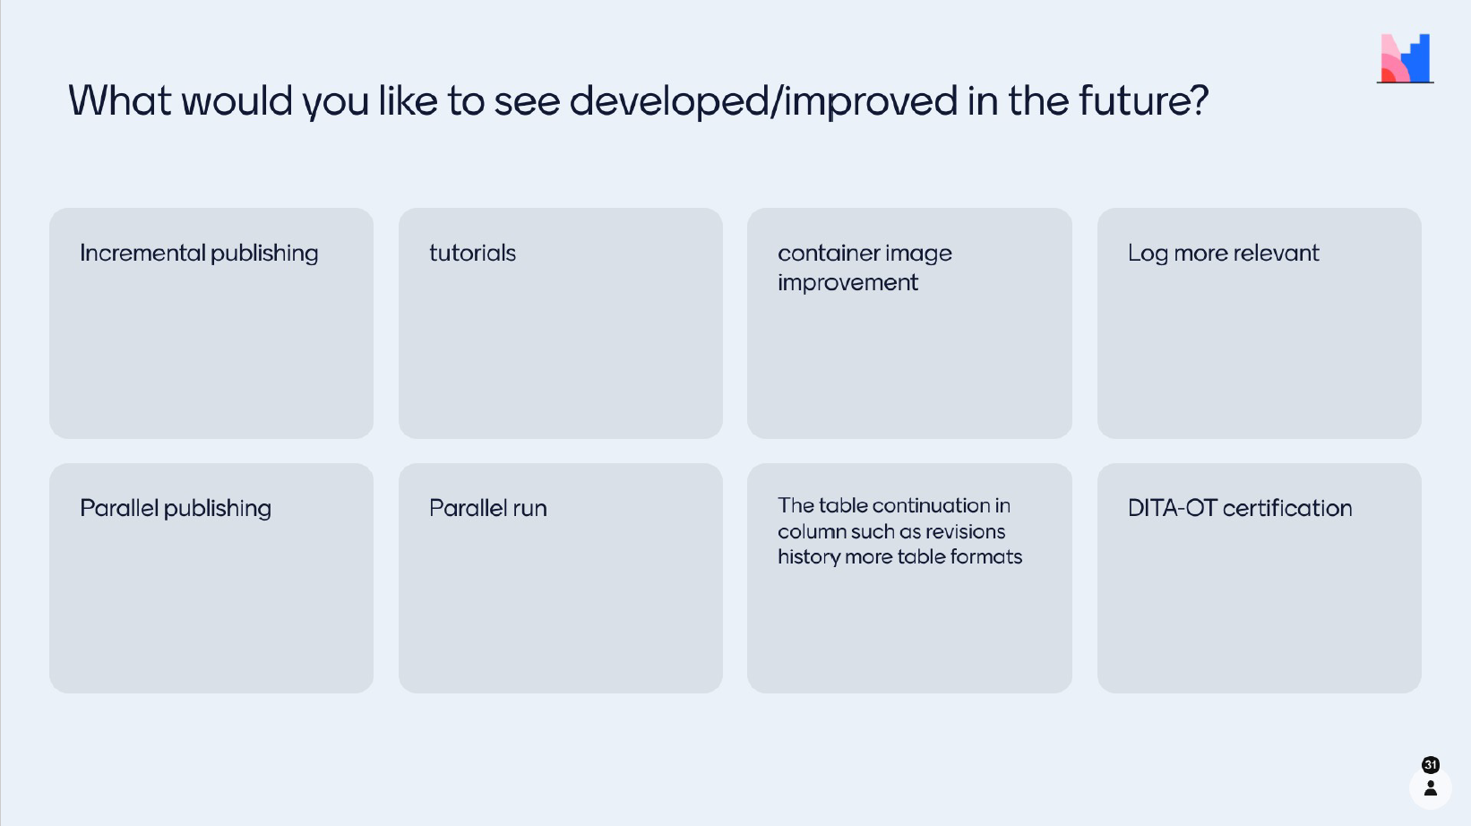
DITA-OT COMMUNITY – Survey results

Slide 40
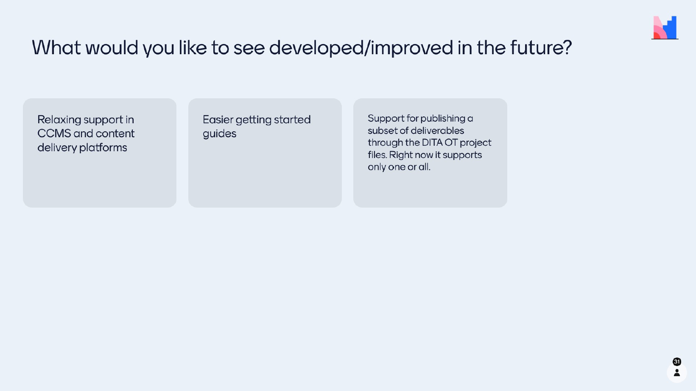
DITA-OT COMMUNITY – Survey results

Slide 41

THANK YOU
WELCOME TO DITA-OT COMMUNITY – Where Code meets Passion
Provide feedback about support channels and resources / IDEAS
LinkedIn
@e-mail

