Slide 1
Building an Ant-based environment around the DITA OT
Eric Sirois | February 16, 2025

Slide 2

Introduction
Output Generator Architecture
Build Process Walkthrough
Questions?

Slide 3


About Eric
Based in Toronto, Canada
Have spent 20+ years as a DITA developer at IBM and now as DITA Toolsmith at MadCap Software
Member of DITA Technical Committee
Developed XSD instance of DITA
Eric Sirois
Senior DITA Toolsmith
eric.sirois@ixiasoft.com

Slide 4



Output Generator Architecture
CCMS Web
Back to CCMS Web, Desktop or Scheduler
Network Share
or
Web Location
CCMS Desktop
Scheduler
Dynamic Publishing
Or
Custom Integrations
Output Generator
Fetching
Pre-processing
DITA OT
(output formats)
Post-processing
Packaging
IXIASOFT TEXTML Server (Content Store)

Slide 5
Output Generator Architecture (High-Level)
Java Code to extract content to disk
Apache Ant-based architecture
Launch DITA OTs via shell script
Bring you own DITA OT
Allows for pre/post-processing of content

Slide 6

Architecture
Java Code creates Ant Project
Setup build properties
  Output folder
  Output type
  Conductor File
  Ant target for selected output type
Export content from CCMS
Bundle Creation
Conductor Build File
Ant Build Targets
Atomic Bundles

Slide 7

Architecture
Contains one or more Ant Targets
Can override default DITA OT and/or Java
  That allows us to specify various JVMs for execution.
    Java 8 – DITA OT 1.x
    Java 8 or 11 – DITA OT 2.x
    Java 11 – DITA OT 3.x
    Java 17 – DITA OT 4.x
One conductor file per DITA OT
Set up all the parameters for the DITA OT
Creates the build script and properties
Bundle Creation
Conductor Build File
Ant Build Targets
Atomic Bundles

Slide 8
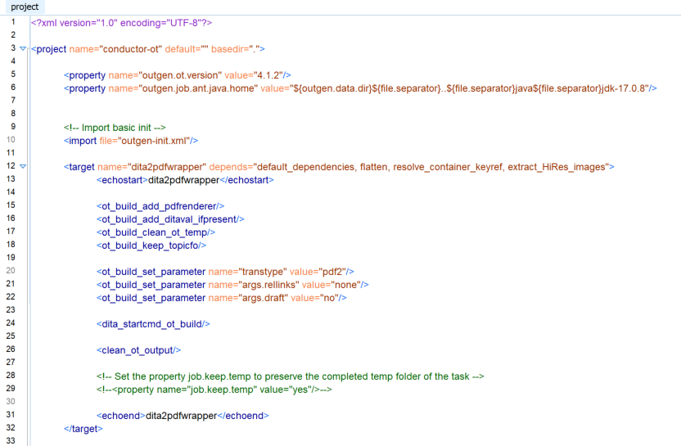
Architecture
Conductor Build File Example
Bundle Creation
Conductor Build File
Ant Build Targets
Atomic Bundles

Slide 9
Architecture
The Ant targets set up the content prior to calling the OT to process it.
Where you can call custom Ant tasks
Build the configuration for OT Jobs
  PDF Formatter
  OT Parameters for transtypes
Bundle Creation
Conductor Build File
Ant Build Targets
Atomic Bundles

Slide 10
Architecture
Ant Build Targets (continued)
Common tasks in our system are:
  Convert system keyrefs to href
    This is for OT performance and memory utilization
    User defined keys are left alone
  Predictable filenames and folder structure
  Image and resource preprocessing
  Cleanup @chunk on submap when creating a single output HTML file
  Generalize L&T map
  Push content to external sites
  Pull content from other silos
Bundle Creation
Conductor Build File
Ant Build Targets
Atomic Bundles

Slide 11
Architecture
Why an Atomic Bundle?
Repeatable Self-contained builds
  Easier to share with others
    Tools development and support
    External Vendors
  Extract all the content and its dependencies into a folder
Bundle Creation
Conductor Build File
Ant Build Targets
Atomic Bundles

Slide 12
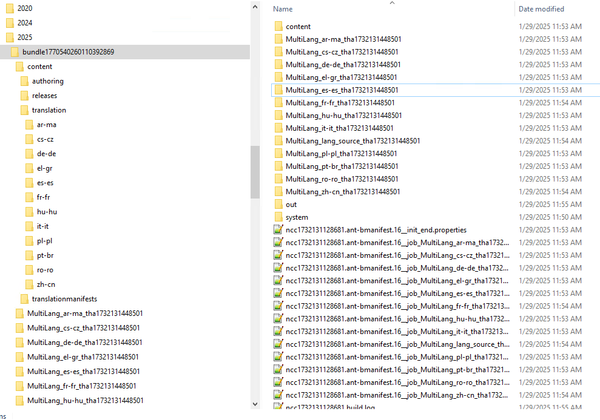

Slide 14
Eric Sirois – Senior DITA Toolsmith
eric.sirois@madcapsoftware.com

