Slide 1
DITA-OT in the Age of AI
Bridging Technical Writing and Artificial Intelligence
A presentation by
DITA-OT Day, 16 February 2025, Copenhagen

Slide 2
About The Presenter
Amit Siddhartha
Amit is a technology enthusiast, DITA-XML evangelist, and a serial entrepreneur working in the TechPub, EduTech, and FinTech domains. Currently, he is working as a CEO at METAPERCEPT TECHNOLOGY SERVICES (LLP).
Amit has worked in the Software Development, Information Architecture, DITA Implementation, and UI/UX areas offering various technological consulting to his clients across the globe.
DITA-OT Day, 16 February 2025, Copenhagen

Slide 3
DITA-OT is a powerful tool for AI-ready content because it enables structured, metadata-rich content generation. Adopting AI-enabled DITA workflows enhances technical publications for search, recommendation, and contextual AI interactions.
About This Presentation
Key takeaways – Enhancing DITA-OT through
Why DITA-OT Matters in AI-driven Content
Comparing DITA with Other Structured Formats
Role of DITA in Enhancing AI-driven Content Retrieval
Avoiding Hallucination in AI Responses with DITA
Future Prospects and Conclusion
DITA-OT Day, 16 February 2025, Copenhagen

Slide 4
How DITA Is Suitable For AI Enablement?
Accurate retrieval and hallucination-free responses, the content must be structured, modular, metadata-rich, and version-controlled. DITA-OT provides a well-organized content framework that ensures LLMs retrieve and generate fact-based, reliable responses. Some key reasons why DITA-OT is the best choice for feeding LLMs.
LLMs and Hallucinations
Content Granularity Prevents Information Overload
Topic-Based Organization for Intent-based Retrieval
Defined Information Types for Better Contextual Understanding
Rich Metadata Improves AI Retrieval Accuracy
DITA Indexing Enhances AI-powered Search
DITA-OT Supports AI-Friendly JSON Outputs
Improves RAG (Retrieval-Augmented Generation) Efficiency
DITA-OT Day, 16 February 2025, Copenhagen

Slide 5
DITA vs. Other Structured Formats
Feature | DITA-OT | Markdown | DocBook | Custom JSON/XML
Modularity
Reusability
Metadata Support
AI Ready Structuring
Specialization & Extensibility
AI Content Processing
DITA-OT Day, 16 February 2025, Copenhagen

Slide 6
Why DITA-OT Matters in AI-driven Content?
DITA-OT as an AI Enabler
Better AI Content Structuring – Modular, reusable, and structured topic-based authoring aligns with AI retrieval needs
More Accurate Information Retrieval - Semantic enrichment with metadata and tagging improve content contextualization
Hallucination-Free AI Responses - Enable better AI consumption due to intent-based DITA tags
DITA-OT Day, 16 February 2025, Copenhagen

Slide 7
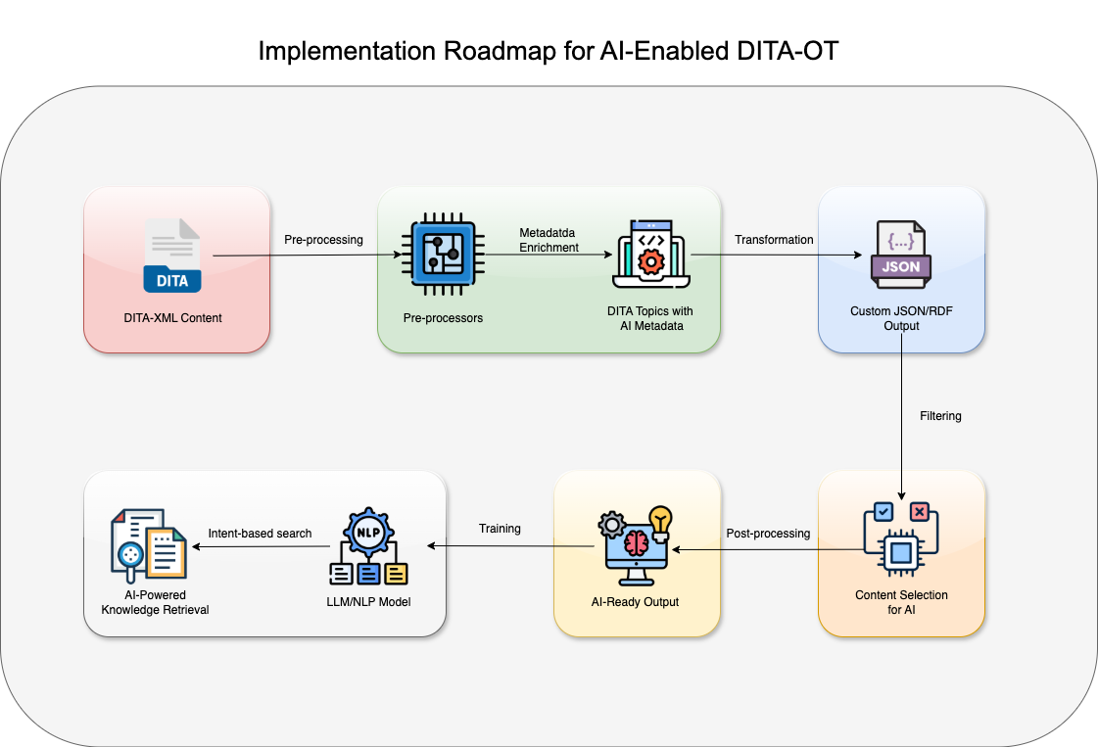
DITA-OT Day, 16 February 2025, Copenhagen

Slide 8
DITA-OT Libraries
org.dita.dost: Core processing engine.
org.dita.parser: Useful for parsing DITA files and extracting data.
DITA-OT Libraries and Plugins for AI
Recommended Plugins
dita-to-json: Converts DITA content into JSON for machine-readable formats.
rdf-output: Publishes DITA as RDF triples, useful for semantic web applications.
custom-metadata-plugin: Enhances DITA topics with custom AI-related metadata.
DITA-OT Day, 16 February 2025, Copenhagen

Slide 9
DITA-OT Libraries
org.dita.dost: Core processing engine.
org.dita.parser: Useful for parsing DITA files and extracting data.
DITA-OT Libraries and Plugins for AI
Recommended Plugins
dita-to-json: Converts DITA content into JSON for machine-readable formats.
rdf-output: Publishes DITA as RDF triples, useful for semantic web applications.
custom-metadata-plugin: Enhances DITA topics with custom AI-related metadata.

Slide 10
Essential DITA-OT Plugins For AI-Enabled Content Transformation
Core DITA-OT Libraries
Plugin Name | Purpose
org.dita.pdf2 | AI-driven content summarization in PDFs
org.dita.html5 | AI-friendly structured web output
org.dita.markdown | Lightweight AI-ready format
org.dita.json | AI/NLP-ready structured format
DITA-OT Day, 16 February 2025, Copenhagen

Slide 11
By leveraging DITA-OT’s structured framework, AI models can:
Retrieve structured content faster via modular DITA topics.
Avoid hallucinations by sourcing content from tagged, authoritative topics.
Improve AI-driven search and recommendations via metadata-rich indexing.
Generate intelligent responses using structured JSON and vectorized representations.
Final Thoughts
DITA-OT Day, 16 February 2025, Copenhagen

Slide 12
Questions?
Suggestions?
DITA-OT Day, 16 February 2025, Copenhagen

Slide 13
Thank you!
Email
info@metapercept.com
Phone
+91-839-090-5726
+91-742-096-5726
Website
https://metapercept.com
DITA-OT Day, 16 February 2025, Copenhagen

