Slide 1
Search, Style and More
Extending DITA Bootstrap
Jason Fox (FIWARE Foundation)

Slide 2
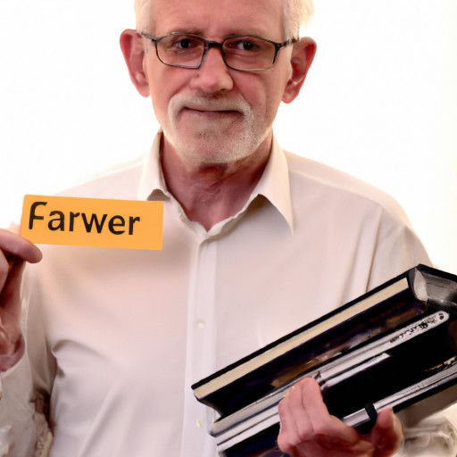
Who am I ?
FIWARE Senior Technical Evangelist

Slide 3
What is my motivation?
Cares if an ethical gent or evil swine

Slide 4
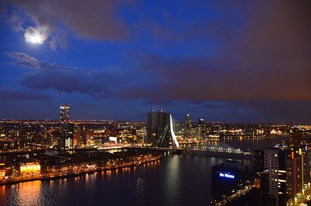

Slide 5
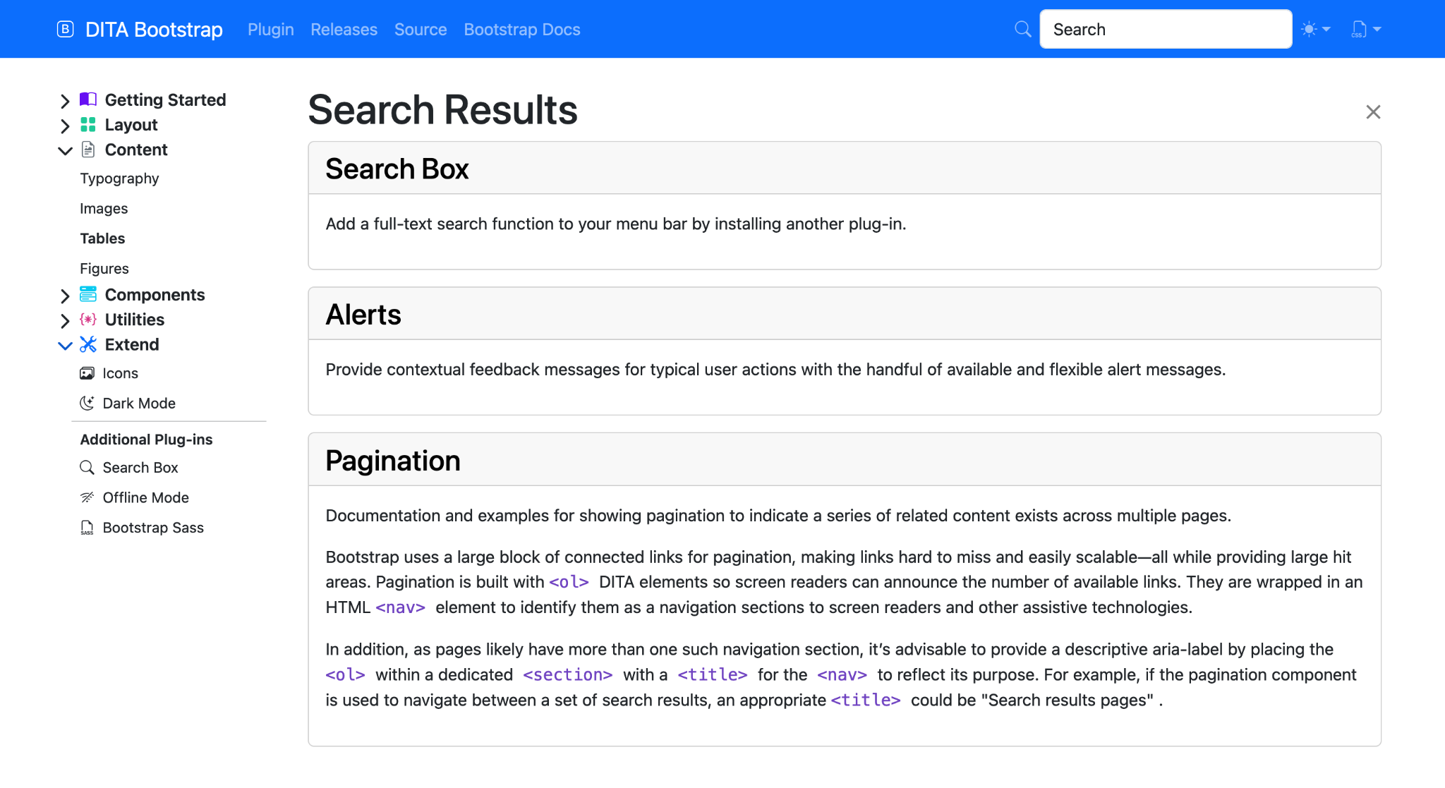
The Missing DITA-OT Search Box
See: https://github.com/infotexture/dita-bootstrap.lunr

Slide 6
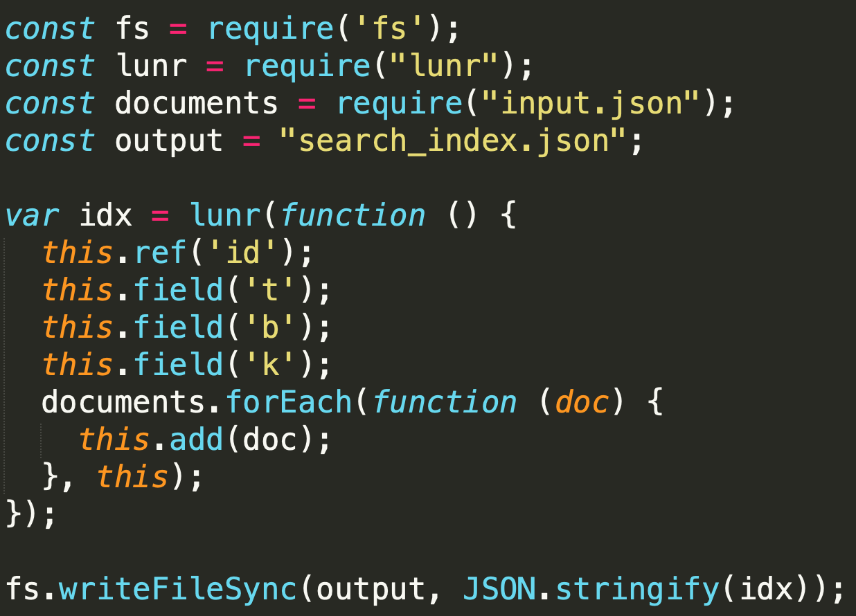
DITA-Bootstrap Lunr Processing: "But I want to be able to search"
XSL to extract all texts from each *.dita file
XSL to merge all files into a single massive XML to work with
Create two files:
list of unique ids each with a preview HTML
list of unique ids each with the raw page of text
Use lunr.js and node to generate a search index.
Push the following to output:
search_index.json
preview.json
lunr-client.js

Slide 7
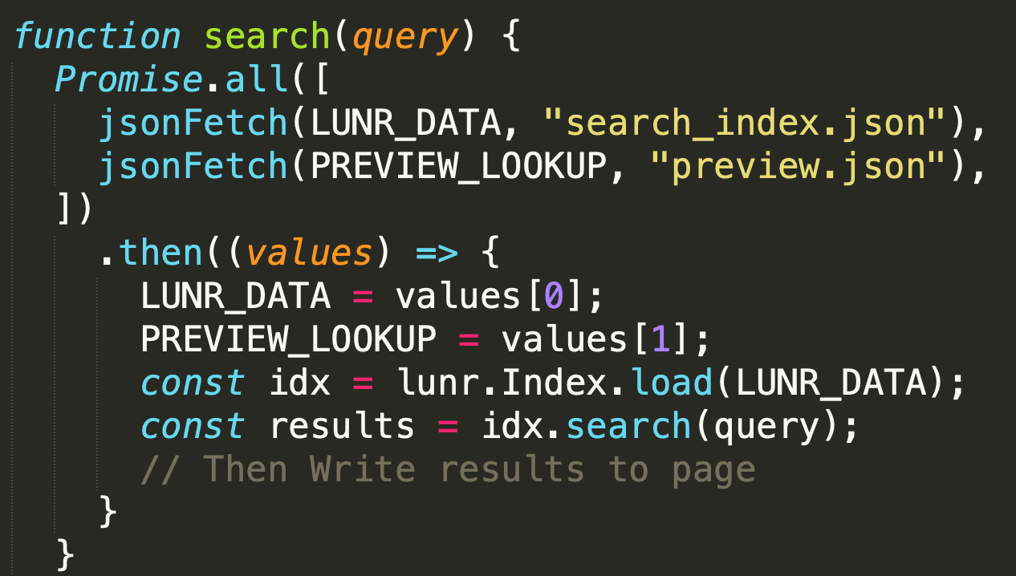
DITA-Bootstrap Lunr Client: "But I want to display results"
Unobtrusive JavaScript to listen to Search Box data entry
Make a lunr.js search request.
Display the results on screen as Bootstrap Cards
Need internationalization for Results and Search found no results

Slide 8
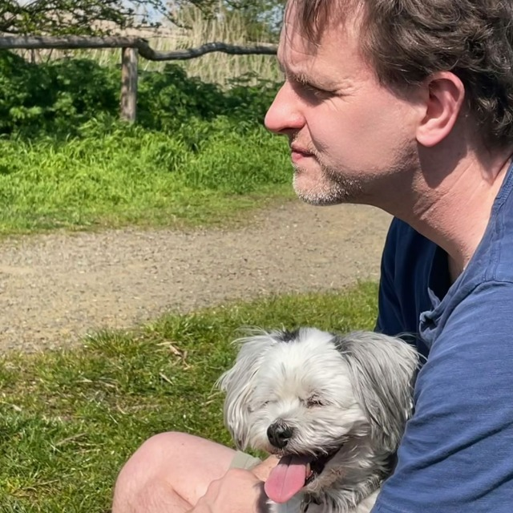
More about me …
This is my dog
Tämä on minun koirani
Das ist mein Hund
I like dogs
Pidän koirista
Ich mag Hunde
I do not own a cat
En omista kissa
Ich besitze keine Katze
This is my dog
Tämä on minun koirani
Das ist mein Hund
I like dogs
Pidän koirista
Ich mag Hunde
I do not own a cat
En omista kissa
Ich besitze keine Katze

Slide 9
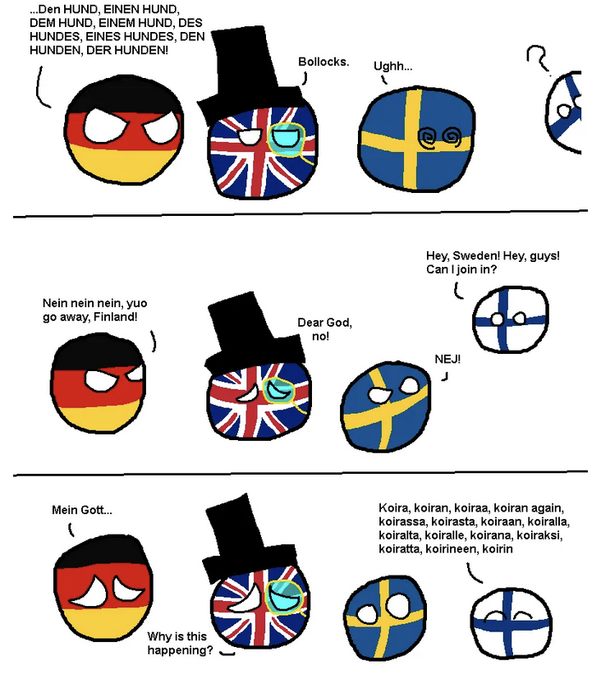
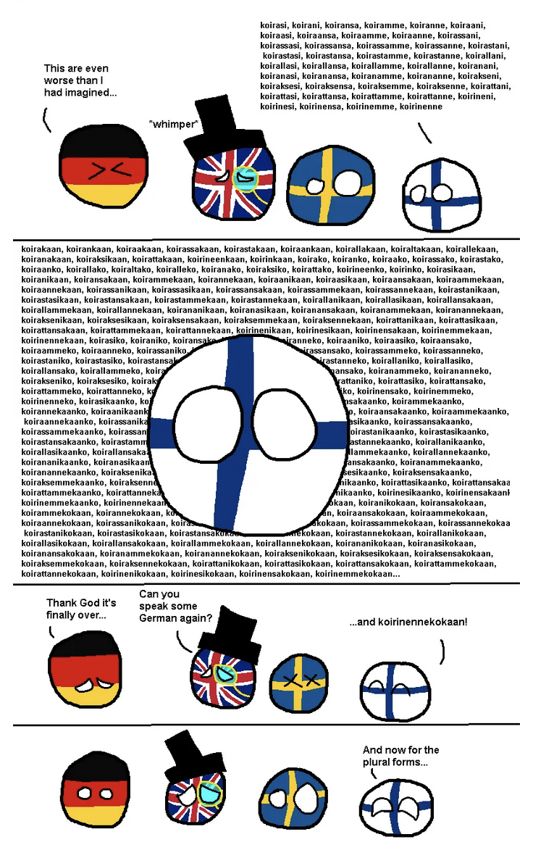
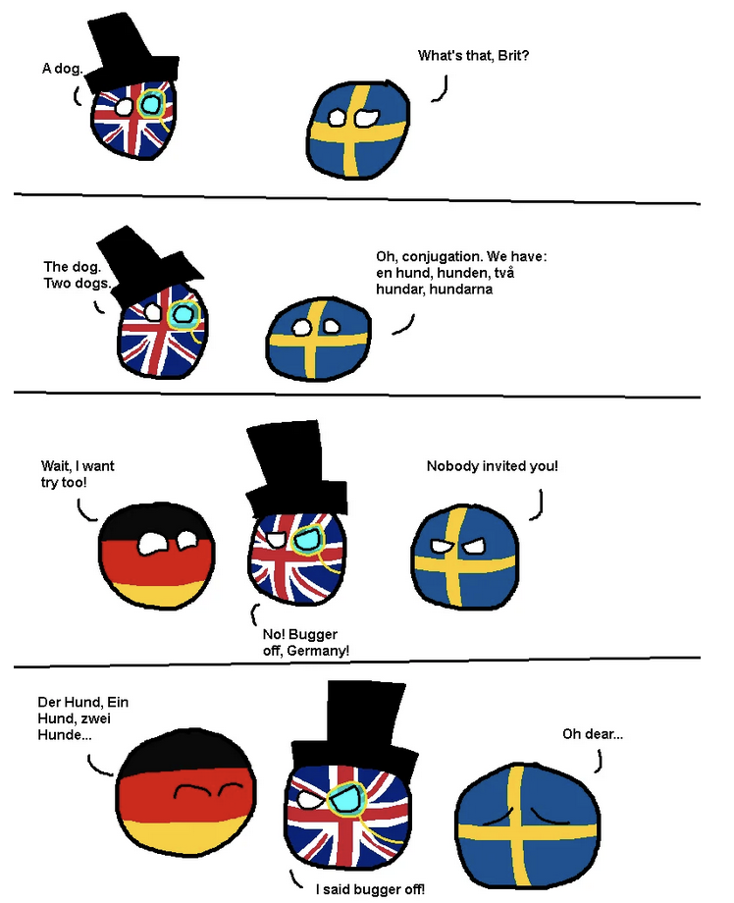
Stop Words and Language Stemming for Search: Dog = Dogs

Slide 10
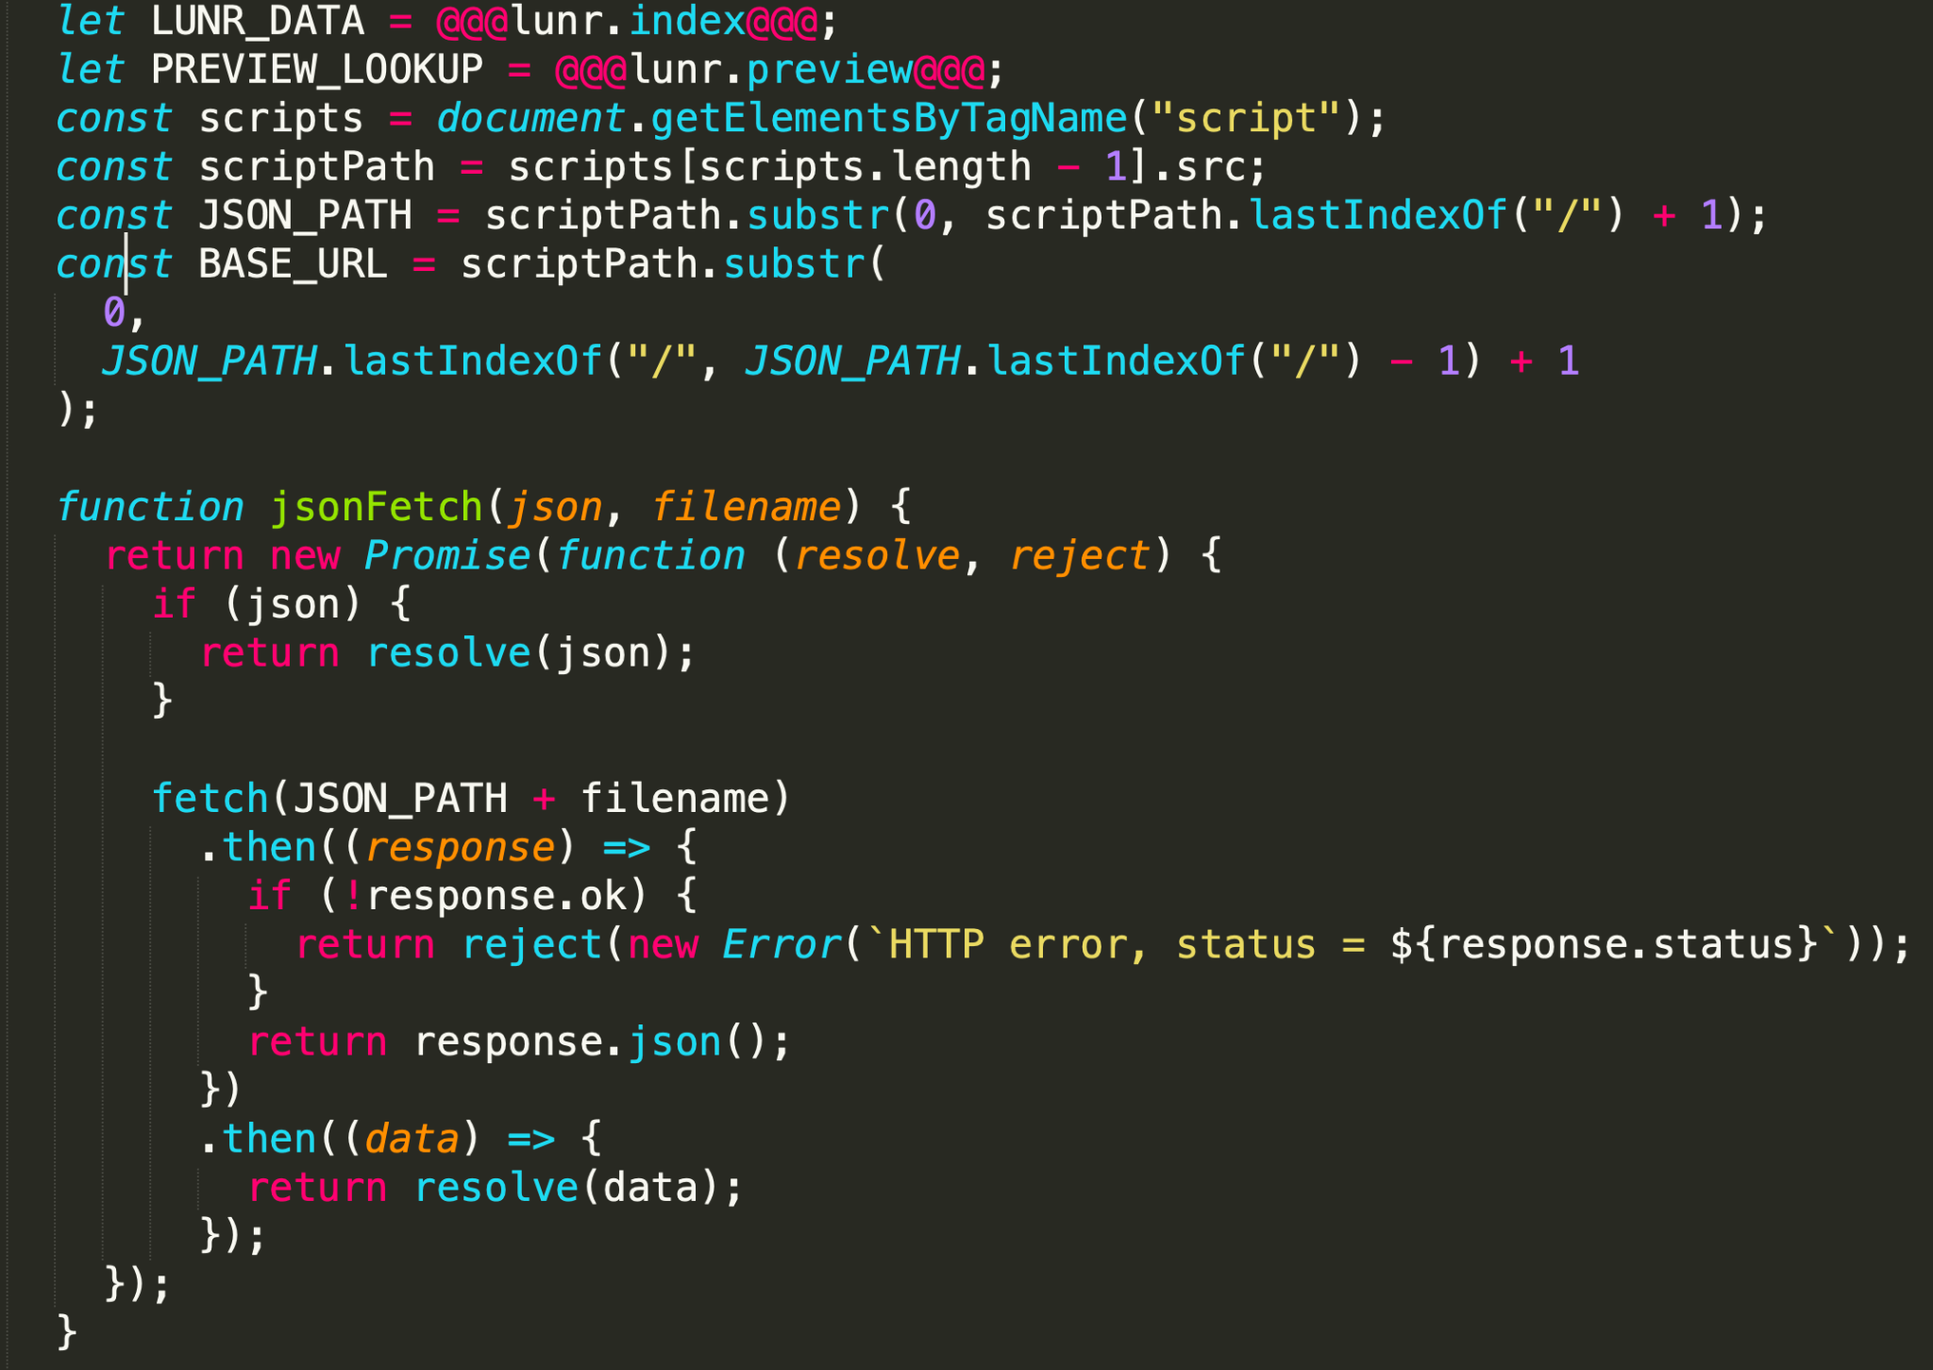
DITA-Bootstrap Lunr Client: "But I want it offline"
JavaScript fetch() only works
if using HTTP.
Instead of generating separate
search_index.json and
preview.json files, stuff the full
search index and preview data
into the lunr.client.js file.
Makes lunr.client.js unnecessarily
large, but it works.

Slide 11
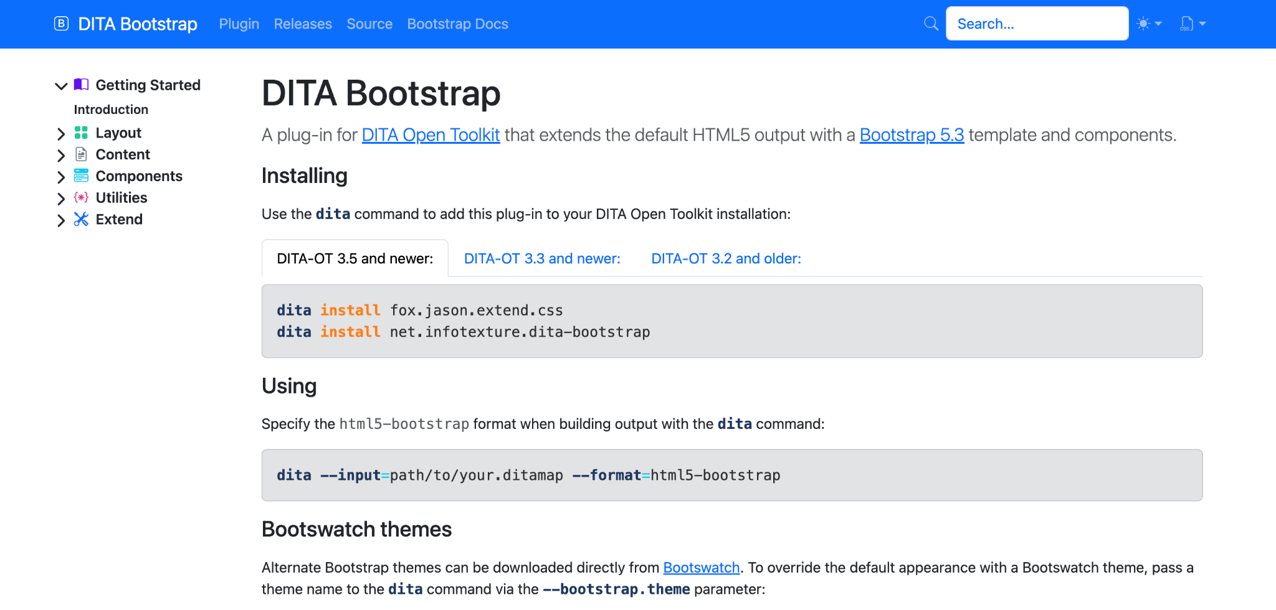
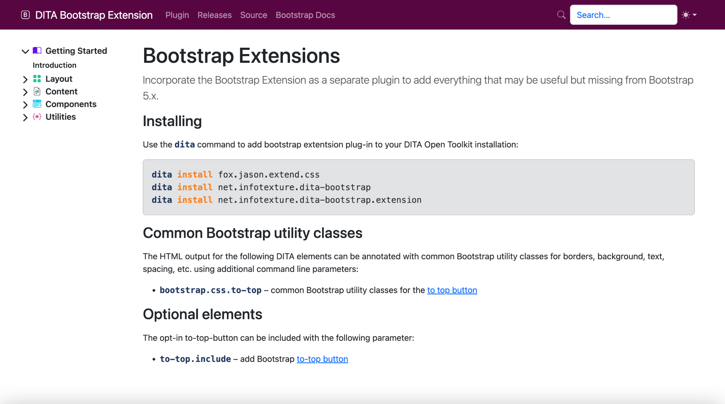
Clone Pages: Why are all Bootstrap Websites so boring?

Slide 12
Bootswatch Themes - Distinctive Themes for Bootstrap https://bootswatch.com/
… and lots more

Slide 13
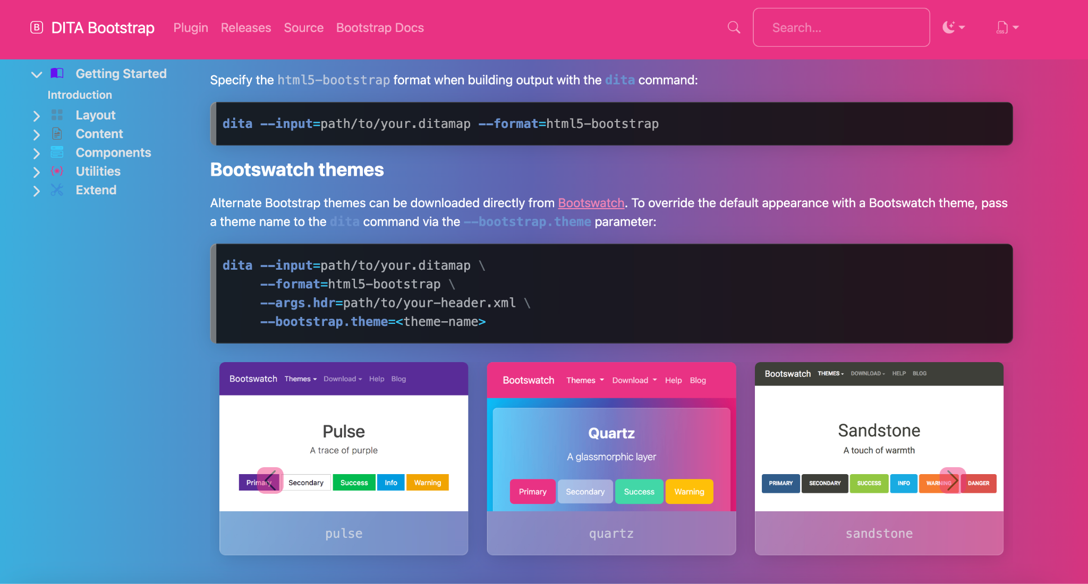
Pick a Bootswatch theme with the --bootstrap.theme parameter,
and the CDN CSS is automatically injected in the header
--bootstrap.theme=quartz

Slide 14
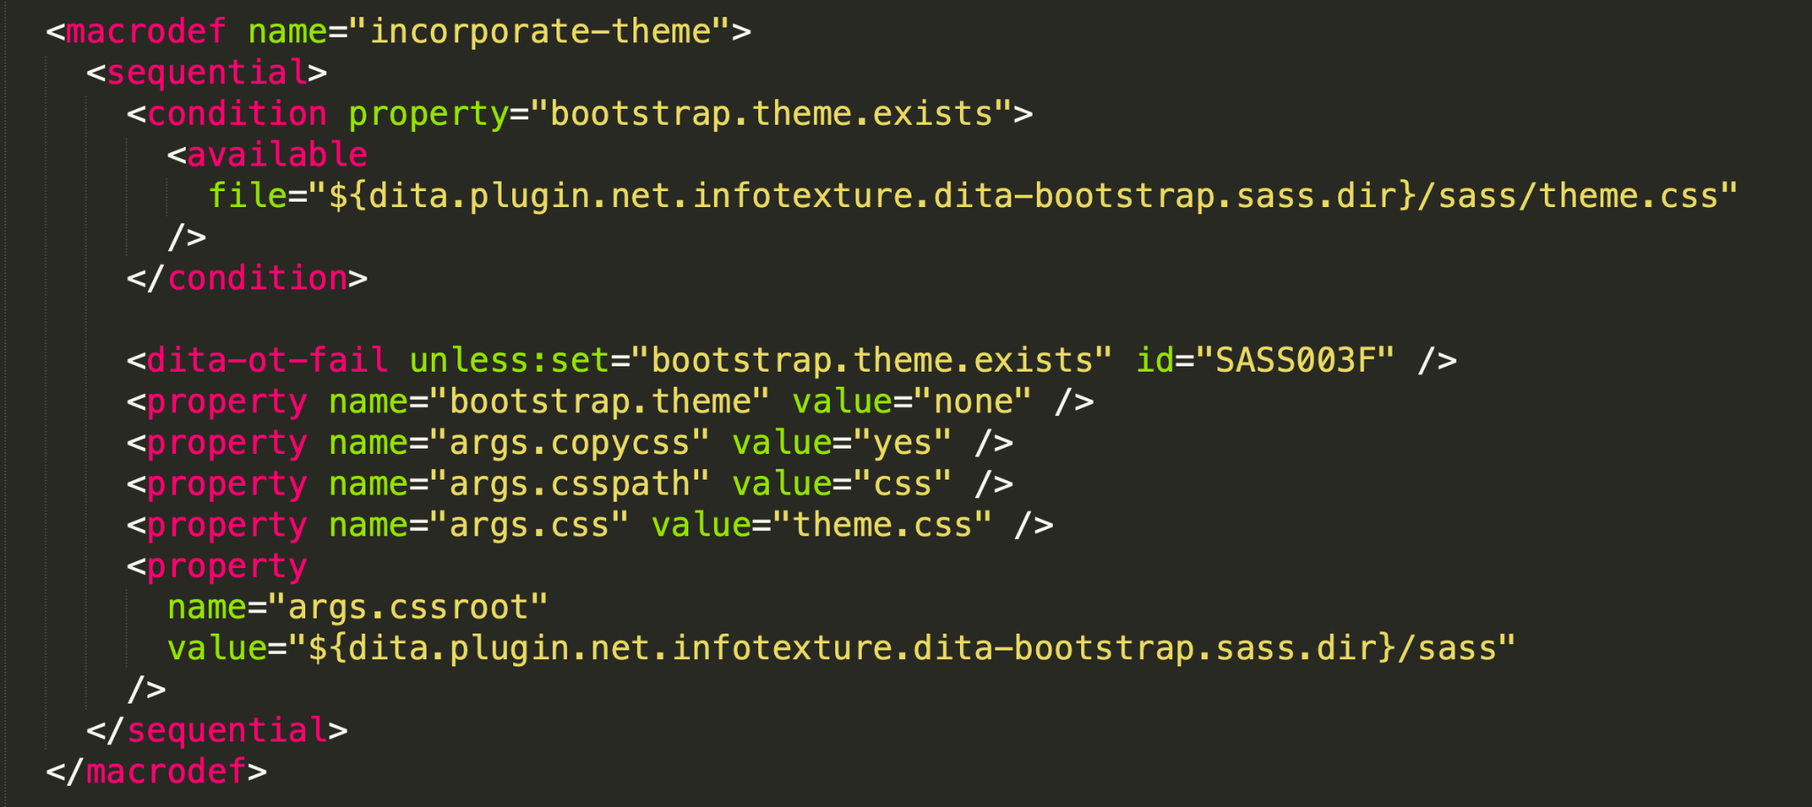
DITA-Bootstrap SASS: "But I want the docs using our branding and style"
https://github.com/infotexture/dita-bootstrap.sass
Take a Bootswatch theme and amend SASS to change colours.
Rebuild CSS to theme.css
(separate DITA transform which invokes Node-Sass)
Amend header to use theme.css in preference to Bootswatch CDN
(run incorporate-theme as part of bootstrap.process.pre to do this)

Slide 15
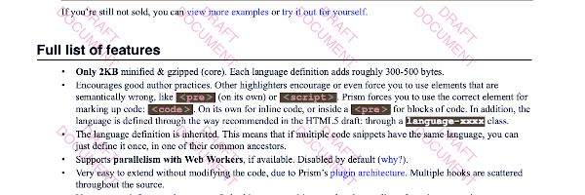
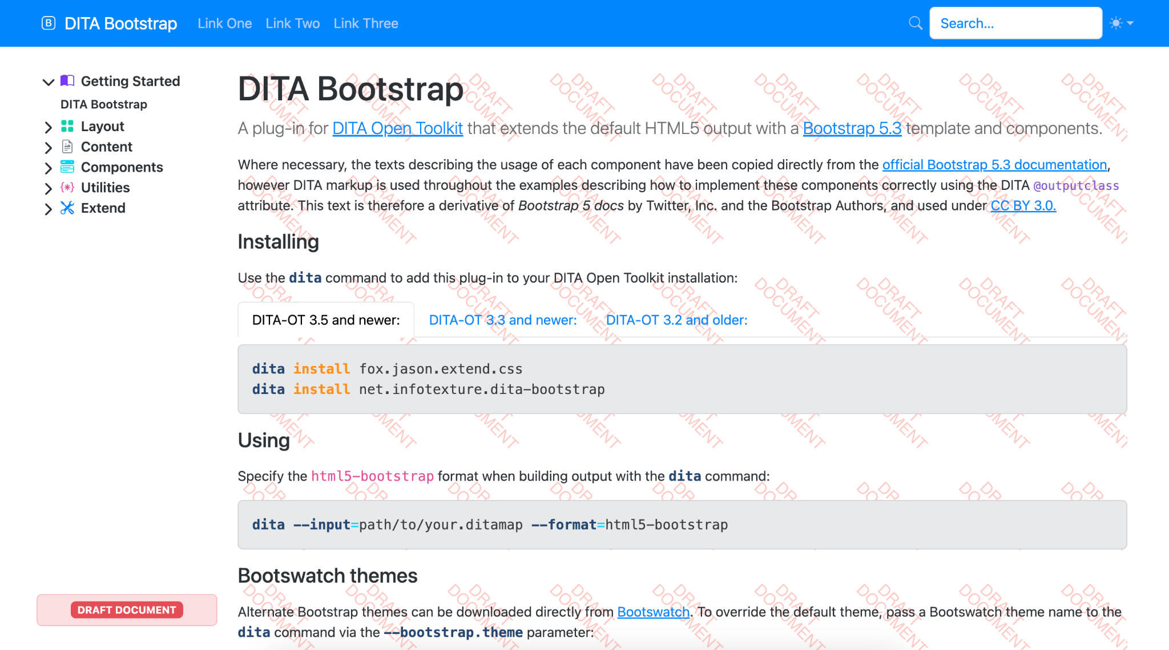
Watermarking: Now it looks stylish, make it uglier
See https://github.com/jason-fox/fox.jason.watermark
Use extend.css.process to inject CSS
Use bootstrap.process.pre to override bootstrap.sidebar.ftr
See https://github.com/jason-fox/dita-bootstrap.watermark

Slide 16
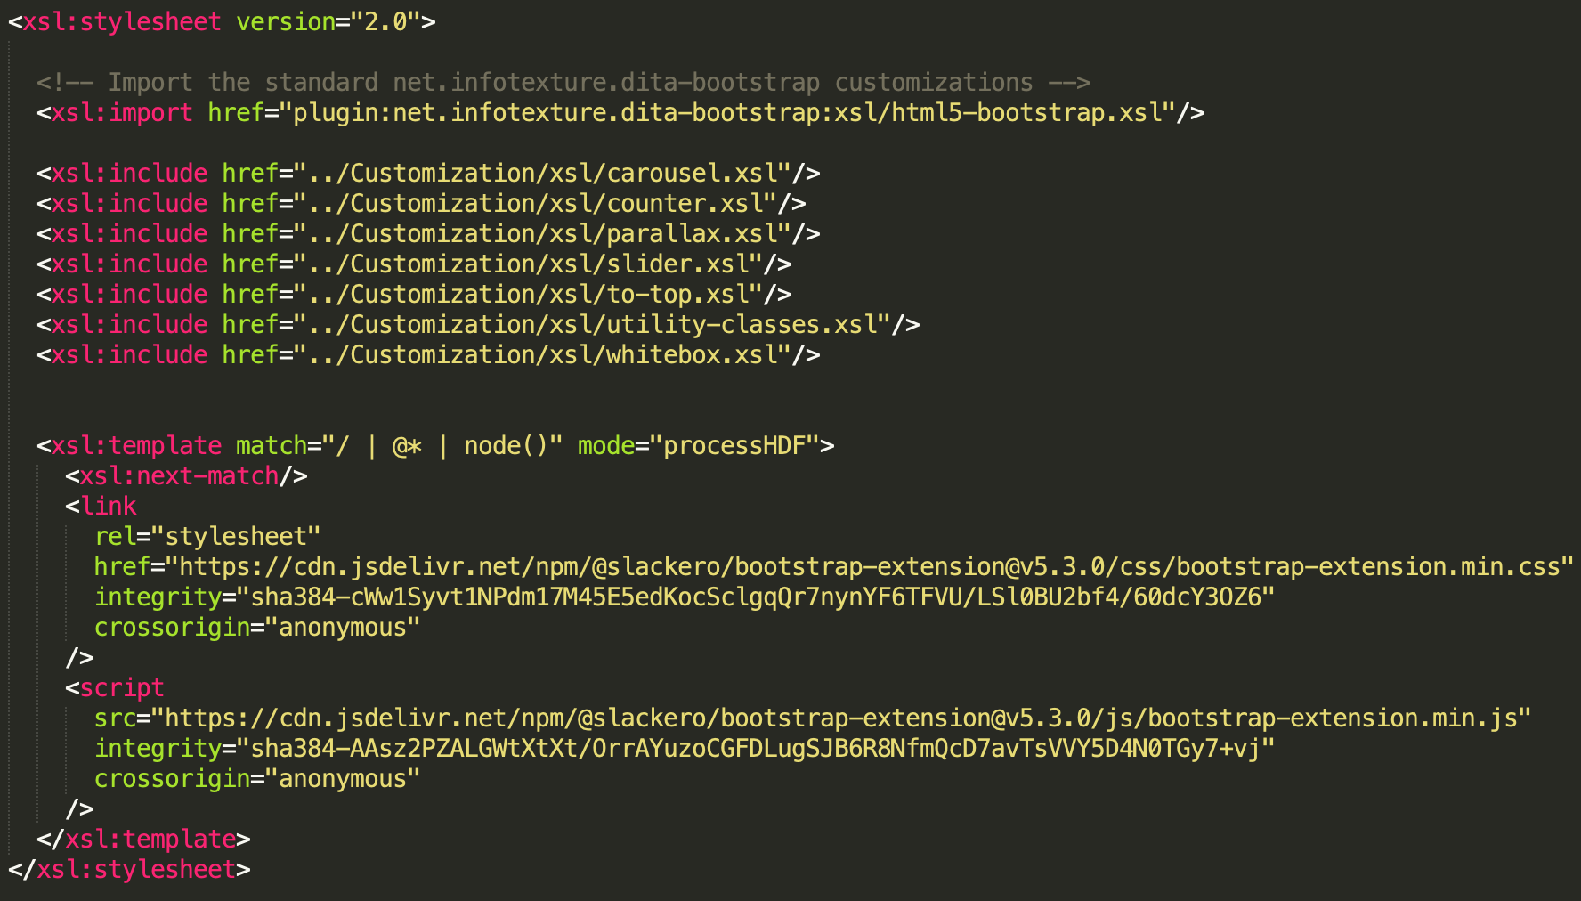
Additional Missing Bootstrap Functions
Parallax, Greyscale, Sliders, Whitebox Gallery etc.
Use bootstrap.process.pre to override args.xsl and
<xml:import href="
plugin:net.infotexture.
dita-bootstrap:xsl
/html5-bootstrap.xsl"/> to include standard DITA Bootstrap
Add a processHDF function to add more JavaScript and CSS to the header
Remember to include an <xsl:next-match/> call.
See https://github.com/jason-fox/dita-bootstrap.extension

