Slide 1
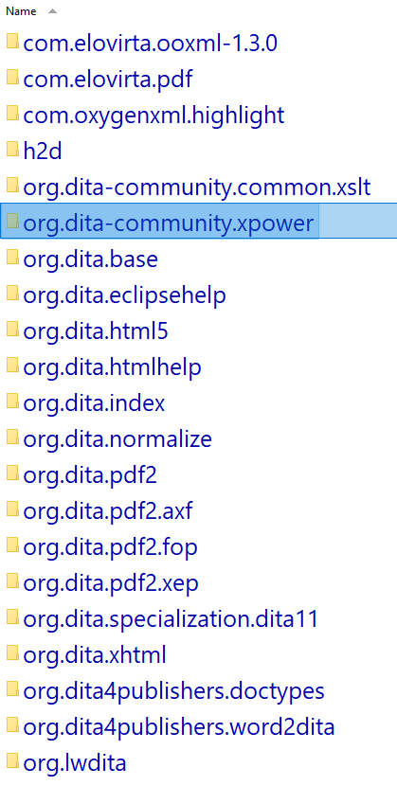

Dita-OT – How far can you go?
Dipl. Ing Helmut Scherzer
Security Analyst
helmut@hscherzer.de

Slide 2
Announcing … Open Source
available March 2024
Dipl. Ing Helmut Scherzer
Security Analyst
helmut@hscherzer.de

Slide 3
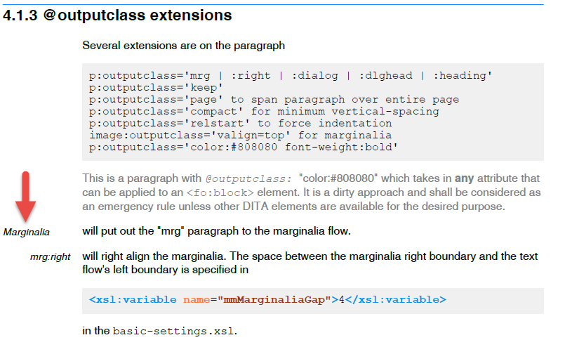
Extensions to Paragraph Marginalia

Slide 4
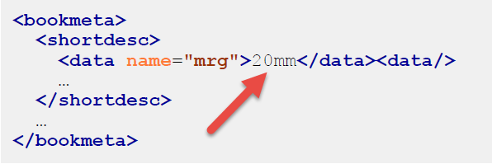
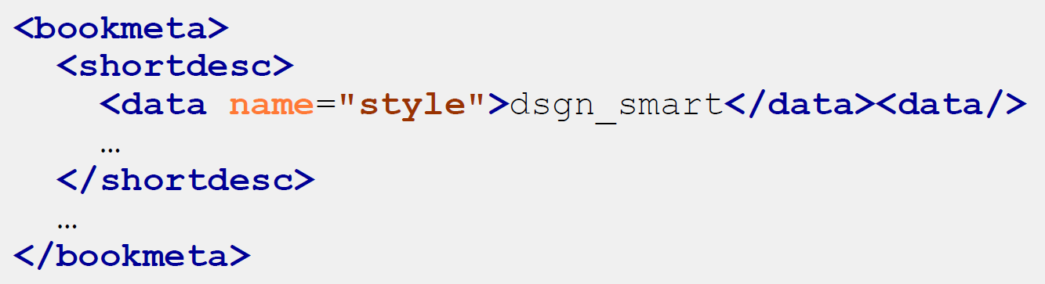
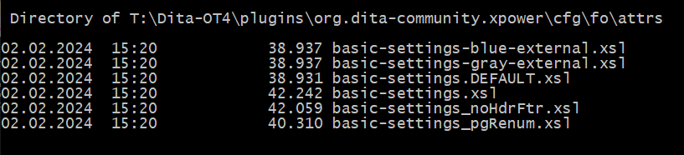
Extensions to Paragraph Marginalia-Spacing
…defined in .ditamap/.../bookmeta
… or as reference to a design profile
.ditamap
.ditamap
Design Identifier

Slide 5

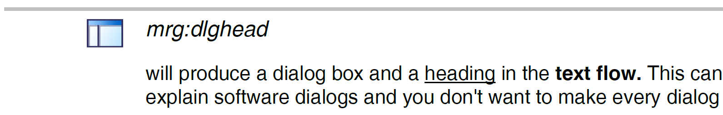

Extensions to Paragraph Marginalia

Slide 6
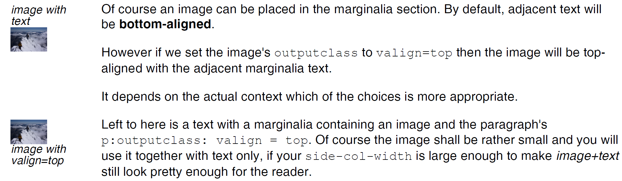
Extensions to Paragraph Marginalia

Slide 7
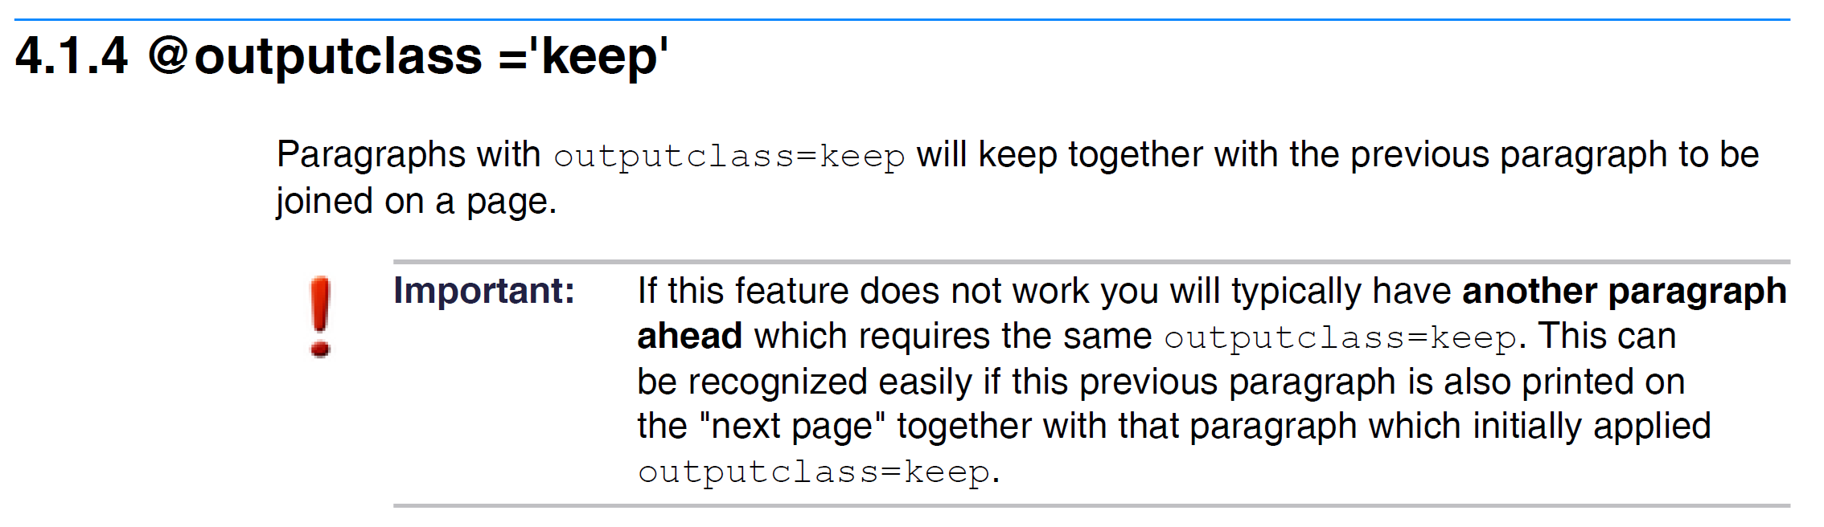
Extensions to Paragraph Keep paragraphs together

Slide 8
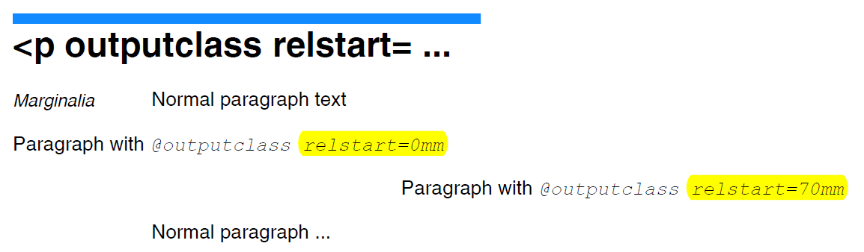
Extensions to Paragraph Enforce paragraph left position
"relstart=0mm"
can also be achieved with
<p outputclass="page">
70 mm

Slide 9
Extensions to Paragraph "New Line" Feature
"<p ... compact" avoids spacing paragraphs
<p>This is the first paragraph</p>
<p>This is the second paragraph</p>
<p outputclass="compact">This is the third paragraph</p>
This is the first paragraph
This is the second paragraph
This is the third paragraph

Slide 10
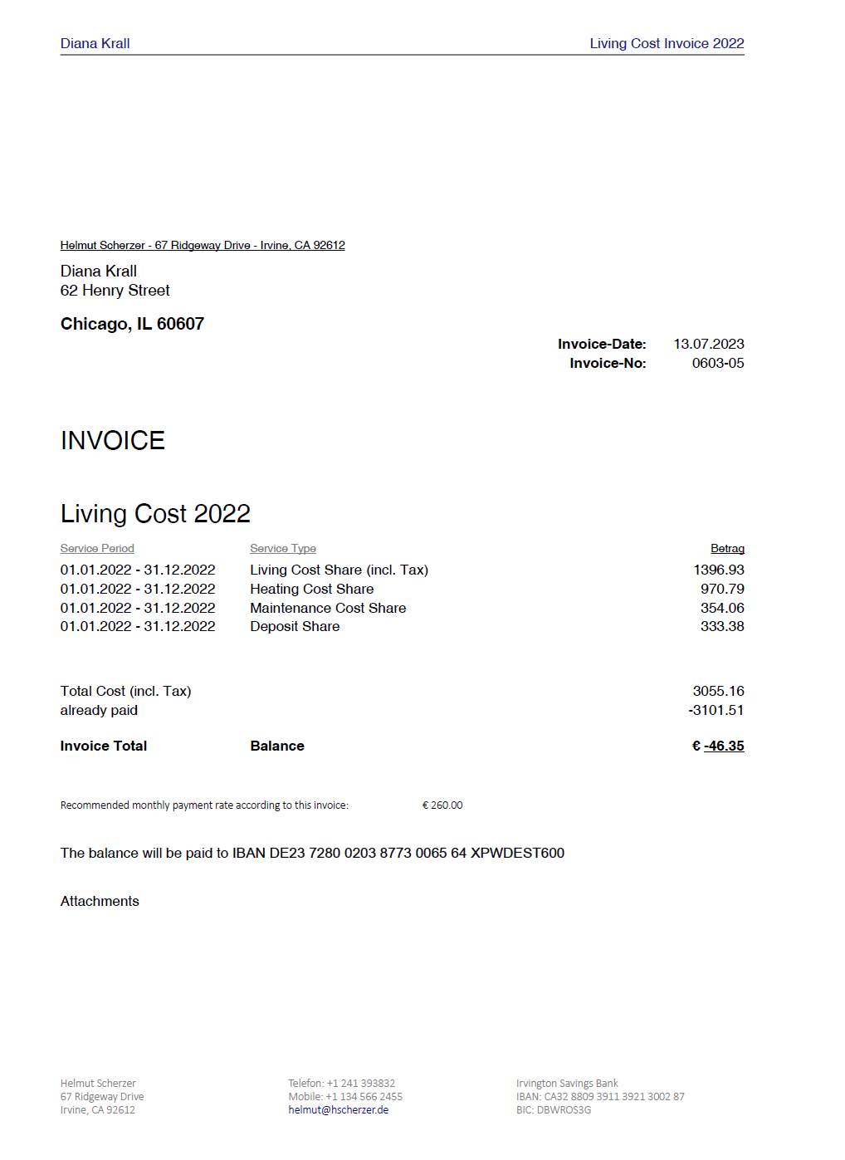
Extensions to Paragraph "<p>" on absolute page position
<p @outputclass="abspos=150mm"> ... </p> places paragraph 150mm below top-margin
150mm
Perfect for
"Creating letters with DITA"

Slide 11
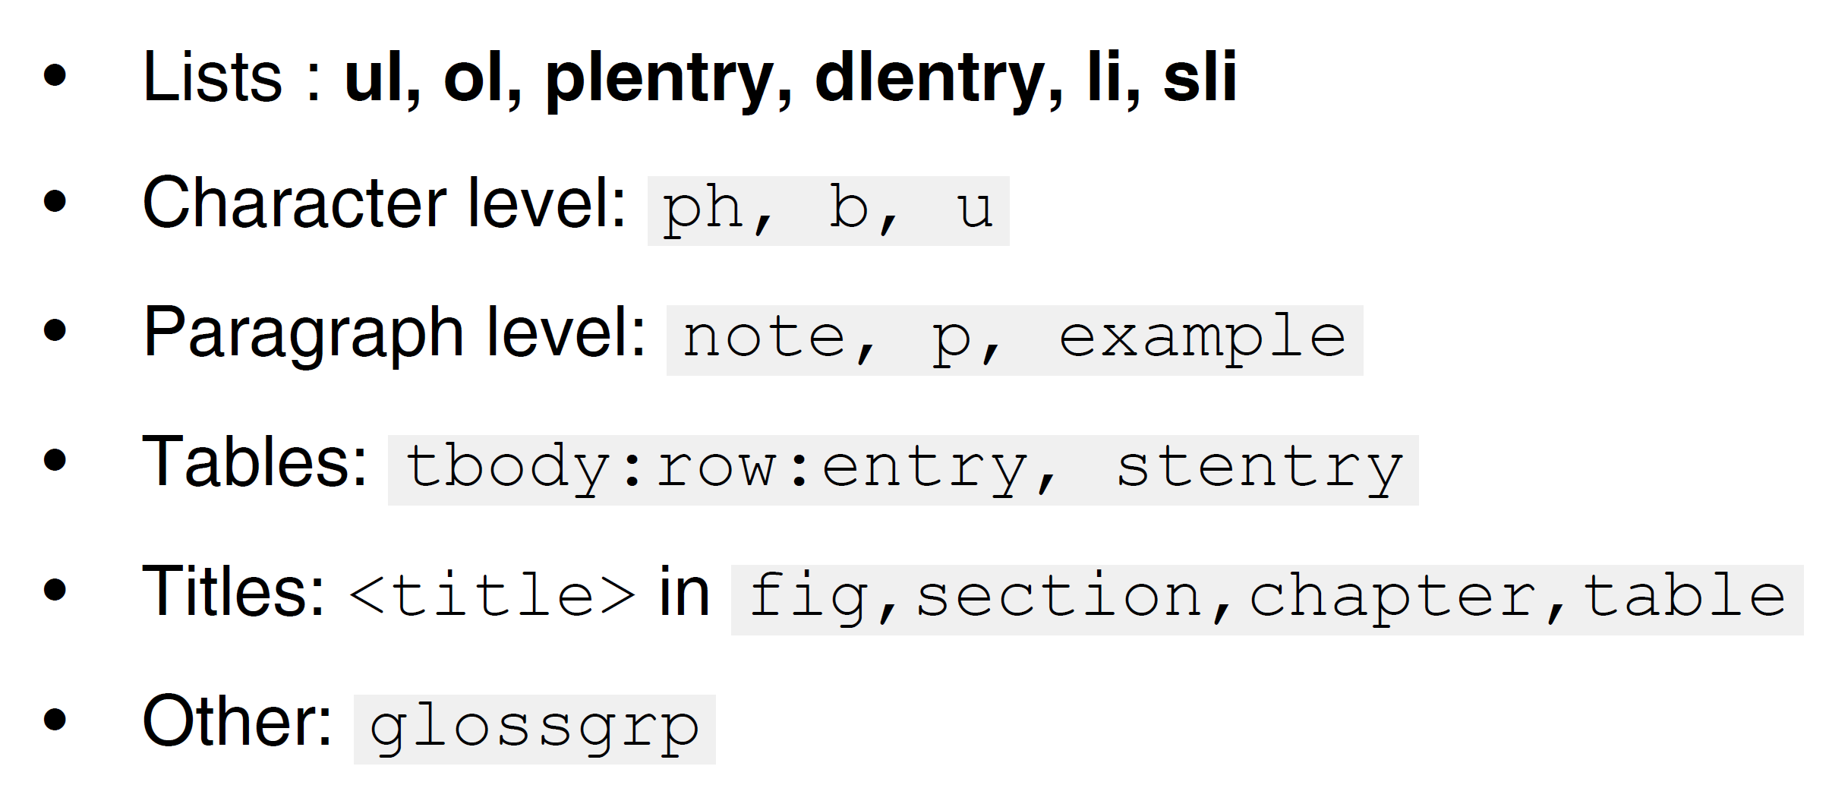
Extensions to Styling Instant fo-Attributes
Try to achieve proximity:
Helmut Scherzer
Author
from: <p>Helmut Scherzer</p>
<p>Author</p>
<p @outputclass="padding-top:-5mm font-size:7pt color:#00598D">Author</p>
Works on …
Use the "instant attributes" only if the task cannot be solved by regular DITA elements !!!

Slide 12
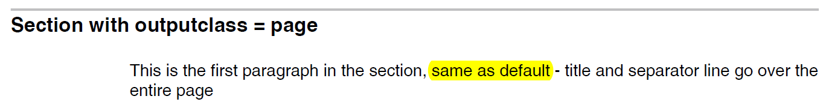
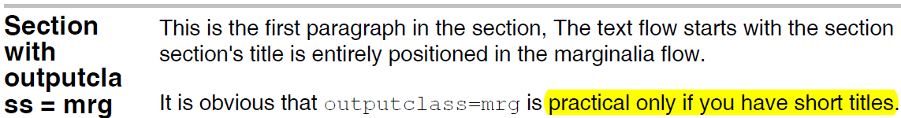
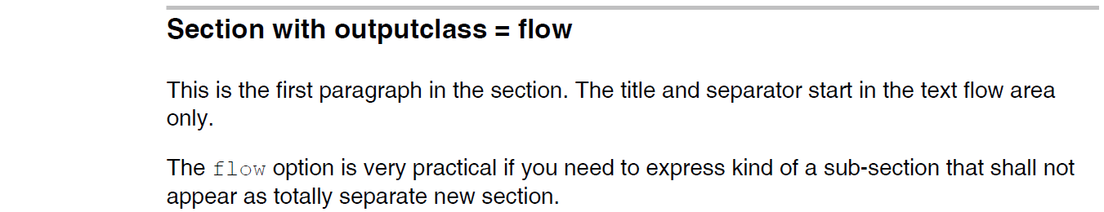
Extensions to SECTION Section Layout

Slide 13
Extensions to SECTION Section with "empty title"
<concept id="myConcept">
<section id="reuseText1>
<title></title> ← can be deleted of left empty
<p>You can use no title or an empty title to suppress a section title</p>
<p>Line 2 ...</p>
... more text ....
</section>
...
...
...
<section conref="#myConcept/reuseText1"/>
</concept>
reusing all paragraphs from section above

Slide 14
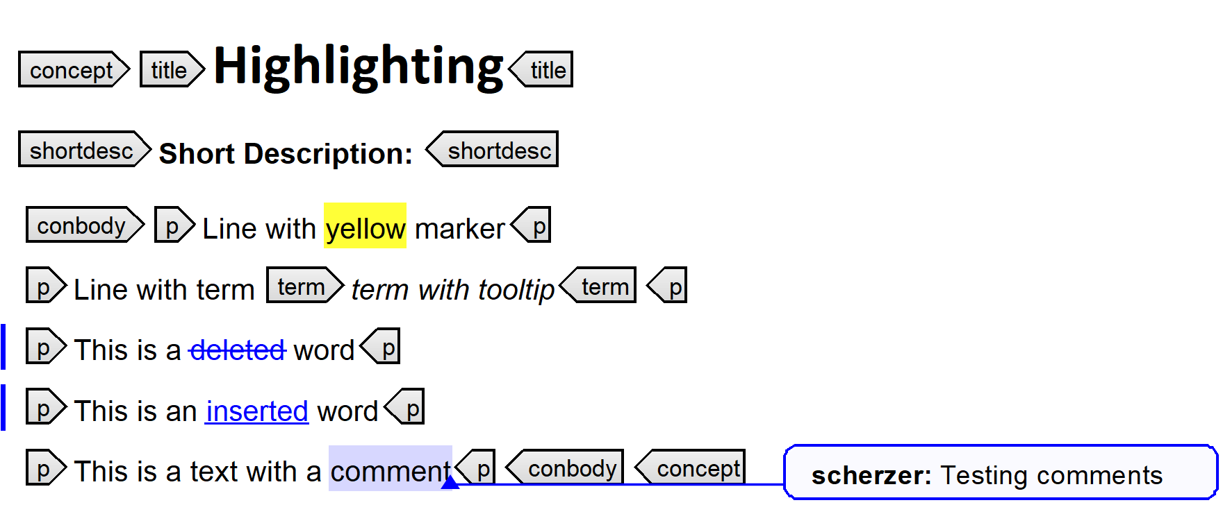
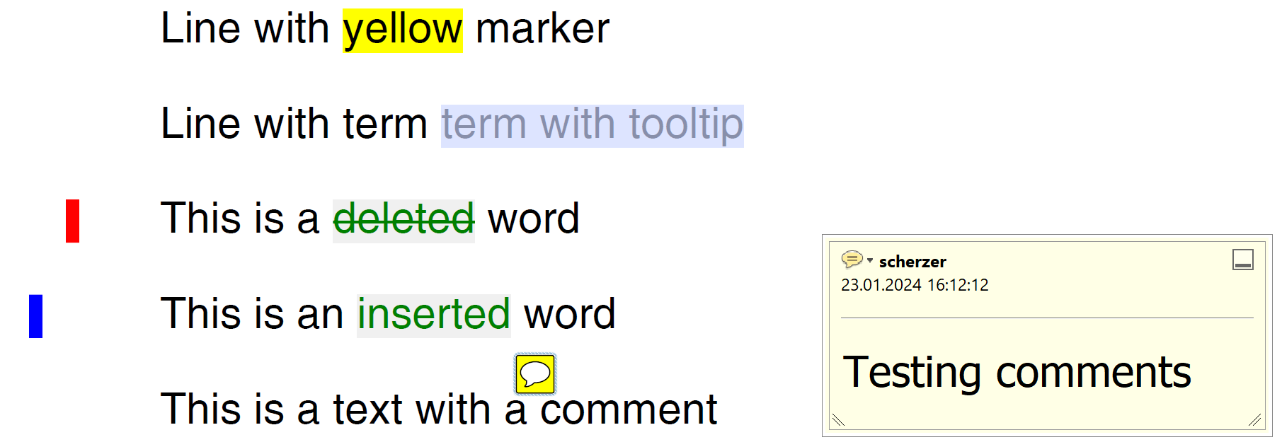
oxygen-Annotations supported in PDF Output
in oxygen Editor
PDF

Slide 15
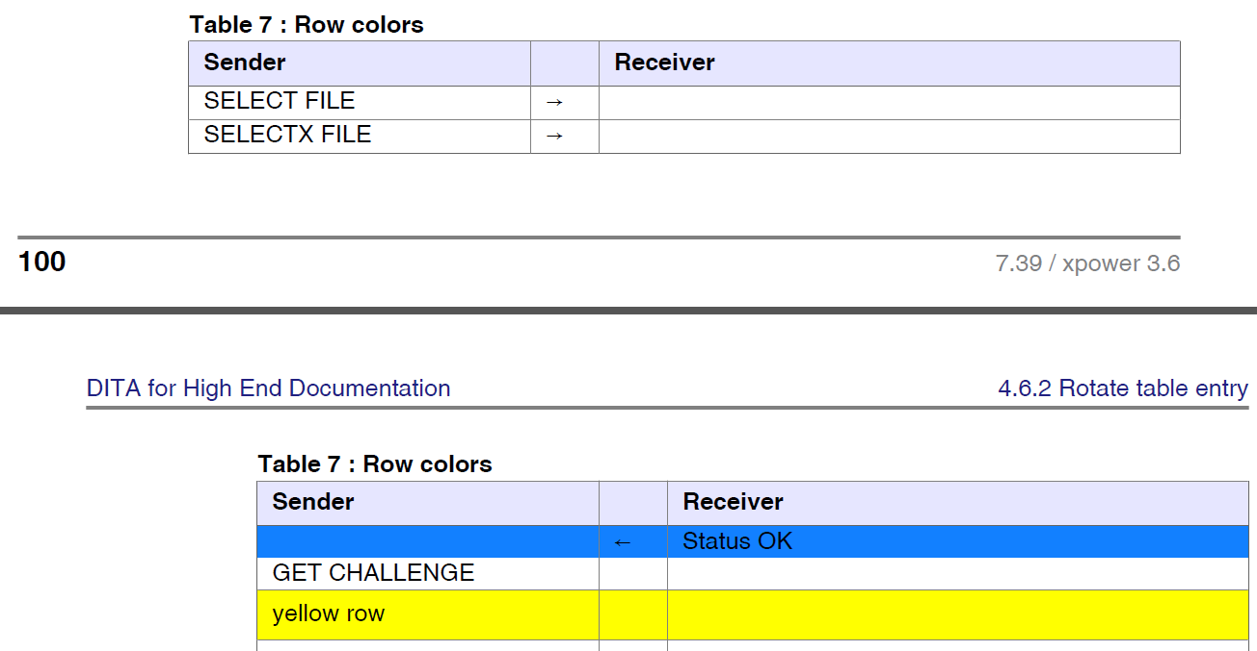
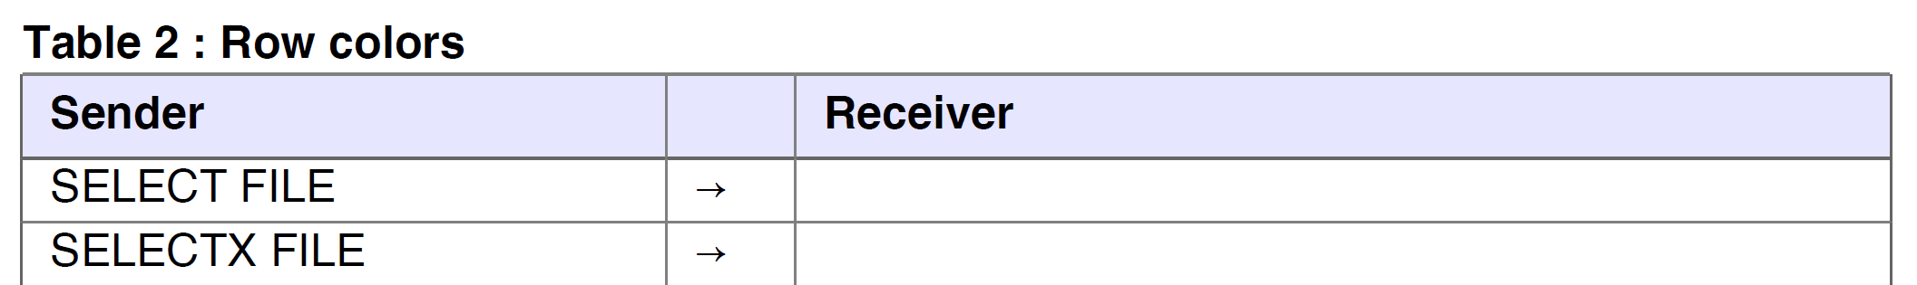
DITA for Print
Leigh W. White
http://xmlpress.net
Extensions to Tables Repeat Headers on next page
"basic-settings.xml": TitlePosition=table_titleRepeat

Slide 16
Extensions to Tables "row:tight-Feature"
up 5pt
<tbody>
<row>
<entry><b>Helmut Scherzer</b></entry>
<entry>Example for a name</entry>
</row>
<row outputclass="tight:5">
<entry outputclass="font-size:8pt">(Author)</entry>
</row>
</tbody>

Slide 17

Extensions to Tables entry "outputclass=box..."
used on tables with "frame=none" and @outputclass="compact"
entry
entry
entry
entry
entry
DITA "colsep" / "rowsep" are the official specifiers … but you can't do with them what you see here …

Slide 18


Extensions to Tables entry "outputclass=box..."
avoids trouble with default DITA framing
<table frame="none" "@outputclass=compact"..... >
... (colspec and the other stuff ...)
<entry outputclass="cellcolor=#E0E0E0
box=LTB!0.2pt,#6060FF
right:2pt">400.12</entry>
<entry outputclass="cellcolor=#FFFFE0
box=RTB!0.2pt,#6060FF"
left:2pt"> EUR</entry>
=
2890.40 EUR
384,12 USD
27704,92 YEN
right aligned left aligned

Slide 19
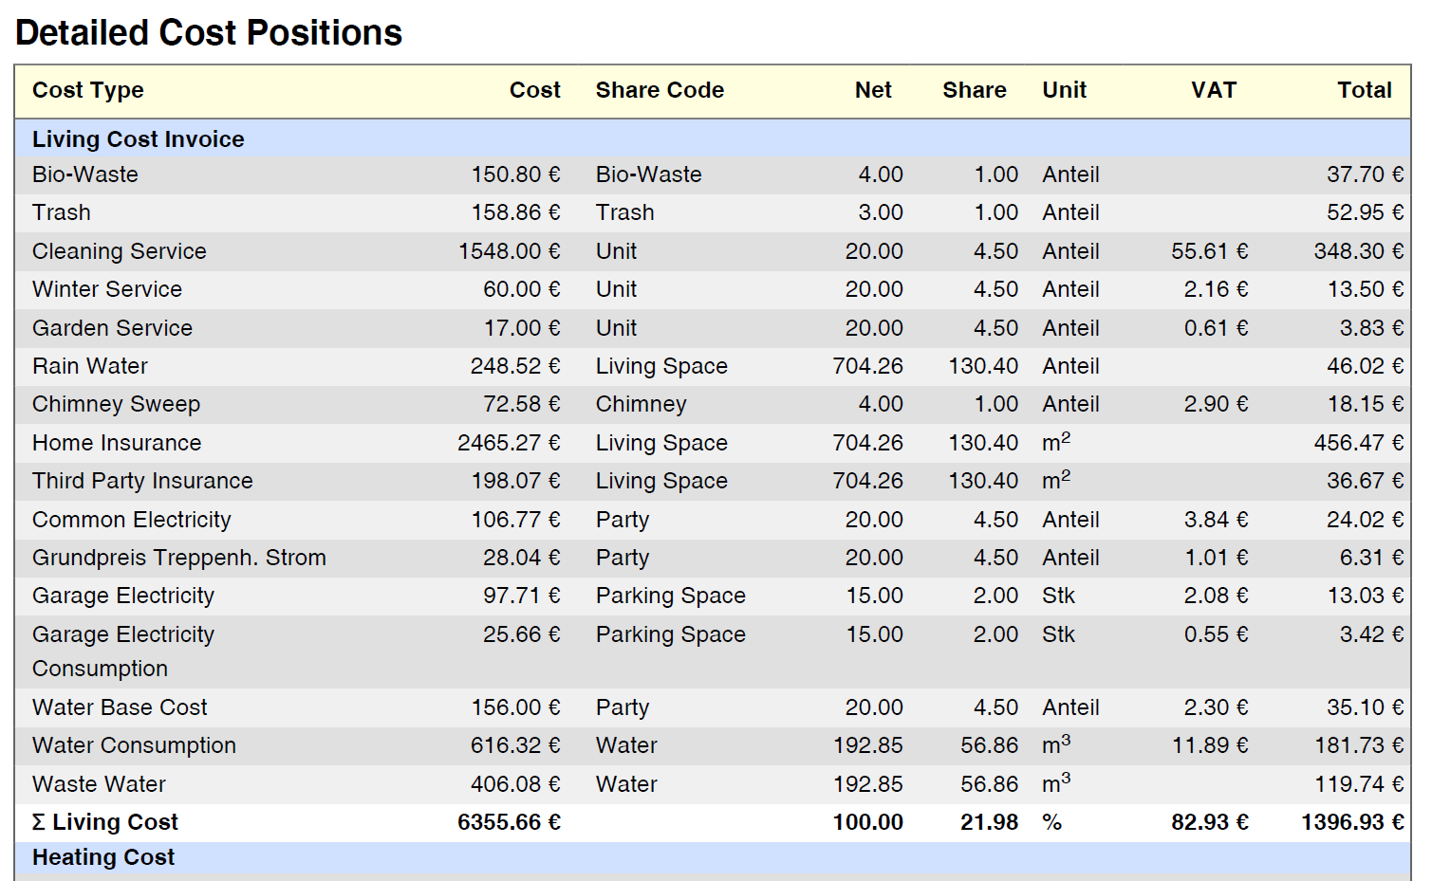
Extensions to Tables (Alternating-) Row Colors
<table frame="all"
rowsep="0"
colsep="0"
id="cstScherzer"
outputclass="compact
rowcolor=#F0F0F0#E0E0E0
fontsize=8pt"
pgwide="1">
specifies alternating row colors

Slide 20
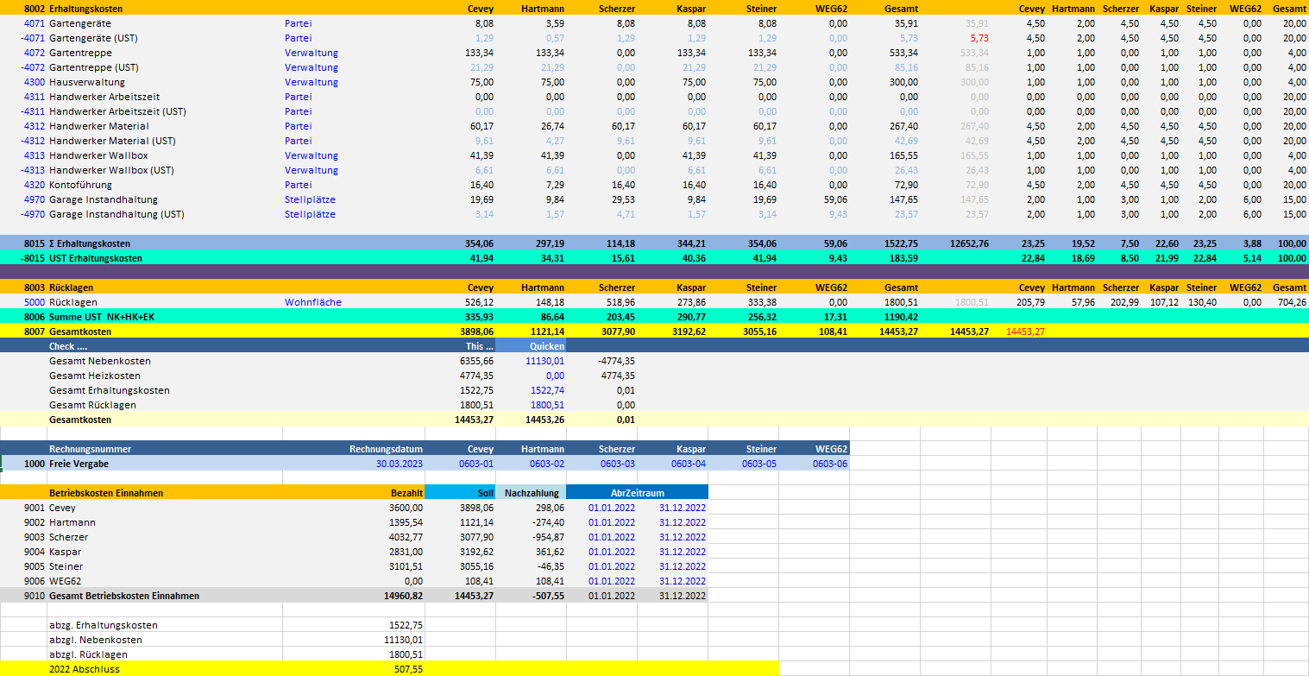
EXCEL Macro Dita Files from EXCEL Sheet
"Save as" chart.xslm
Process chart.xslm → <name>.dita
... creating letters ...
form.xsl

Slide 21
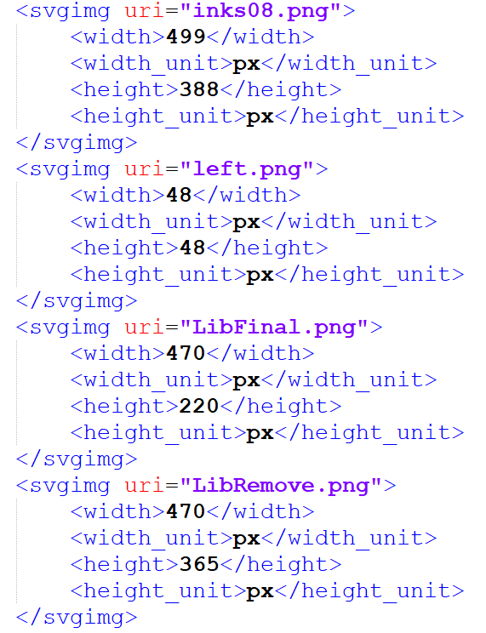
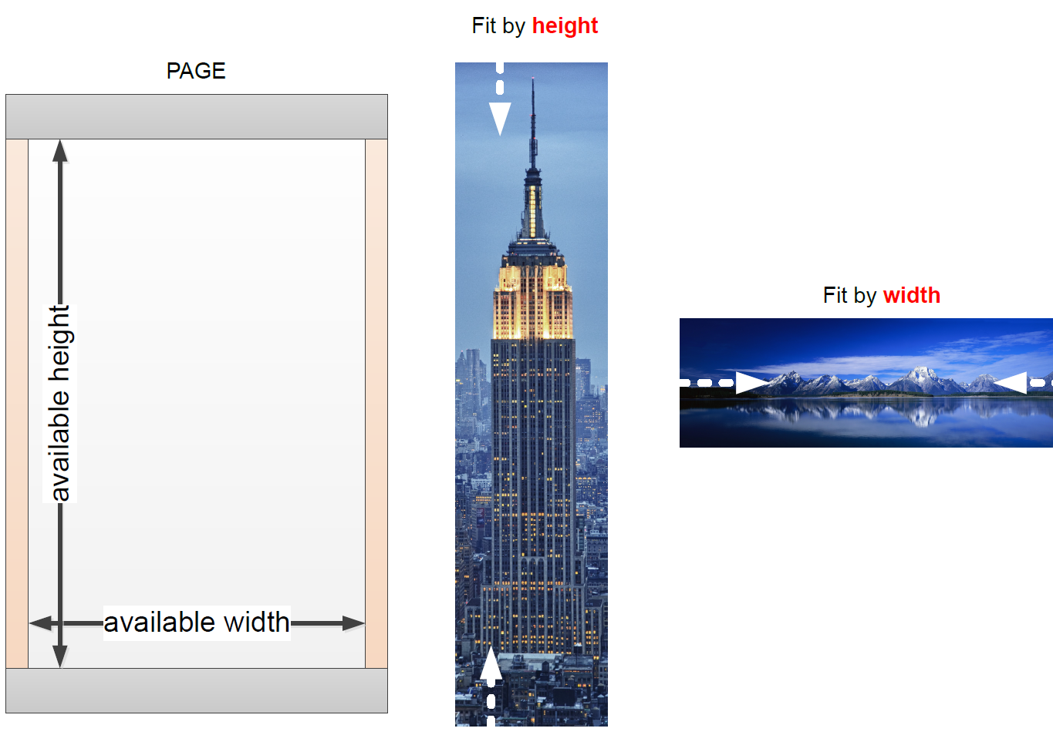
svgsize.xml
Extensions to Figures expanse=page
<figure expanse="page" outputclass="size=75%">
<xsl:when test="@expanse = 'page'">
"<compute fit-width>"
</xsl:when>
The size of all images is available in svgsize.xml
… created and used in the process to auto-adjust images

Slide 22
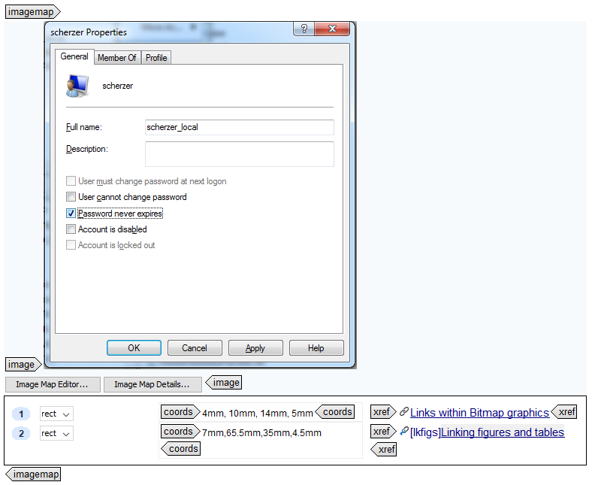
Extensions to Figures Links in Graphics (using DITA "imagemap")
imagemap ...
Great Feature – "Click for help"
However …
coords: "Very tedious to design

Slide 23
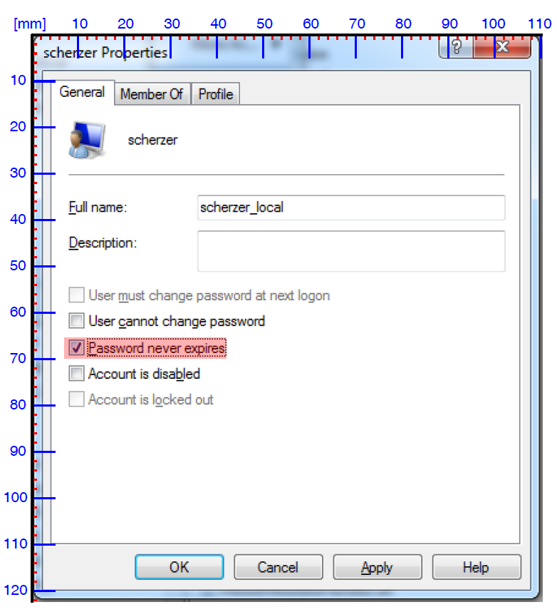
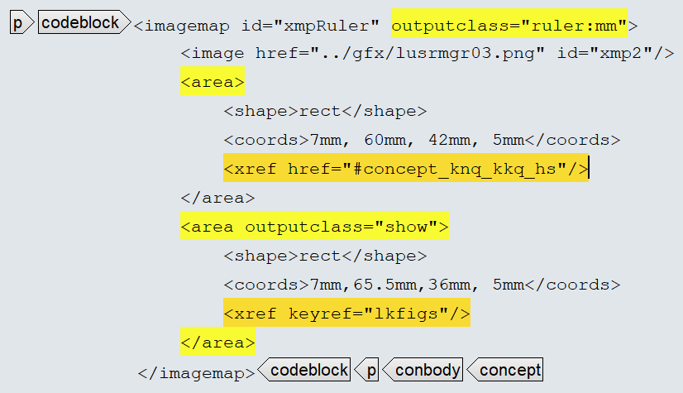
Extensions to Figures Links in Graphics
PDF Output
DITA Input

Slide 24
Extensions to unordered Lists User specific "bullets"
Allow user specific "bullets"
<ul>
<li>First Line</li> • First Line
<li>Second Line</li> • Second Line
<li>outputclass="text[§]">Paragraph Item</li> § Paragraph "bullet"

Slide 25
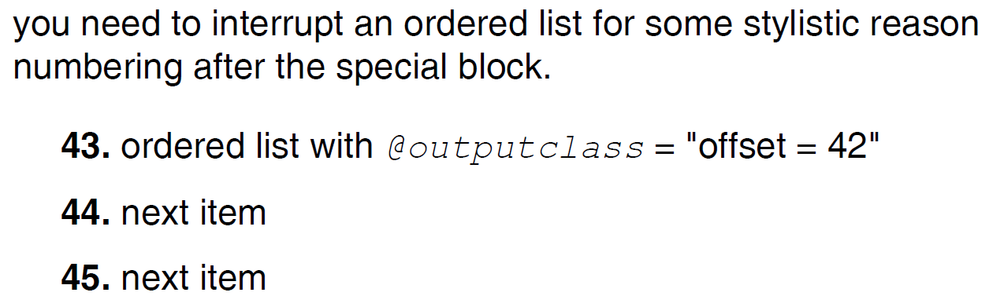
Extensions to Lists Ordered List "offset"
... continue an ordered list with a numbering offset
<p>
<ol outputclass="offset=42">
<li>ordered list with <xmlatt>outputclass</xmlatt> = <q>offset = 42</q></li>
<li>next item</li>
<li>next item</li>
</ol>
</p>
...
… if you need to interrupt an ordered list flow for some reason

Slide 26
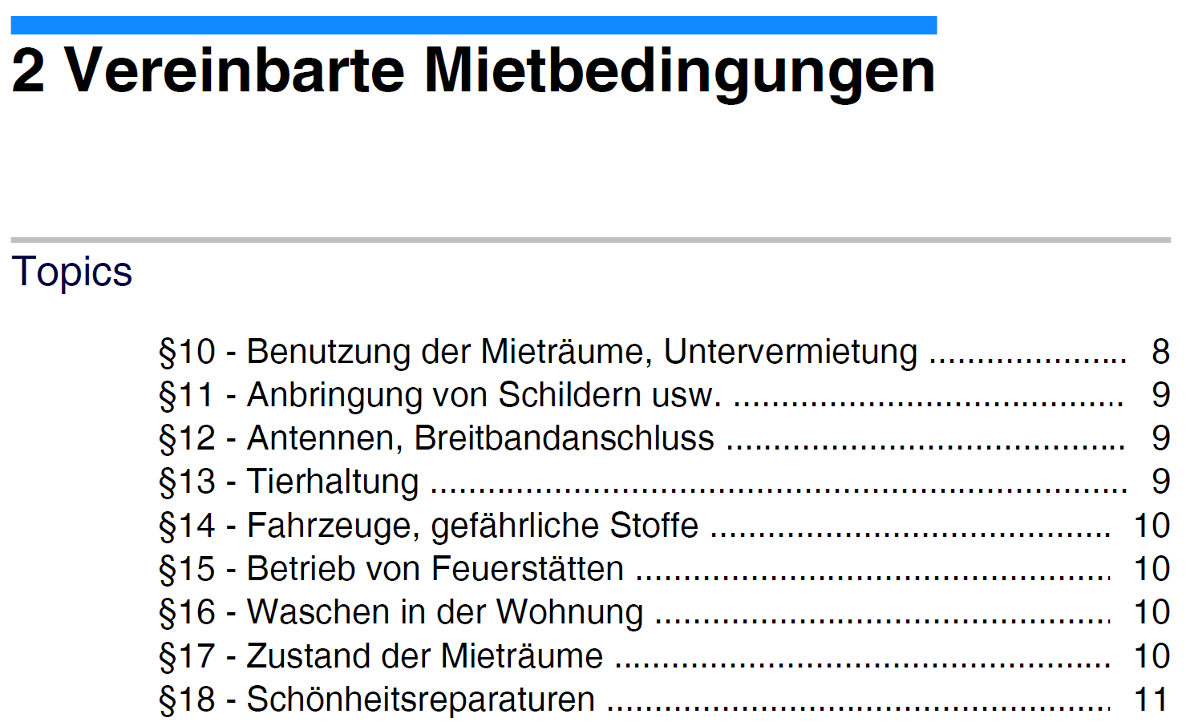
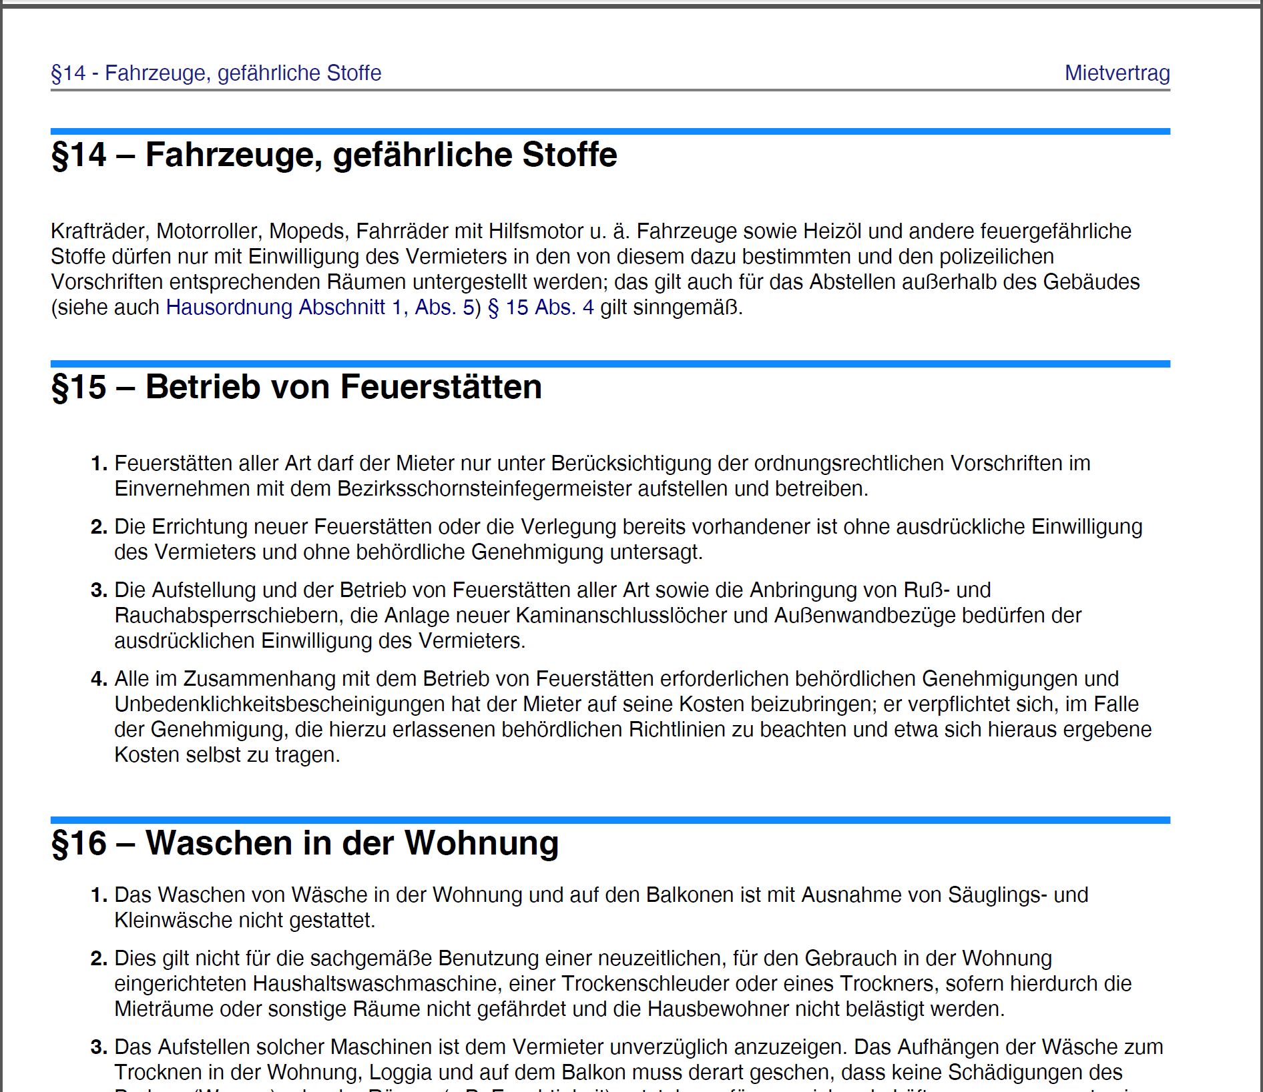
Extensions to Titles Proprietary Title Numbering used in legal text …
<concept id="mvZustand">
<title>§16 – Waschen in der Wohnung</title>
<titlealts>
<navtitle>:§16 – Waschen in der Wohnung</navtitle>
</titlealts>
<conbody>
colon ":" avoids auto-numbering

Slide 27
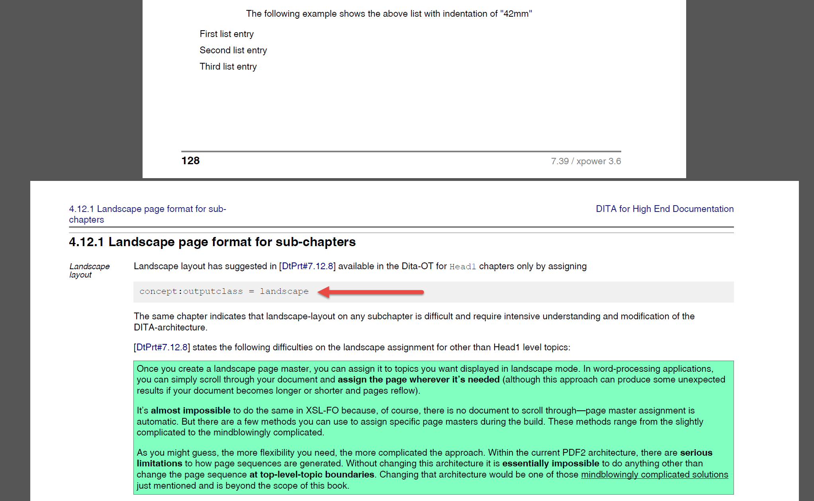
Extensions to Pages "Landscape" in page flow

Slide 28

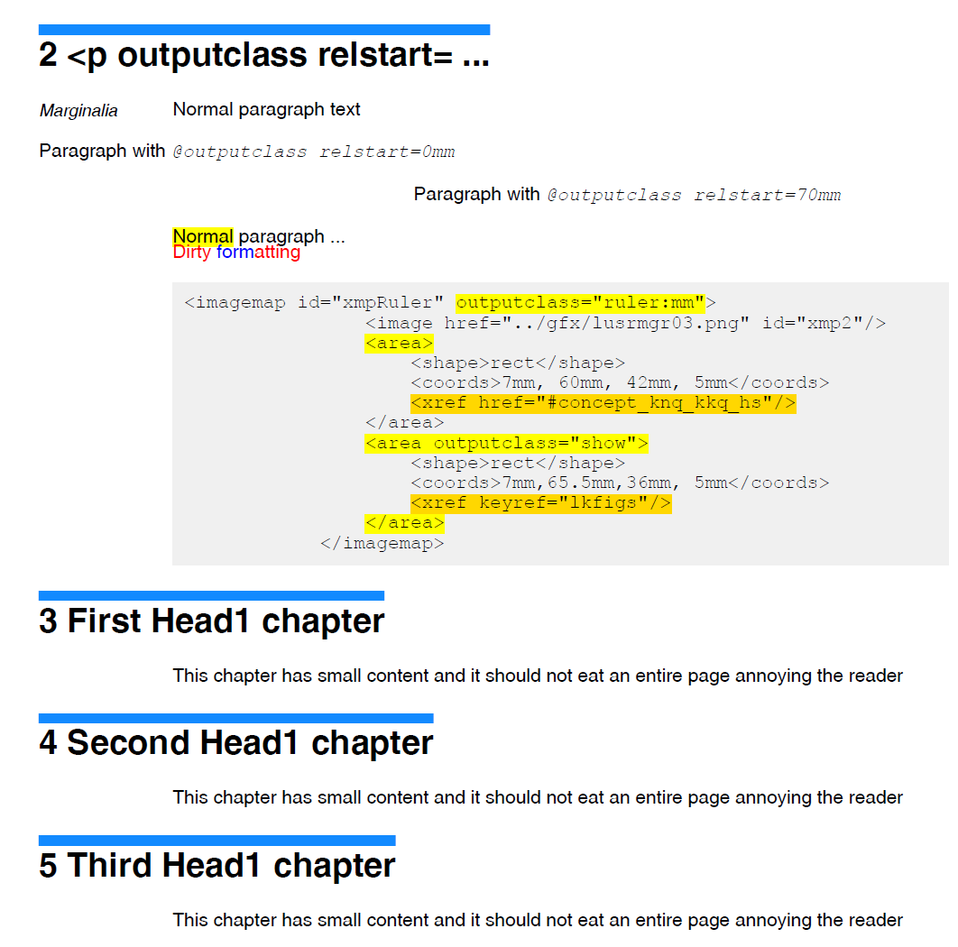
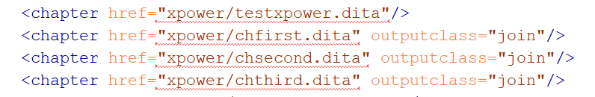
Extensions to Pages "Join Head1 chapters on a page"
approved
<Document>.ditamap
outputclass="join"

Slide 29
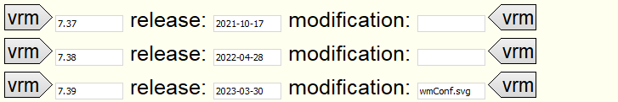

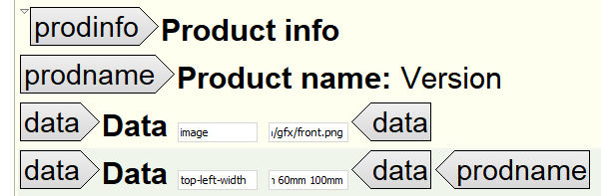
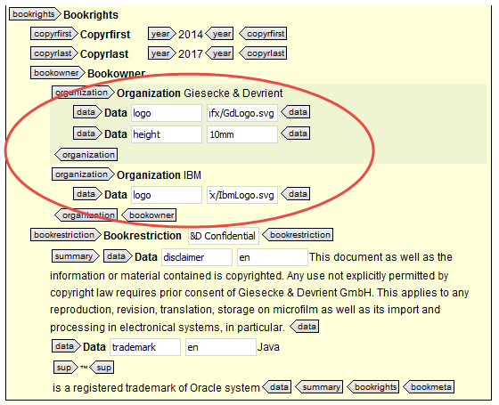

.ditamap Extensions to Front Page
Watermark
Front Picture
Dual Logo Support
Security Classification

Slide 30
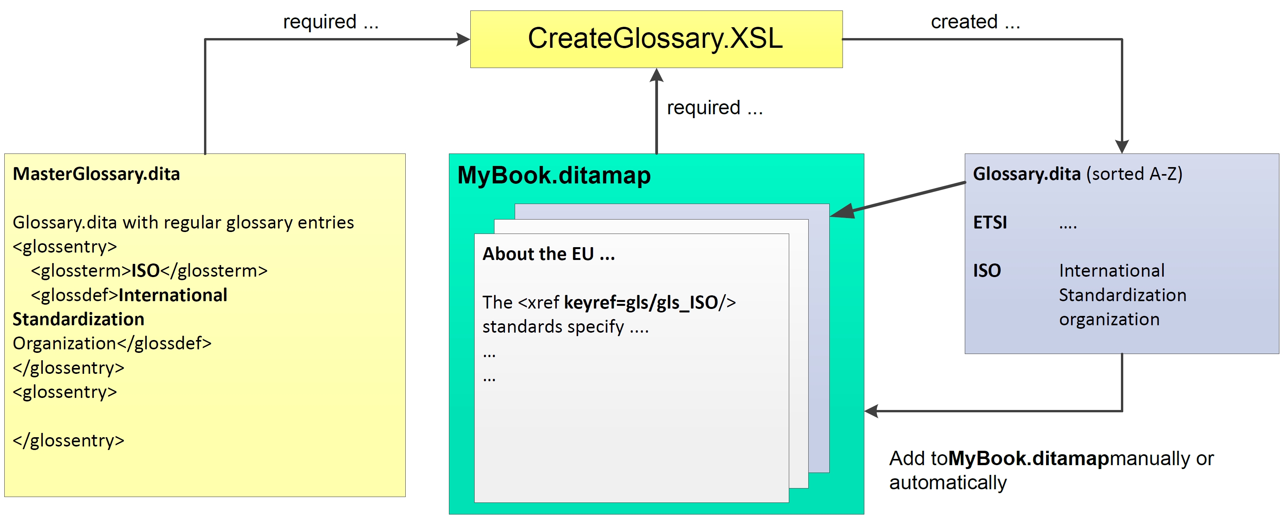
Auto-Glossary + Bibliography Generation
3.
automatically executed on running the DITA-Process
1.
2.

Slide 31
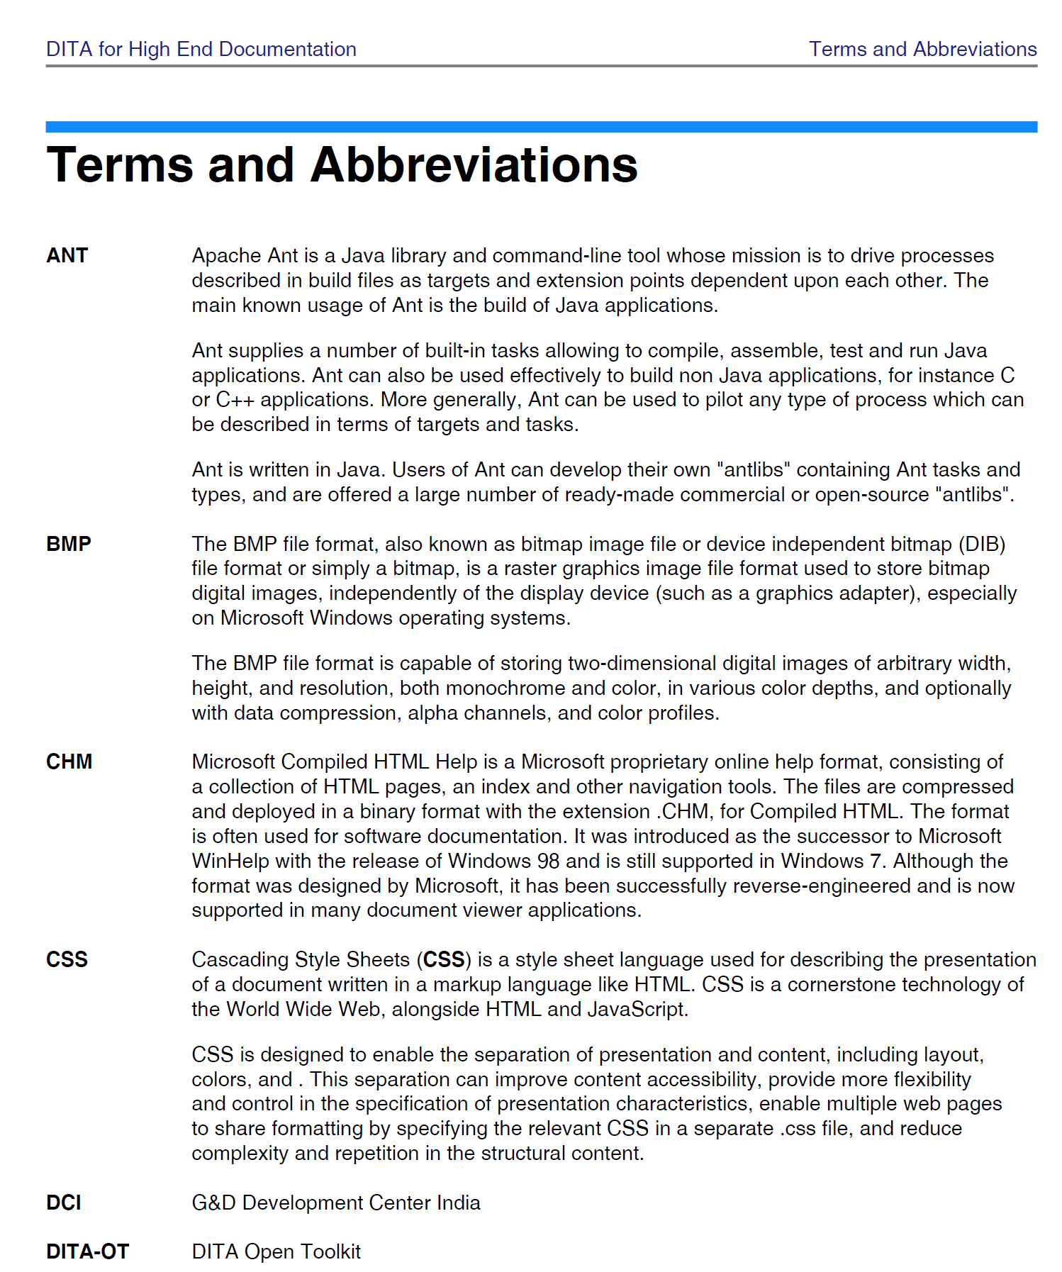
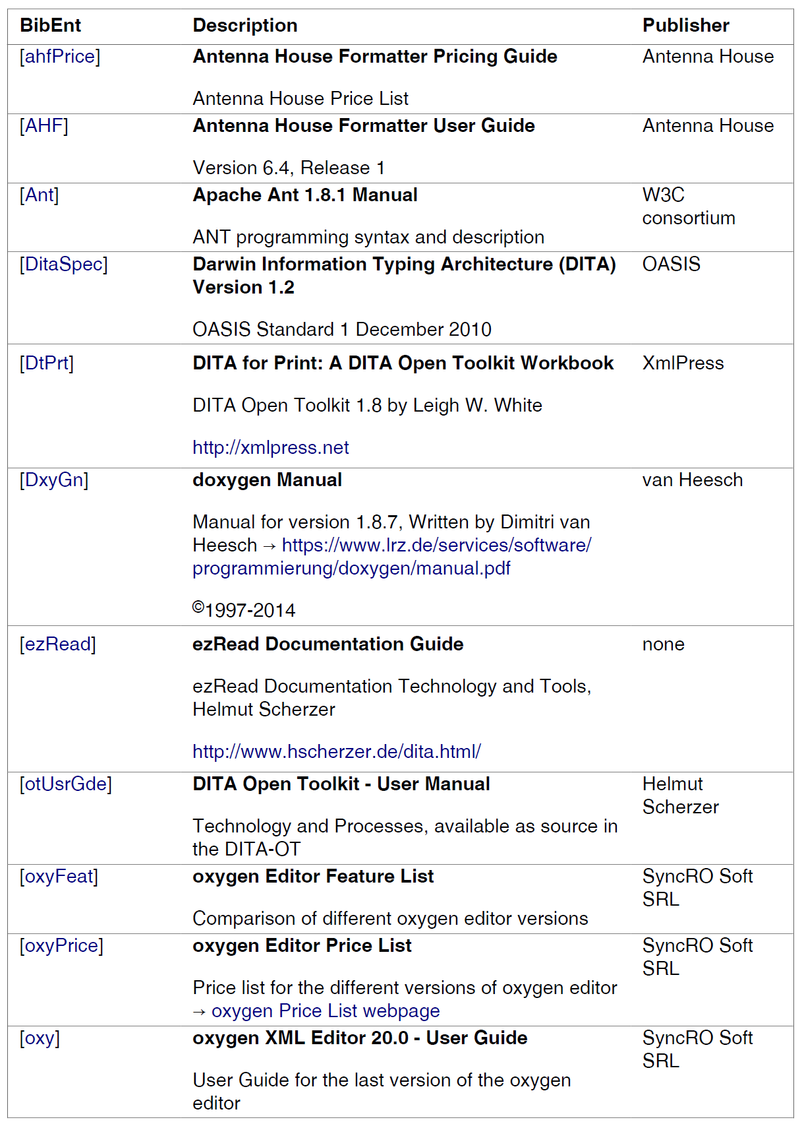
Auto-Glossary + Bibliography Generation

Slide 32
New Feature Auto-Glossary + Bibliography Generation
Working Links to Documents (auto generated !)
Think !
Check for valid links
and apply ~[DtPrt]
"~[...]" to avoid link creation
for commercially available docs

Slide 33
New Feature Meeting Report – Participant List
Attendees List: created by Meeting Reporter
MS-Outlook
every Meeting
ExportVCF
Macro
run ... (2 seconds)
Meeting Report.dita
...
Participants ...
...
...
...
Once only
"myContacts.xml"

Slide 34
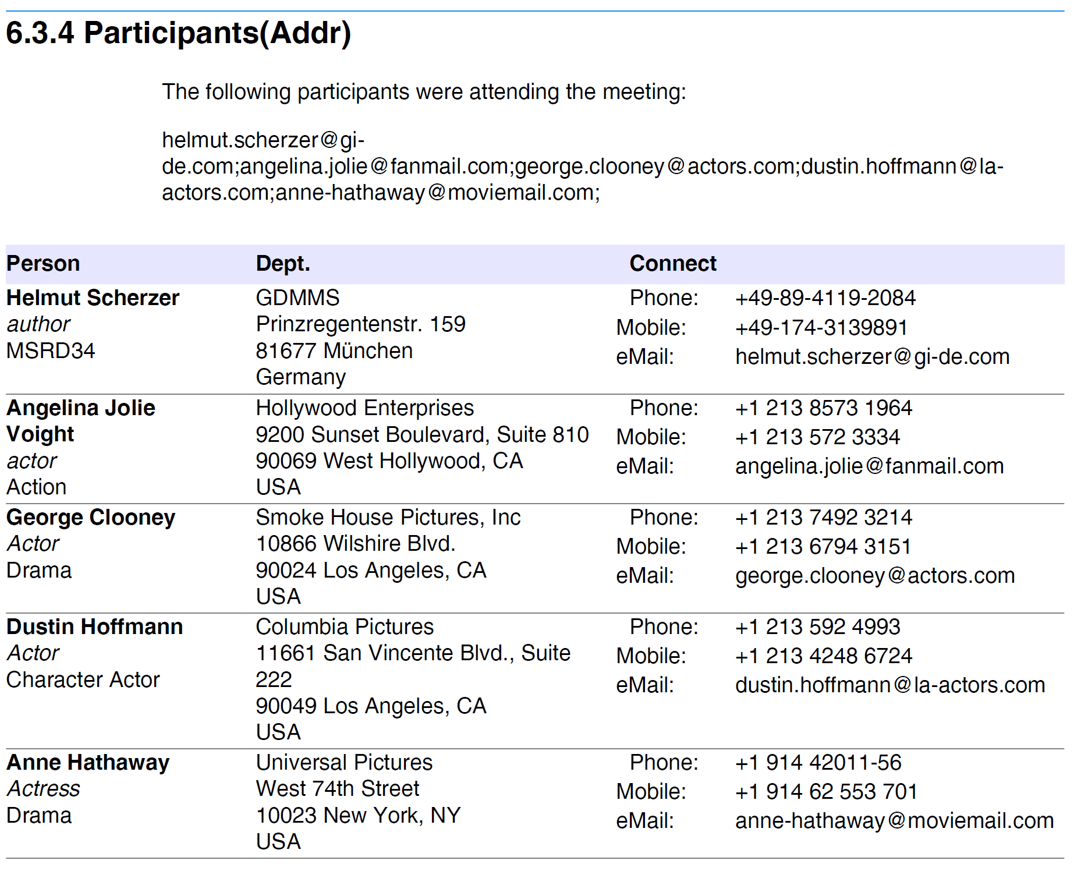
New Feature Meeting Report – Participant List
Auto: e-mail List to all participants

Slide 35
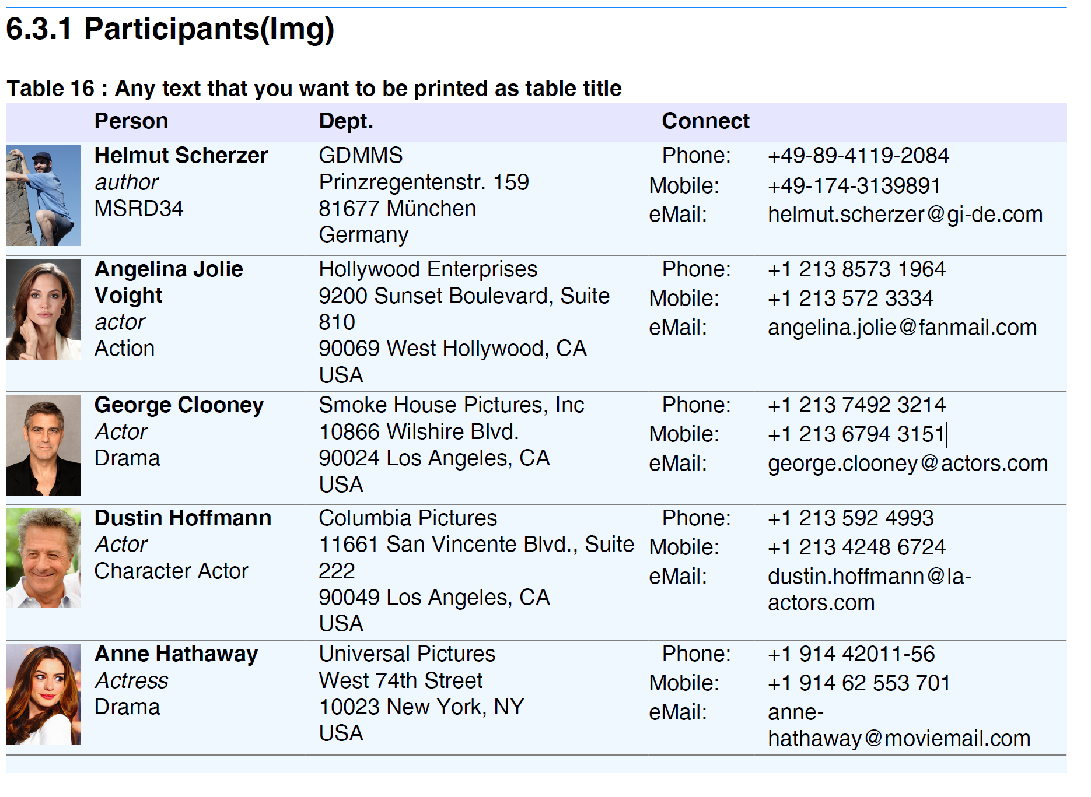
New Feature Meeting Report – Participant List

Slide 36
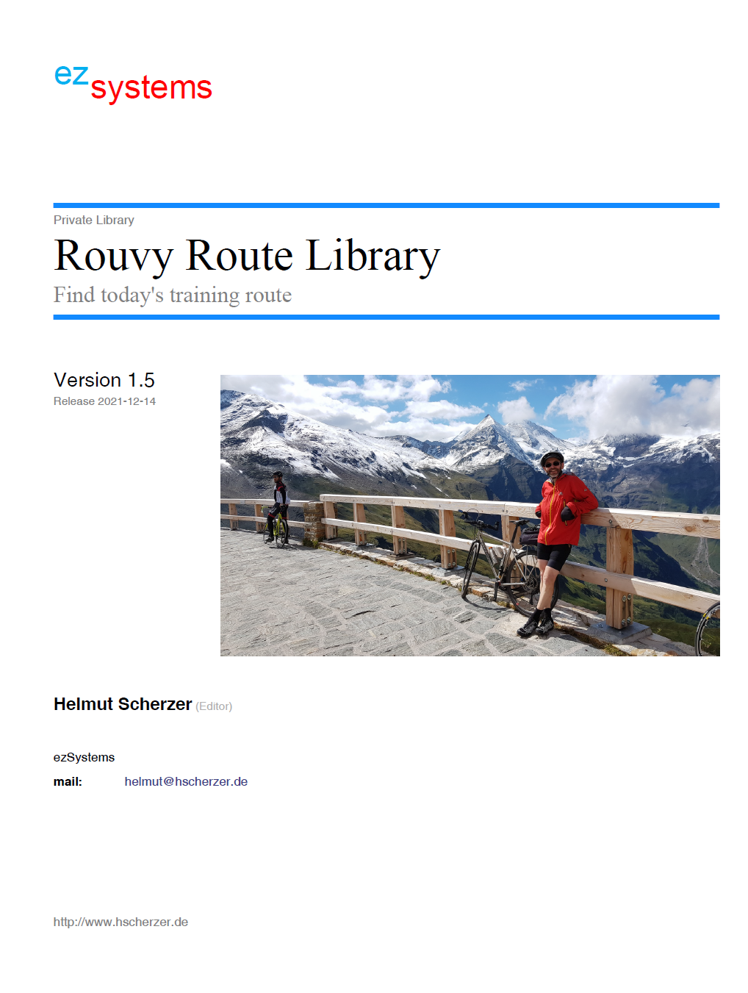
Output Formats
PDF

Slide 37
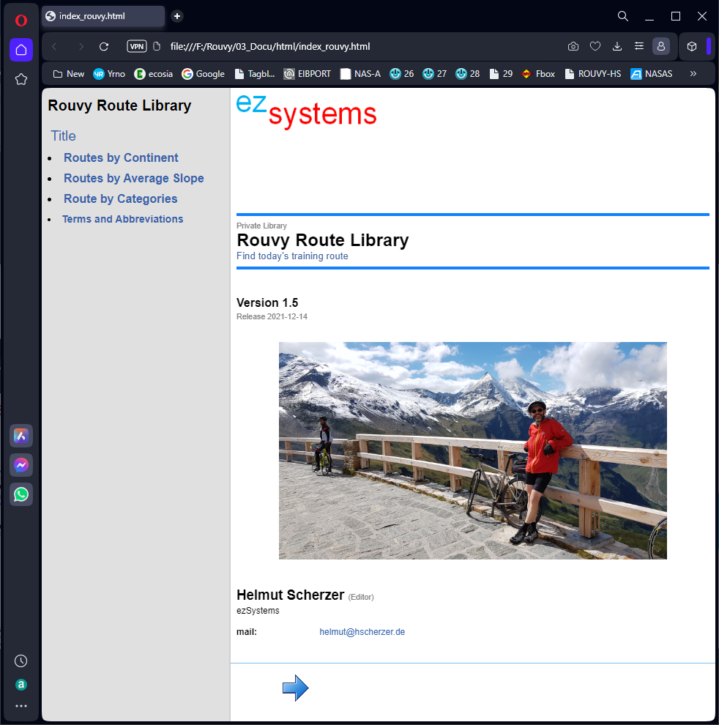
Output Formats
HTML

Slide 38
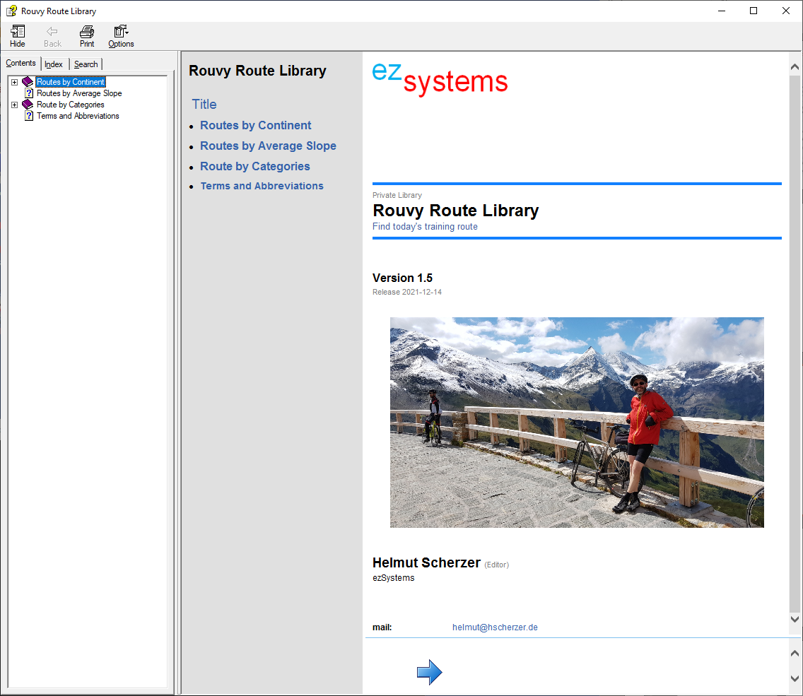
Output Formats
CHM

Slide 39
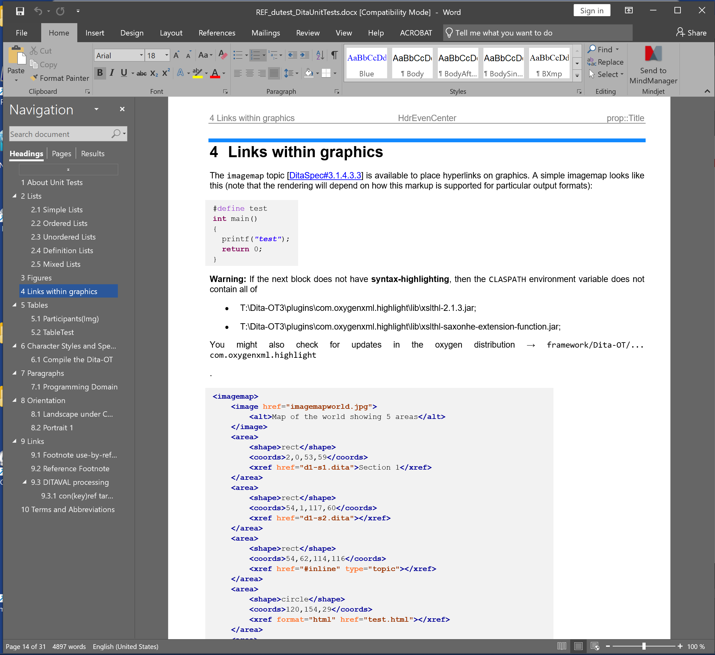
Output Formats
DOCX

Slide 40
New Feature ezLinks to external documents
Linking to <xref href="file:///F:/Books/GUIDE_ezRead_UserManual.pdf" format="pdf"/>
... use instead
... [ezRead#9.3.3] ... ... [ezRead#9.3.3] ...
... ~[ezRead#9.3.3] ... ... [ezRead#9.3.3] ... "~" avoids linking)
... [my Linktext::ezRead#9.3.3] ... ... my Linktext ... "::" shows Linktext only
... ~[my Linktext::ezRead#9.3.3] ... ... [my Linktext] ... "~" avoids linking
... ![my Linktext::ezRead#9.3.3] ... ... [my Linktext] ... "!" enforces brackets[ ]
Dita Source mydoc.dita
... how it shows in final PDF ....

Slide 41
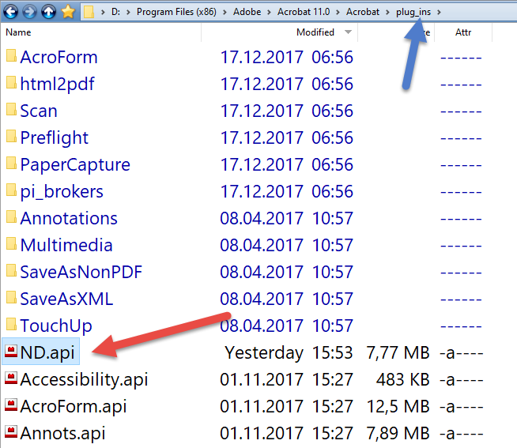
New Product Increase Productivity and Quality In Documentation
Software Development/-Testing
Product-/Software Specifications
Evaluation/Certification
(Help-) Manuals
......

Slide 42
Open a PDF with Named Destinations
... brings you directly (!) to the desired chapter/location
A command line interface exists ... since the beginning of time
Acrobat.exe /A "nameddest=myTarget" "xpower.pdf"
and it does even work for the free Adobe Reader
but ... who wants to open a PDF this way ?

Slide 43
The solution ... [Instant Links]
mark a [....] construct in Excel, Text, oxygen-editor, MS-Word, Notepad++ or any other situation
Press F12 (works after installation) to get to the chapter of the document
bla bla ... [pdfparm#4.3] ... bla bla
mark generously ...
F12 ... opens PDF at Chapter 4.3
Examples
[oxy#4.4]
[ezread#9.3.3]
[ezRead#syntax]
... Labels work too

Slide 44
Case 1 – Understand account movements ... Where did the money go ?
mark ...
F12
Check the Invoice PDF
Bank Statements
09.01.24 | 990 | PayPalEurope S.a.r.l. et Cie S.C.A | -89,50
09.01.24 |  | [elvAAdum] AA-dummies for Tom's Device
24.01.24 | DE00087 | Stadt Soest, , Abt. Stadtentwicklung, 59494 Soest | -37,50
24.01.24 |  | [wbucac01] LB 1063.6911433 Transfer 1063.6911433
26.01.24 | 994 | PayPalEurope S.a.r.l. et Cie S.C.A | -1623,01
26.01.24 |  | [fsth4] 1032103855700/PP.8885.PP/. Contorion Corp.
05.04.24 | DE00088 | Martin Brown Building Corp. | -3.651,30
05.04.24 |  | [wbuSc10fg] Invoice 206-23-03

Slide 45
Case 2 – Just find a document ... Tax Declaration (defense)
Expenses | Amount
[wb21rats] Rat Plague Removal | 119,00
[wb21jk1] Sanitary Repair EG1R | 54,26
[wb21jk2] Sanitary Pipes Installation | 2178,53
[wb21wsp] Wasp Nest Removal | 142,80
mark ...
F12
Check the
Invoice PDF

Slide 46
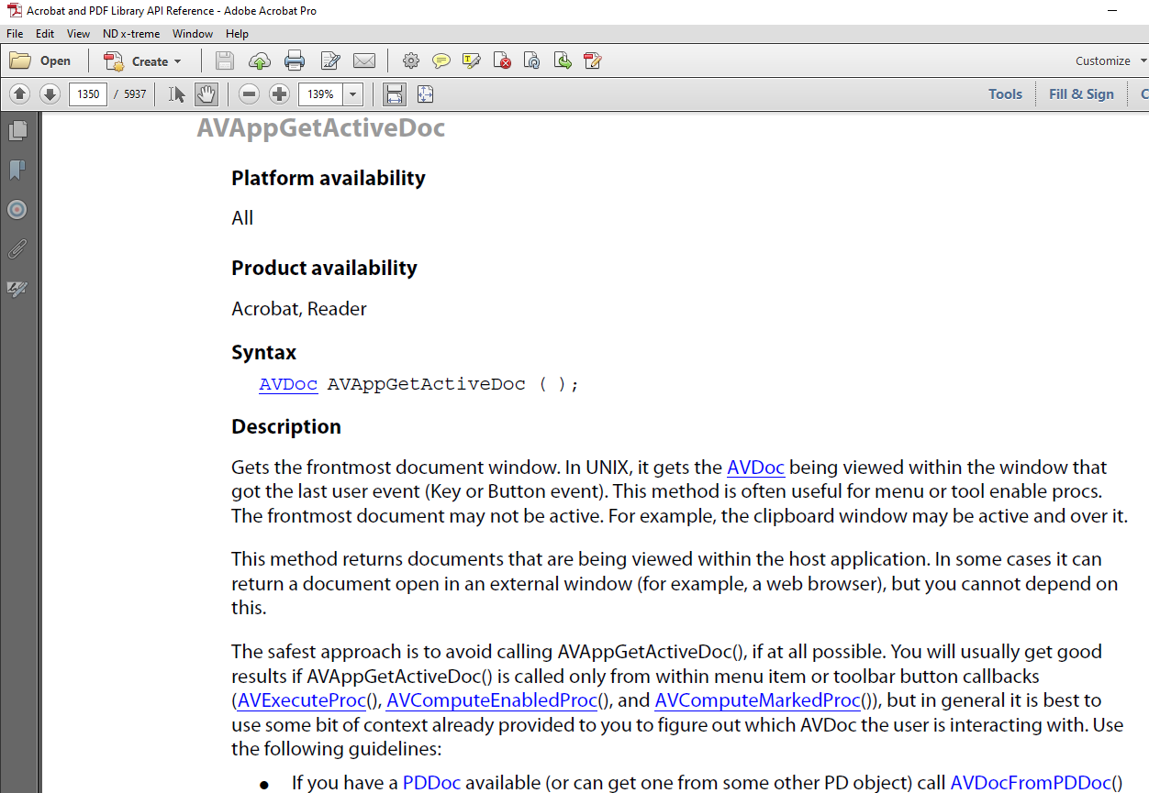
Case 3 – Understanding ... Software Development
////////////////////////////////////////
// @cont All stub files deleted here, we can now create the new stub files by parsing
// all named destinations and create the appropriate files.
if ((FindHandle != -1) && (FindHandle != 0))
_findclose(FindHandle);
////////////////////////////////////////
// @step 2 | Visit all named destinations | The <v NameTree> is to be
// developed through <xref PDDocGetNameTree>.
if (DocPathName == NULL)
{
avDoc = AVAppGetActiveDoc(); // [plg#AVAppGetActiveDoc]
pdDoc = AVDocGetPDDoc(avDoc); // [plg#AVDocGetPDDoc]
DestRec.eDoc = avDoc;
DestRec.pDoc = pdDoc;
////////////////////////////////////////
// @step 3 | Generate new NDs | special migration time (ended 20140808) to remove all
// "ChA" for letter chapters to become "A" only.
//
// This is deactivated by the (1=0) statement
if ((1 == 0) && (mode > 1)) // bulk modes
{
BkRoot = PDDocGetBookmarkRoot(pdDoc); // [plg#PDDocGetBookmarkRoot]
rc = PDBookmarkGetCount(BkRoot); // [plg#PDBookmarkGetCount]
////////////////////////////////////////
// @cont DISABLED repair function to remove Ch-prefix on alpha bookmarks (20150628)
if ((rc != 0) && (0 == 1))
{
////////////////////////////////////////
// @cont First clear all M8.newlink named destinations to remove old Ch-prefix on annex
// This call shall go later on
ClearAllM8inFile(pdDoc);
mark ...
F12
Understand function in Reference Manual

Slide 47
New Feature Suggested File Naming Convention
[MyDita#4.6.1]
[oxy#4.2]
[ezRead#9.3.3]
REF_MyDita_MyDitaMaster.PDF
GUIDE_ezRead_ezReadDocumentationStrategy.PDF
REF_oxy_OxygenUserManual.PDF
"oxy" = unique "Bibliography Tag Name"
Author's Free Choice of the tagname
bibTag Name is not case-sensitive
Condition1: "must be unique"
Condition2: "shall not contain blanks"
Naming convention HIGHLY recommended but not mandatory.

Slide 48
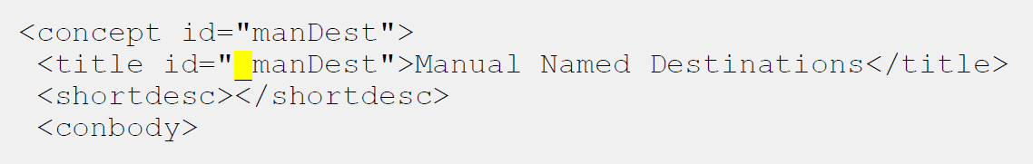
Create Named Destinations in Dita-Source
Any "id" starting with an underscore _ creates a named destination in the final PDF

Slide 49
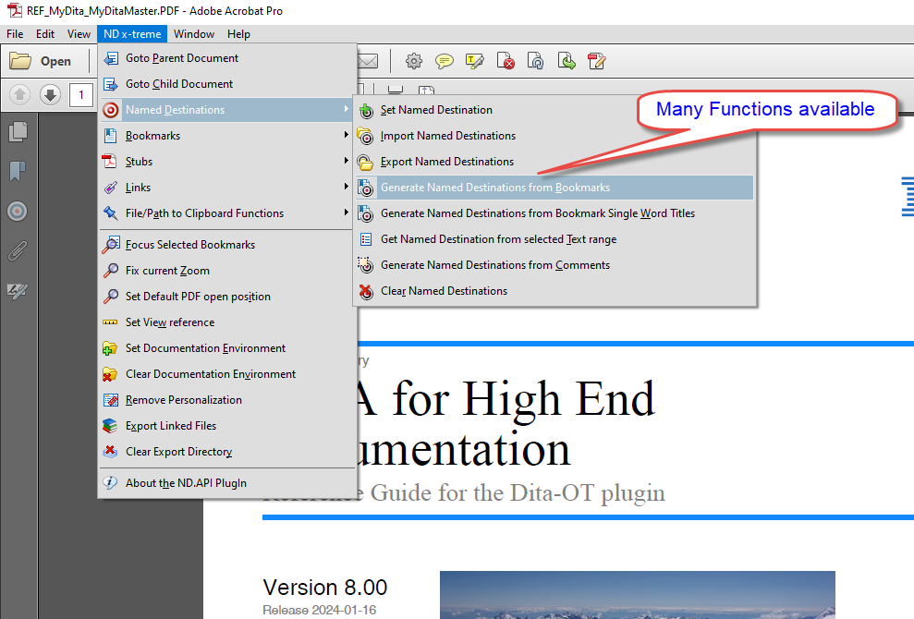
If it is easy to call a named destination ...
How do we get them into a PDF file?

Slide 50
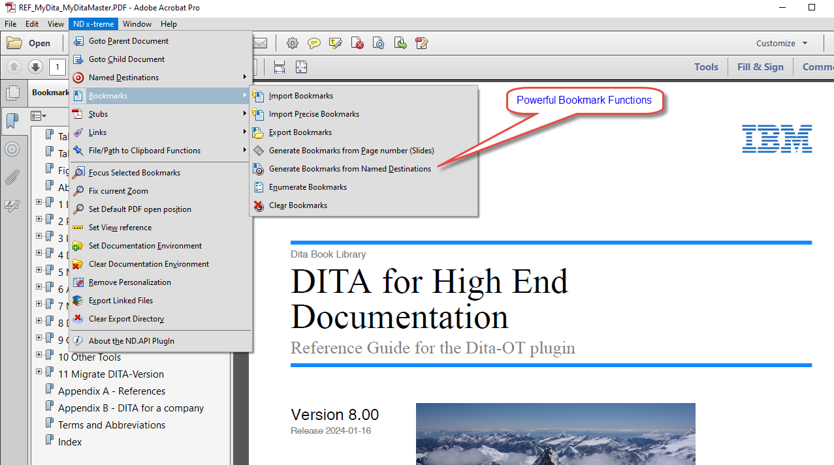
Managing Bookmarks
Auto-Rework "poor" PDF-Documents to Industrial Level

Slide 51
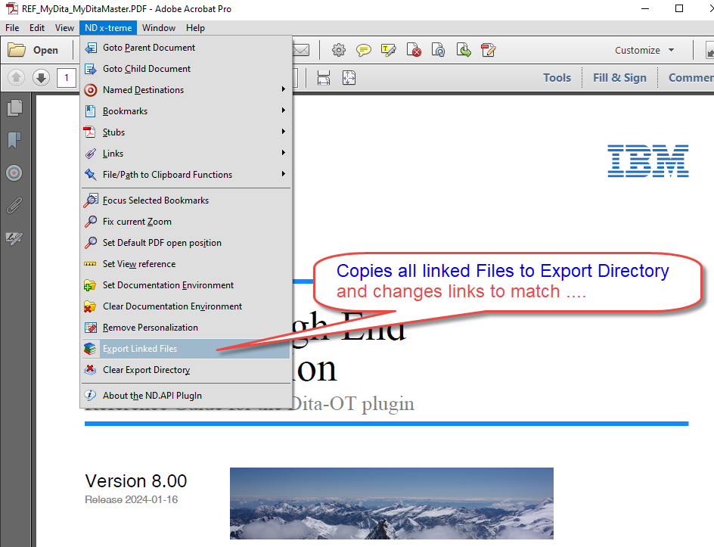
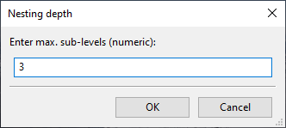

Export Linked Documents
Export Function changes links to match in target Directory (Powerful Feature !)
2. Specify Nesting Level to copy
1. Select Function
3. Copy and Change Links
Book types can be specified ...
Main PDFs → "Books"
Ref PDFs → "References"
... with working Links in the new directory structure
Perfect for (customer) delivery as .ZIP file !

Slide 52


Reference Manuals come with the products
Demo Only
80 pages
108 pages

Slide 53
A few last words …
xpower.plugin always follows latest Dita-OT release
Both products planned for open source delivery (3/2024)

Slide 54


Slide 55

Extensions to Tables Rotate Headers
"entry": rotate = ±90|180|±270 ...

Slide 56
Extensions to Tables (Alternating-) Row Colors

Slide 57
Extensions to Styling Instant Attributes
Specify formatting (fo: statements) ... … on
<p>This is the first paragraph with ...</p>
<p outputclass="padding-top:-5mm color:red">
Instant<ph color:blue>form</ph>atting</p>
Using <ph> for formatting changes within a text ...
This is the first paragraph with ...
Instant formatting
Try doing below with <p>Helmut Scherzer</p> <p>Author</p>
Helmut Scherzer
Author
requires
@outputclass="background-color:#FFFF99" padding-top:-5mm font-size:7pt color:#00598D" on "Author"
Use the "instant attributes" only if the task cannot be solved by regular DITA elements !!!

Slide 58


Extensions to Notes noImage / no Label
Notes were extended with
@outputclass = noImage → does not show an icon at all
@outputclass = noLabel → does not print a label (like "Note:" or "Tip")

Slide 59


Extensions to Figures expanse=page
<xsl:when test="@expanse = 'page'">
<element xsl:use-attribute-sets="__expanse__page"/>
</xsl:when>
<xsl:attribute-set name="__expanse__page">
<xsl:attribute name="start-indent">0</xsl:attribute>
<xsl:attribute name="end-indent">0</xsl:attribute>
<xsl:attribute name="width">auto</xsl:attribute>
</xsl:attribute-set>
Trouble with complex aspect ration !

