Slide 1
Technical Data
2022-11-13 DITA-OT Day Rotterdam
Stefan Jung – Global Head of Technical Documentation

Slide 2
goal

Slide 3
goal
Presenting a plugin to process technical data.
The plugin is closed source.
If there is interest in the audience, I can try to get an approval to release the code.

Slide 4
Dometic

Slide 5
Dometic today
Dec 31, 2021
REVENUE,
SEK b*
PRODUCTS SOLD
IN MORE THAN
21.5
(USD 2.5 b)
100
COUNTRIES
NO. OF
EMPLOYEES
SALES
OFFICES IN OVER
9,000
30
COUNTRIES
*Rolling 12 months

Slide 6







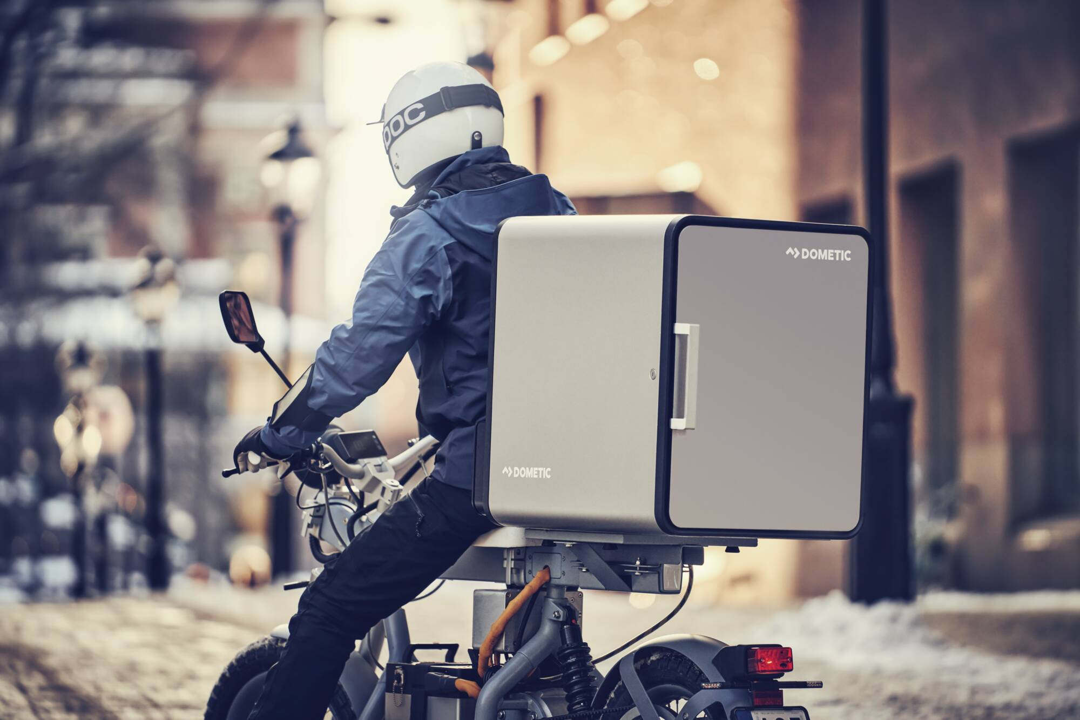
Technology leadership serving several vertical markets
RVs
Passenger cars
Leisure Marine
Residential
CPVs
Professional Marine
Hospitality
Mobile Deliveries

Slide 7







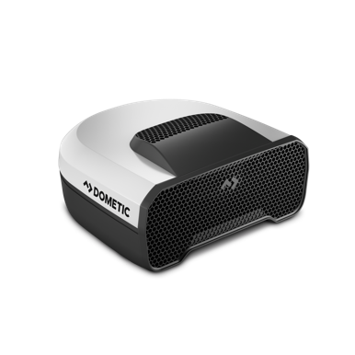

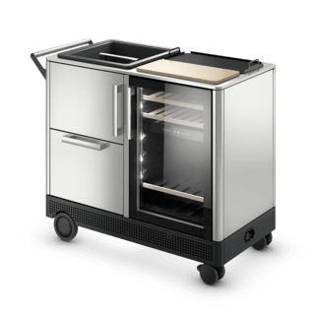

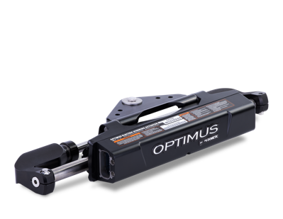
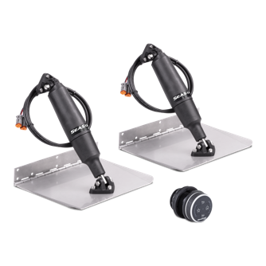



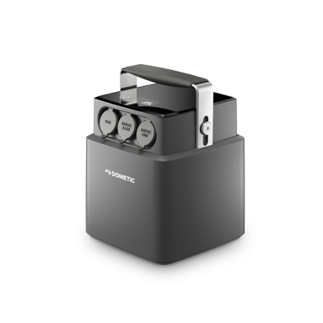
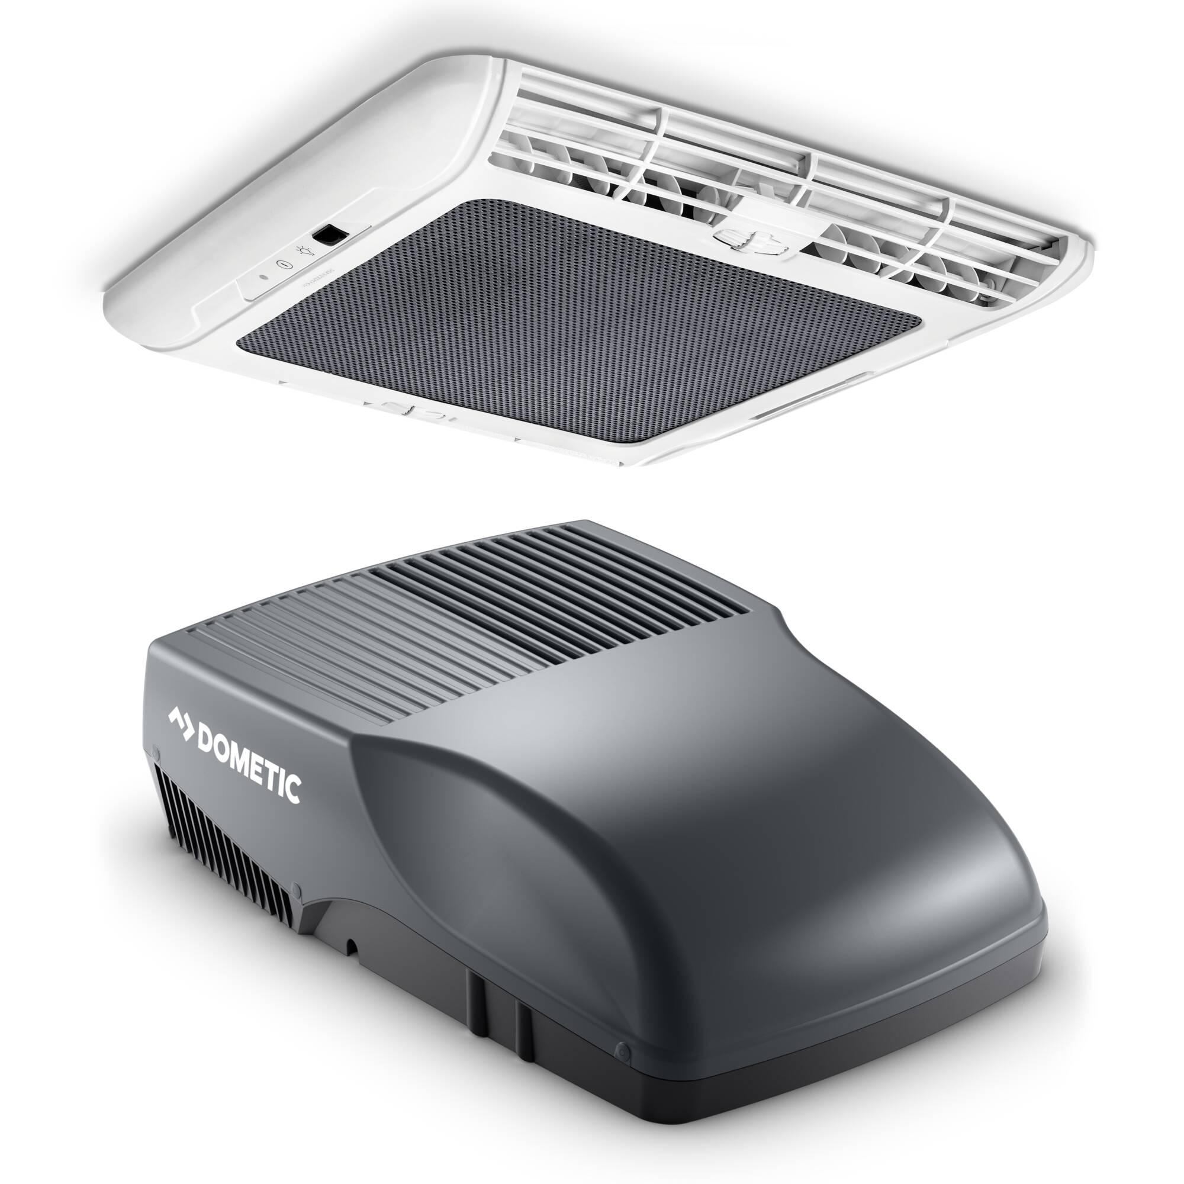
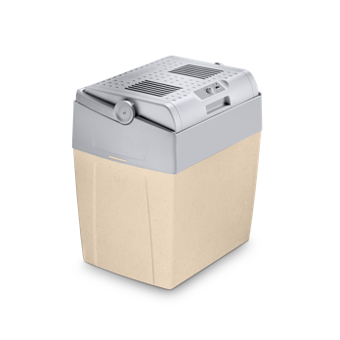
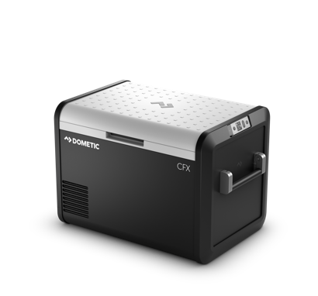
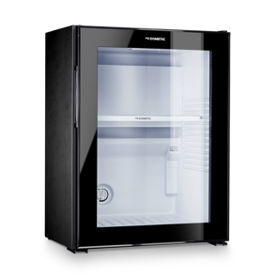



Dometic – PRODUCT LEADERSHIP and strong brand

Slide 8
Stefan Jung

Slide 9

Stefan Jung (Born Stefan Eike)
Job: Global Head of Technical Documentation at Dometic
Spare time: Stefan Jung Consultancy (stefan-jung.org) – Dometic needs to approve projects
Location: Germany/Greven (NRW)
Family: Married, 2 kids
Education:
  Technical Writer B.A. at HS Hanover (FH Hanover)
  Media Computer Scientist M.Sc. at FH Lübeck (oncampus)
DITA Experience
  Owner of Doctales (Open Source DITA plugins)
Technologies
  XML, DITA
  DTD, Relax NG
  HTML, CSS, LESS
  XSLT, Xpath, Schematron
  Visual Basic

Slide 10
The challange

Slide 11
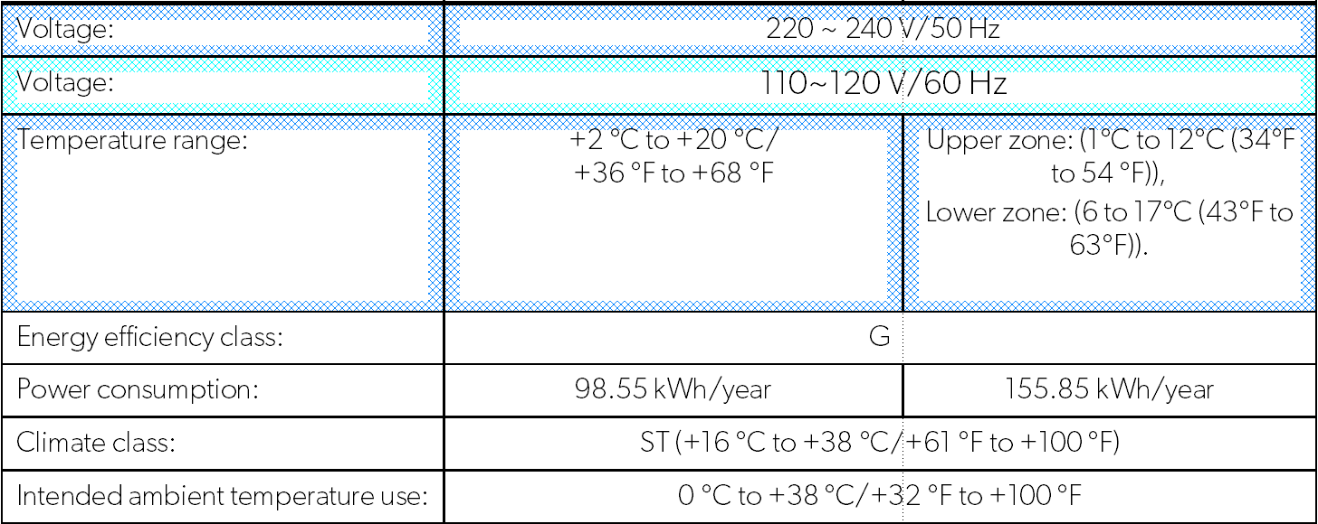
The challange
To use technical data in a manual, the technical writer usually needs to copy and paste it to a DTP tool or XML editor.
With a calculator he needs to convert SI to imperial units.
With FrameMaker conditions he is showing/hiding rows, columns and phrases.
Translators swap decimal commas and points.
→ This is time consuming and error prone. ☹

Slide 12

Let’s automate it

Slide 13
New elements

Slide 14
New elements
DITA has tons of elements, but no semantical element to represent technical values. This means, usually technical values are written as plain text. This also means, they are usually running through the translation process.
To represent a technical value and automatically render it, we need new semantical elements.
To represent a single technical value: <tv>
To represent ranges of technical values: <tv-range>

Slide 15
Challanges

Slide 16
challanges
Convert between SI and imperial units.
Technical unit based handling of decimal places.
Global and in-context definition of appearance by attribute value. system=“si+imperial”
Dynamic localization of technical units. 10 mm → 10 мм
Dynamic conversion of decimal seperators. 10,0 m → 10.0 m
WYSIWYG live conversion with CSS+Xpath in Oxygen Author mode.

Slide 17
It’s not ucum

Slide 18
UCUM
The Unified Code for Units of Measure (ucum.org) tries to represent and convert all global technical units, including customary units (imperial). https://github.com/ucum-org/ucum (Thanks Jang Graat ☺)
The problem is, ucum is very complex and there is almost zero info about how to implement it.

Slide 19
examples

Slide 20
<tv>
<tv unit="cm">1</tv>
1 cm
<tv unit="cm" system="si">1</tv>
1 cm
<tv unit="cm" system="imperial">1</tv>
→ 0.39 in
<tv unit="cm" system="si+imperial">1</tv>
→ 1 cm (0.39 in)
<tv unit="cm" system="si+imperial" show-unit="no">1</tv>
→ 1 (0.39)
<tv unit="cm" system="si+imperial" show-unit="no" sign="≤">1</tv>
→ ≤ 1 cm (0.39 in)
System can also be globally set with a parameter.
Attribute value overrides global setting.

Slide 21
<tv-range>
<tv-range separator="…">
<tv unit="cm" system="si" show-unit="no">1</tv>
<tv unit="cm" system="si">2</tv>
</tv-range>
1 ... 2 cm
<tv-range separator="×">
<tv unit="cm" system="si" show-unit="no">10</tv>
<tv unit="cm" system="si" show-unit="no">20</tv>
<tv unit="cm" system="si">30</tv>
</tv-range>
10 × 20 × 30 cm

Slide 22
Decimal separator

Slide 23
Decimal Separator
Decimal separator is automatically detected by validating the closest @xml:lang.

Slide 24
Decimal places

Slide 25
Decimal places
Decimal places can be defined via format-number patterns. They are read from DITA-OT variable files.
<variable id="T">#,###0.00</variable> <!-- Tesla -->
<variable id="V">#,###0.00</variable> <!-- Volt -->
<variable id="W">#,###0.00</variable> <!-- Watt -->

Slide 26
Localization of technical units

Slide 27
Technical units
mul.xml
<vars xmlns="http://www.idiominc.com/opentopic/vars">
<variable id="technical unit W">W</variable> <!-- Watt -->
</vars>
ar.xml
<vars xmlns="http://www.idiominc.com/opentopic/vars">
<variable id="technical unit W"> وات </variable> <!-- Watt -->
</vars>
ru.xml
<vars xmlns="http://www.idiominc.com/opentopic/vars">
<variable id="technical unit W">Вт</variable> <!-- Watt -->
</vars>

Slide 28
WYSIWYG in Oxygen Author view

Slide 29
WYSIWYG
*[class~="dometicTechnicalData-d/tv"]:not([conref]):not([conkeyref])[system='si+imperial'][unit='cm'] {
content: oxy_xpath('concat(text(), " cm (", format-number(. div 2.54, "#,##0.00"), " in)")');
}

Slide 30
pim

Slide 31
Product Information Management (PIM)
(Most) technical data is stored in a PIM system, as usual in larger companies.
Technical data is distributed to websites, e-shops (e.g. dometic.com) or dealers (e.g. amazon.com).
Examples for technical data:
  Product dimension
  Power consumption
  Weight
  ...
  Let’s automate it!

Slide 32

PIM Integration
Get technical data from a PIM system and inject into DITA project.
REST API with curl returns JSON, JSON to DITA Warehouse with XSLT,
everything orchestrated with Apache Ant, called from Oxygen XML.
Get data
Convert data
Update topic in repository
PIM REST API returns structured product data as JSON.
Convert JSON → XML → DITA Warehouse via XSLT.
Check if warehouse topic exists in the Git repository.
If yes, update it. If not, place it on the desktop.

Slide 33
Q&A → Coffee brake/Linked IN

