Slide 1
DITA HTML Styling via Bootstrap 5
Jason Fox, FIWARE Foundation

Slide 2
Coding Katas
From: https://blog.codinghorror.com/the-ultimate-code-kata/
Contrary to what you might believe, merely doing your job every day doesn't
qualify as real practice. Going to meetings isn't practicing your people skills, and
replying to mail isn't practicing your typing. You have to set aside some time once
in a while and do focused practice in order to get better at something.
What matters is not experience per se but "effortful study," which entails
continually tackling challenges that lie just beyond one's competence.
See: https://www.scientificamerican.com/article/the-expert-mind/

Slide 3
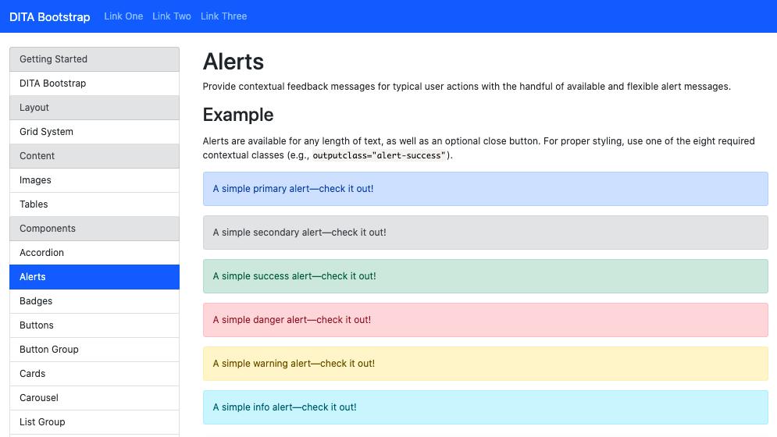
1st Kata: Inject Baseline JavaScript and CSS
See: https://github.com/infotexture/dita-bootstrap

Slide 4
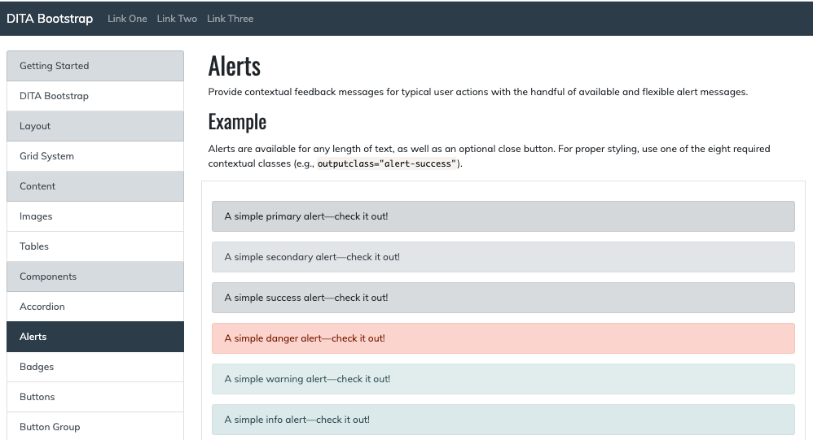
2nd Kata: Override with Custom CSS
See Also: https://github.com/jason-fox/fox.jason.extend.css

Slide 5
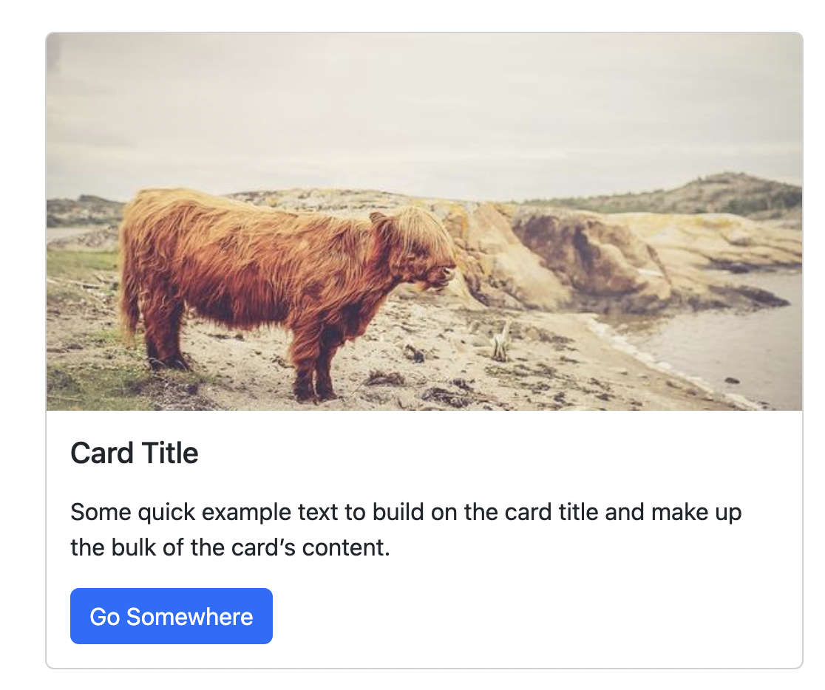
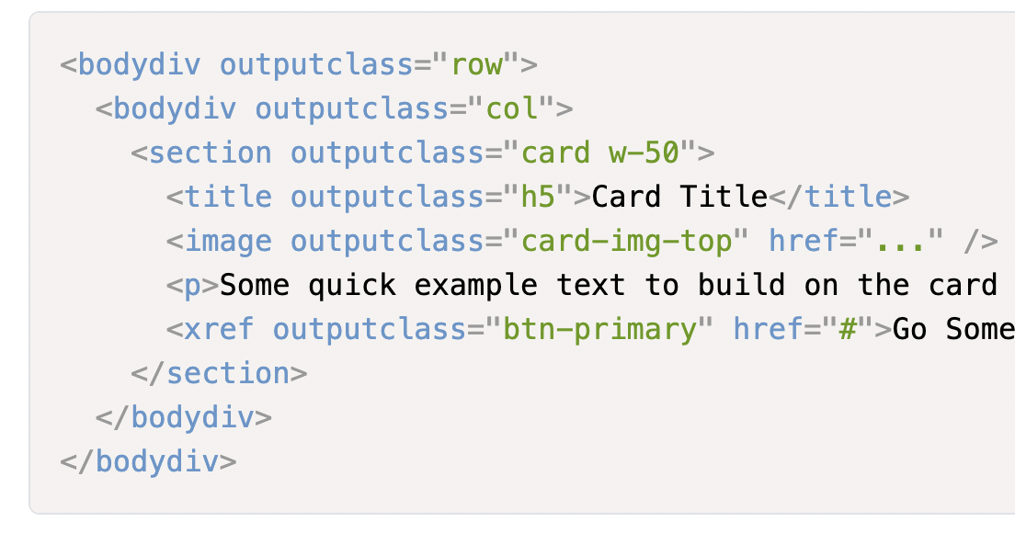
3rd Kata: Simple outputclass Based Components
Button
Badge
Alert
Card
List Group

Slide 6
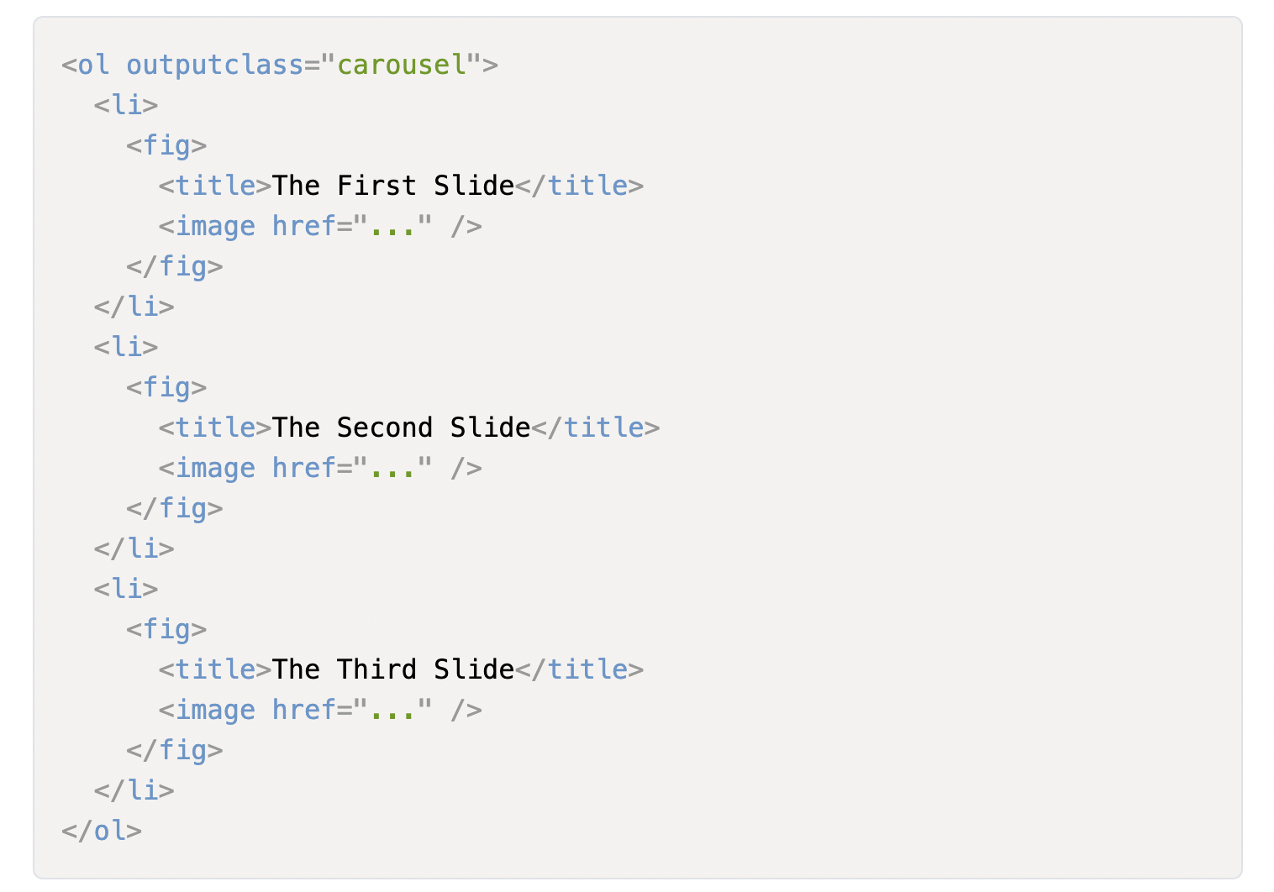
4th Kata: outputclass with added HTML structure
Carousel

Slide 7
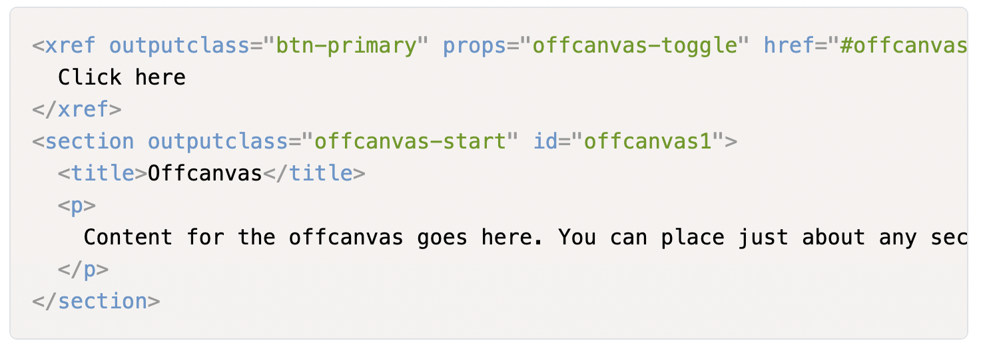
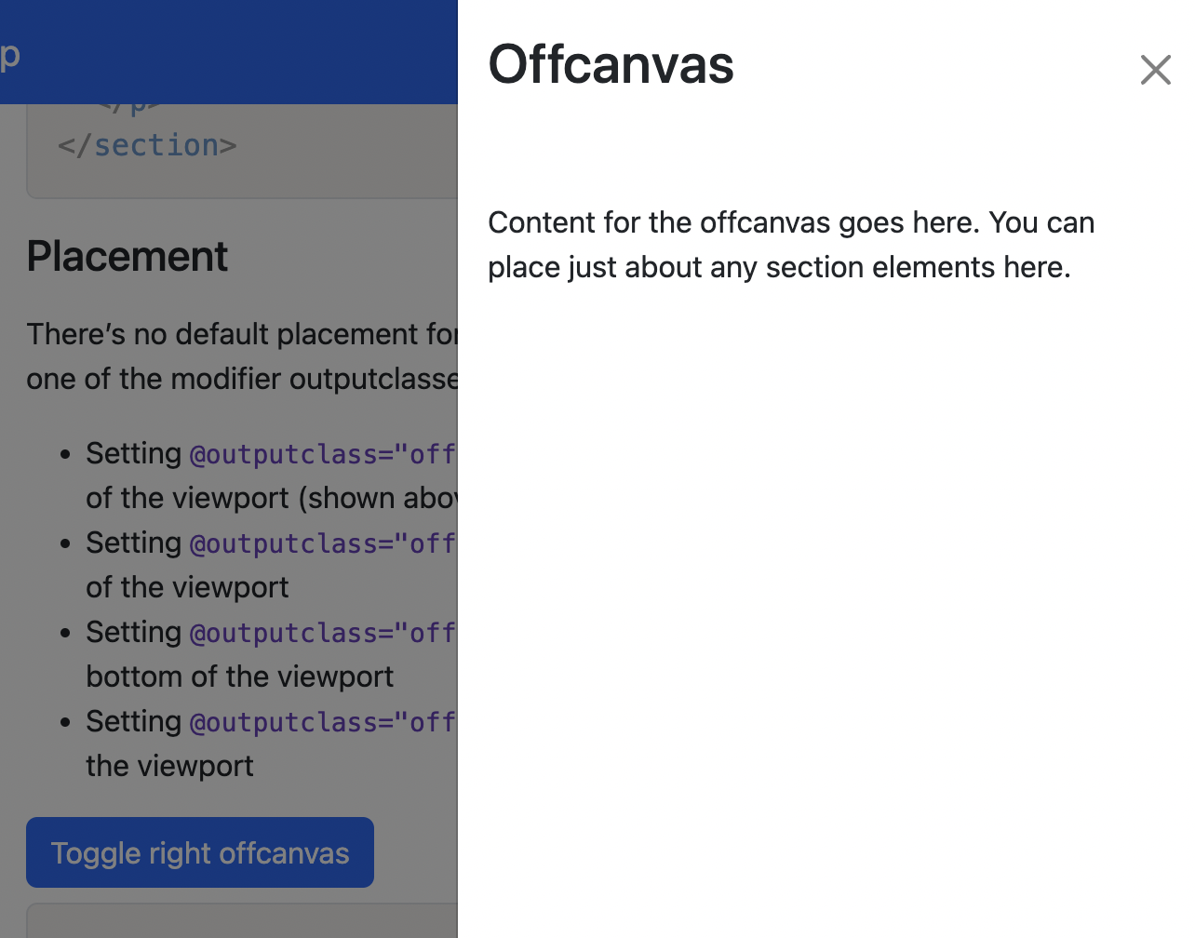
5th Kata: Bipartite controls connected by props
OffCanvas
Collapse

Slide 8
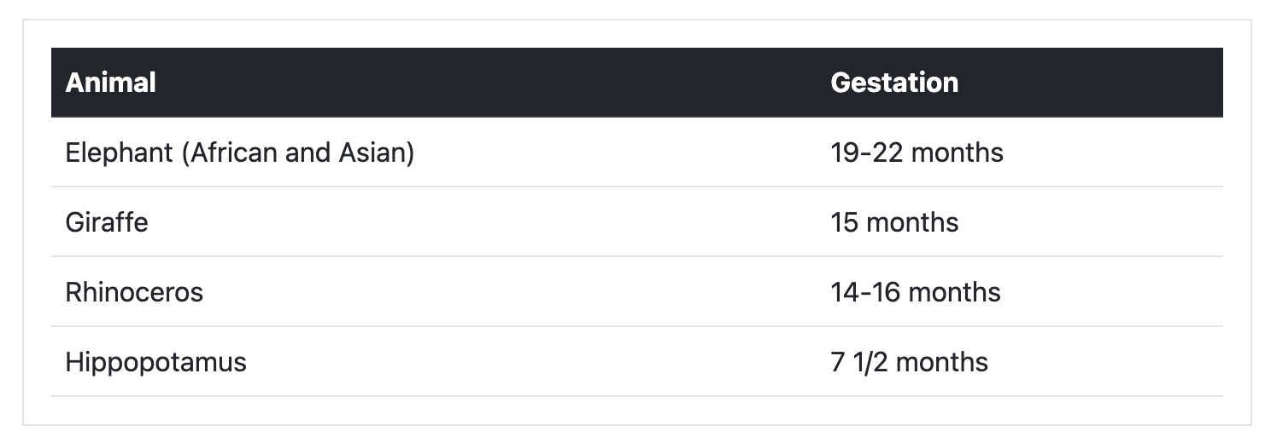
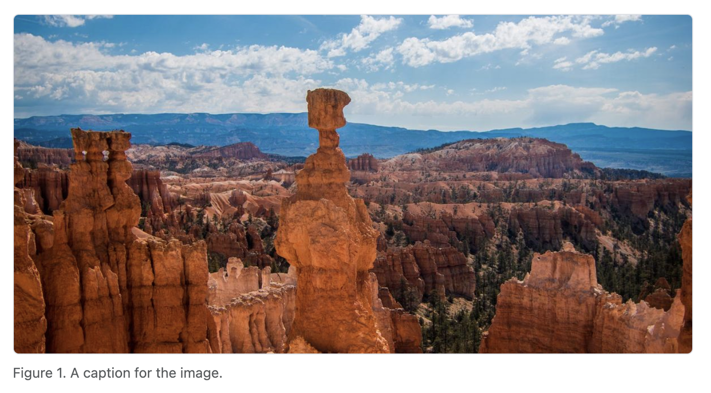
6th Kata: Leveraging existing DITA elements and attributes
<table>
<figure>
<image>
<note>
frame
scalefit
rowsep
colsep

Slide 9
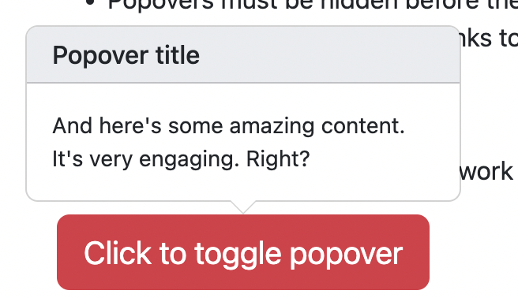
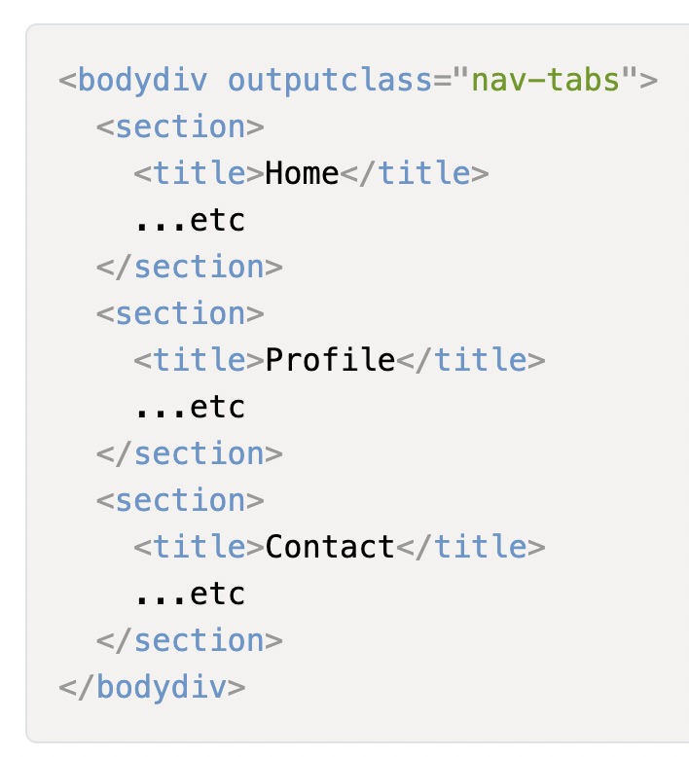
7th Kata: Complex Multipart Components
Tabbed Dialog
Tooltips
Popovers

Slide 10
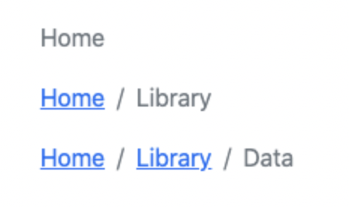
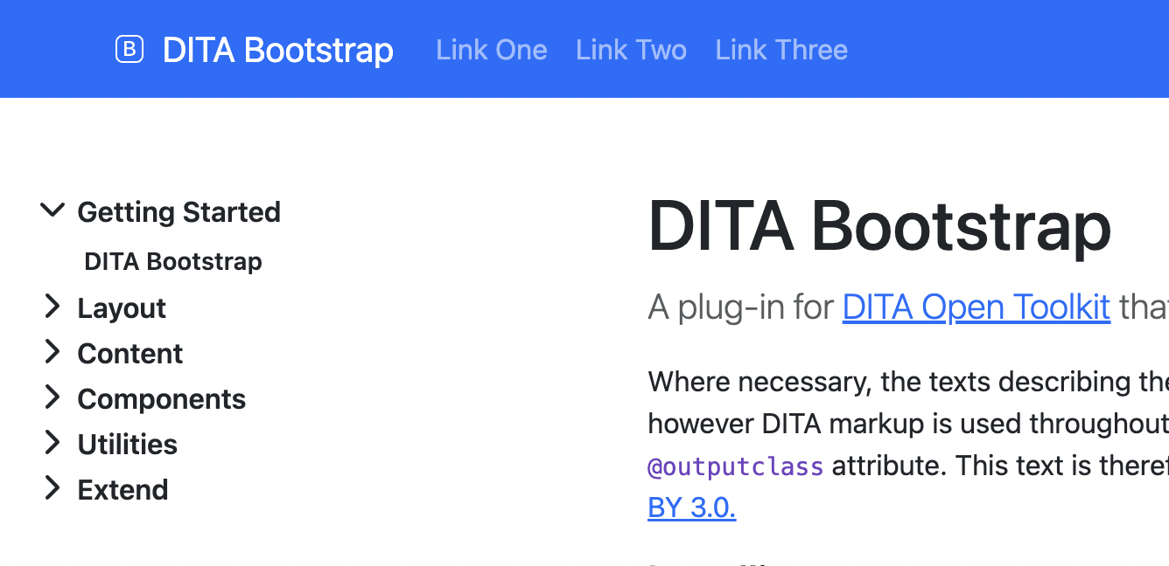
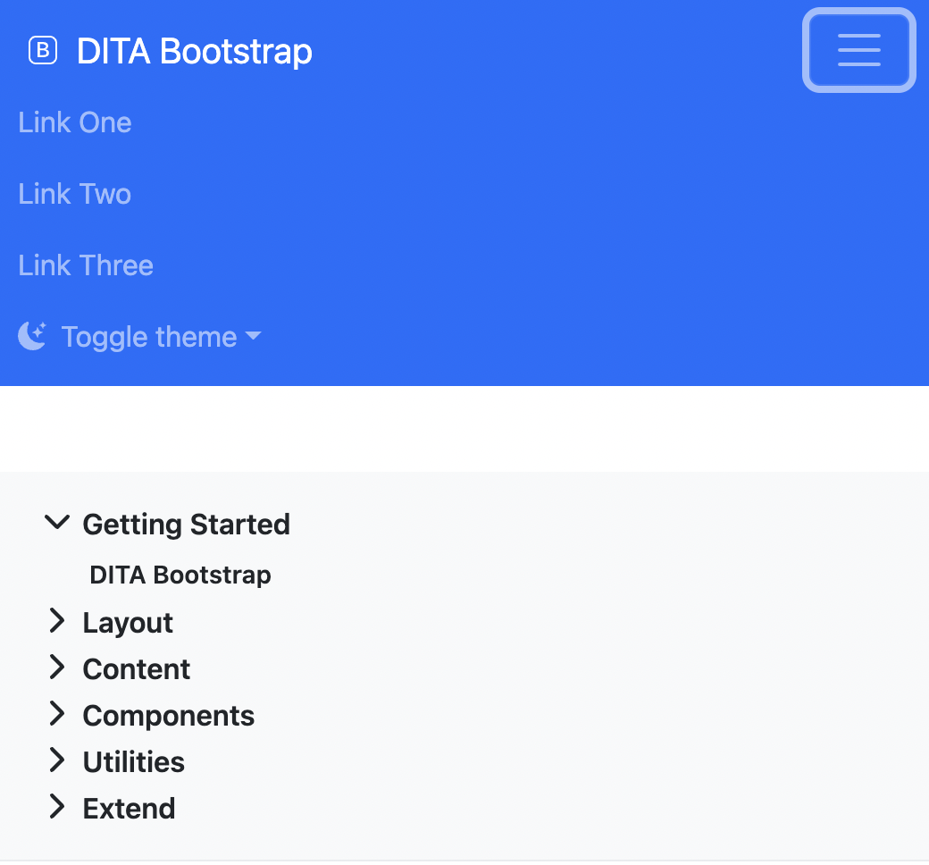
8th Kata: Navigation Controls
Navigation Options
Breadcrumb
Accessibility
Responsive Design

Slide 11
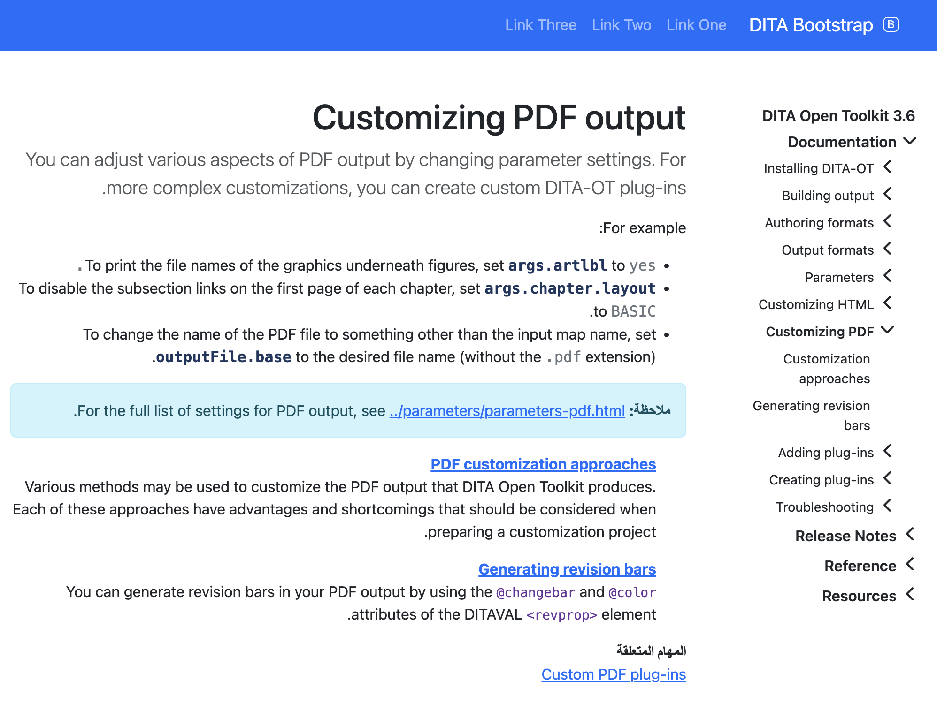
الكاتا التاسعة: دعم من اليمين إلى اليسار مثل العربية والعبرية وما إلى ذلك
Separate CSS for RTL
bidirectionality issues
<codeblock> and <codeph>
Use of defaultLanguage

Slide 12
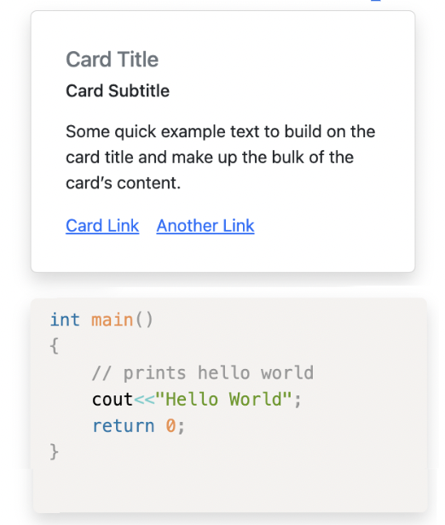
10th Kata: Overriding defaults
dita --input=path/to/your.ditamap \
--format=html5-bootstrap \
--args.hdr=path/to/your-header.xml \
--args.css=<name-of-css>.css \
--args.copycss=yes \
--args.csspath=css \
--args.cssroot=path/to/your/theme \
--bootstrap.css.card="shadow p-3 rounded" \
--bootstrap.css.codeblock="shadow p-3 rounded"
Over twenty parameters available
(so far)

