Slide 1
A fast path for building data assets from DITA
François violette – November 4, 2018 – DITA-OT-DAY

Slide 2
Company overview
Data Integration, Data Quality, Big Data, Cloud, APIs
Free Products
  Data Streams Free Edition
  Talend Open Studio
  Talend Cloud (Free Trial)
Last 2 years:
  600 to 1000 employees
  10 to 20 Tech Writers

Slide 3
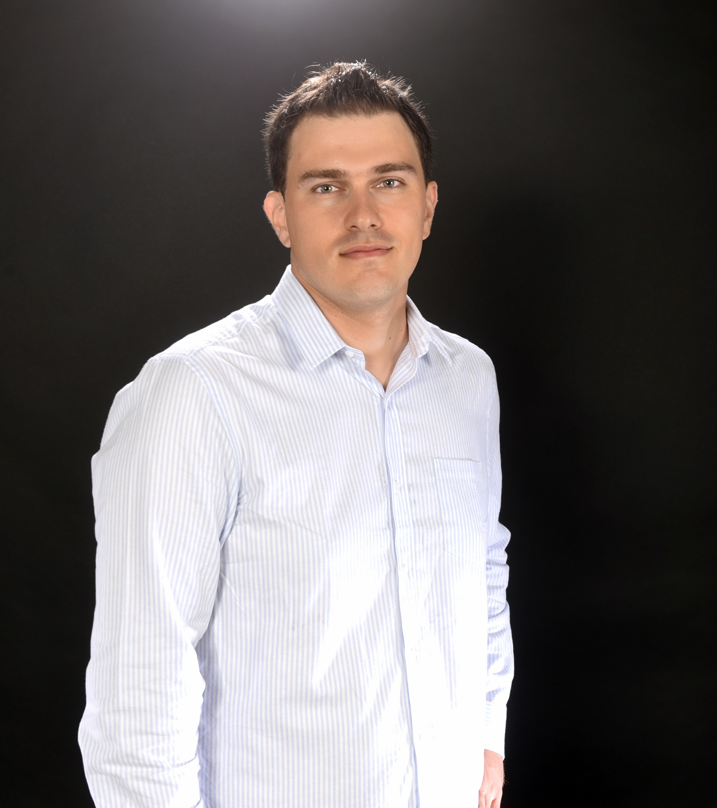




Information Architect, formerly Tech Doc Manager in Tax and Private Equity
Supporting a distributed team of tech writers in Paris, Nantes, and Beijing
Content Engineering, DITA, Semantics
francoisviolette
@fr_violette
fr_violette
francoisviolette

Slide 4
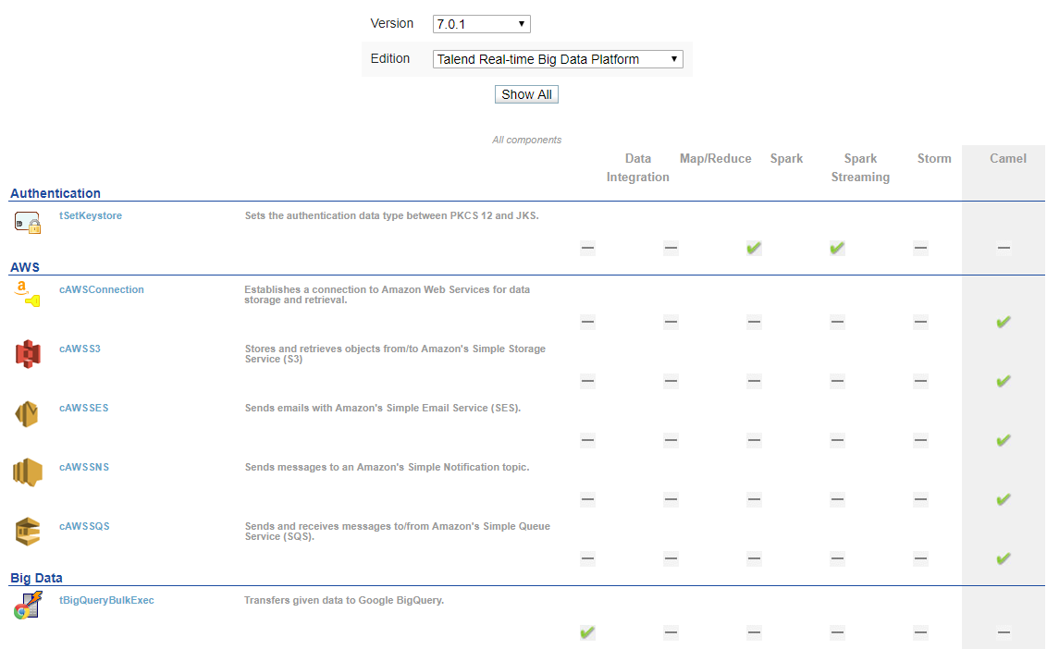
Context & REquirements
  Feed a MySQL database with records
  about connector features
Feature matrix for:
Pre Sales
Project Managers
Support
Prospects

Slide 5
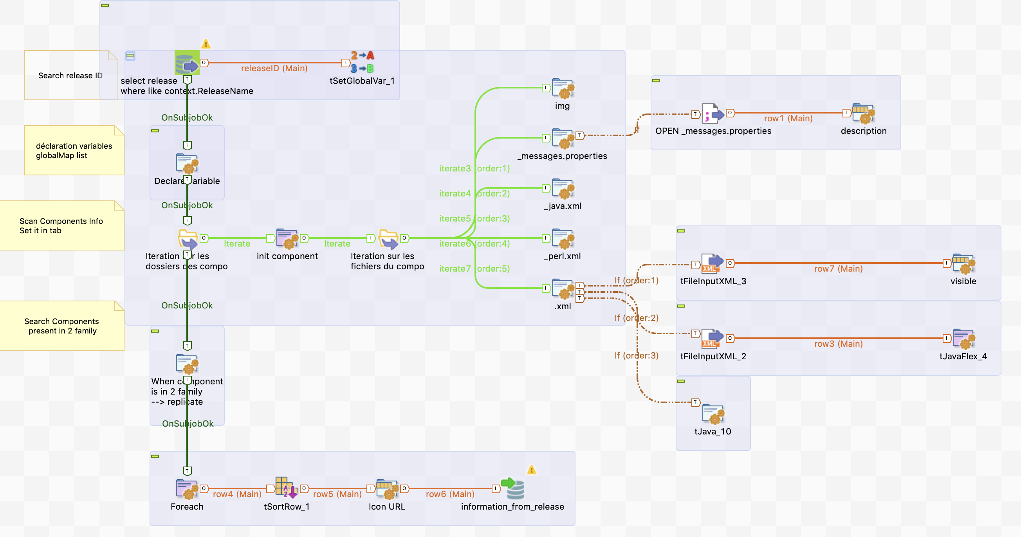
How it used to be

Slide 6


DITA to data
  Number of connectors
  1149
  Number of possible records for each connector
  39 = Connector (1) * Families (1 to 3) * Editions (1 to 13)
  A record checks up to 5 features
  facts
  1 DITA Map per connector
  Each DITA MAP = 1 concept container topic + 1 reference topic per feature
  Families are found in each reference topic (keyword/@keyref)
  Editions are found in map metadata (prodname/data/@conref)

Slide 7
Normalizing dita
DITAMAP
Normalized
DITAMAP
<title>tFileInputDelimited</title>
<topicmeta>
<prodname>
<data conref="meta/edition1"/>
<data conref="meta/edition2"/>
</prodname>
</topicmeta>
<title>tfileInputDelimited</title>
<topicmeta>
<prodname>
<data>Talend Big Data</data>
<data>Talend Data Fabric</data>
</prodname>
</topicmeta>
Concept
<shortdesc>…</shortdesc>
<shortdesc>…</shortdesc>
Concept
<keyword keyref="family1">File</keyword>
<keyword keyref="family2">XML</ keyword>
Reference
Reference
<keyword keyref= "family1"/>
<keyword keyref= "family2"/>
Reference
Reference
<keyword keyref= "family3"/>
<keyword keyref="family3">MR</keyword>
Reference
Reference
<keyword keyref= "family2"/>
<keyword keyref= "family2">XML</keyword>

Slide 8
Mapping data
  CONNECTOR
  //title
  //topicref[@type = 'concept']/topicmeta/shortdesc
  EDITIONS
  //prodname/data
  FEATURES
  doc-available($reference_props || '_prop-standard.dita') * features
  FAMILIES
  distinct-values(document(//topicref/@href)//keyword[@keyref]/text())

Slide 9






Generating sql
  <xsl:for-each select=" collection('target/' || $version || '/connectors/en
  ?select=dm-*_properties.ditamap;recurse=yes')">
  <xsl:for-each-group select="$features" group-by="$families">
  <xsl:for-each select="current-grouping-key()">
  <xsl:for-each select="$editions">
  <xsl:value-of select="number(current-group() = $feature_X)/>
  <xsl:value-of select="number(current-group() = $feature_Y)/>
  <xsl:value-of select="number(current-group() = $feature_Z)/>
  …
  </xsl:for-each>
  </xsl:for-each>
  </xsl:for-each-group>
  </xsl:for-each>
1149 connectors
13787 distinct records

Slide 10
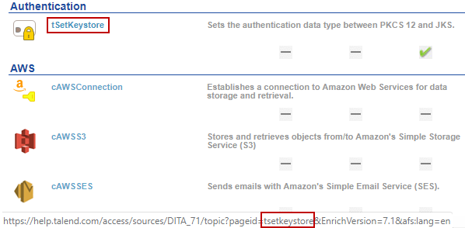
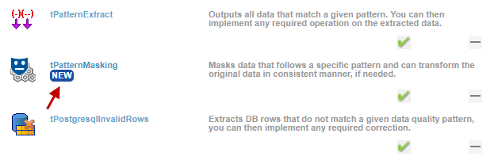
Quick wins
  "This page should be in the
  docs in the first place!"
  => Provide link to Help Portal (XSL)
  "Which connectors are released
  for the first time?"
  => Add a "NEW" flag (SQL)

Slide 11



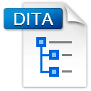
LOCAL Setup
./gradlew --rerun-tasks
Download task
Groovy (JDBC)
Normalized
DITA
DITA-OT
dita-ot
-gradle
saxon-gradle
Input maps
SQL
statements

Slide 12


operations setup
IT
Web Dev
Test SQL script
Revamp frontend design (please!)
gradle/<version>
gradle/<version>
mysql:<version>
mysql:<version>
php:<version>
php:<version>
docker-compose up -d
Single Page Application

Slide 13
Wrapping up
  The first rule of DITA-OT (and DITA) is:
  you do not talk about it?
  DITA-OT APIs are key — Gradle support (Maven?), Docker images, plugin registry
  Be creative to promote DITA… using the OT!

Slide 14
Thank you
  https://www.talendforge.org/components/index.php
Check out Talend Help Center at https://help.talend.com
@fr_violette
francoisviolette

